Slide 1
Scottish CIPFA Conference – Annual Reporting Solution
www.TechnologyOneCorp.com

Slide 2
Background
Scottish CIPFA Conference – 12 months ago
Final Accounts Close process
Austerity and legislative pressures
“DP BRB”
Solution/Partnership Approach
TechnologyOne CommunityWorks contribution
Combined investment

Slide 3
Agenda
What is the Annual Reporting Solution ?
Solution Approach
Demonstration

Slide 4
Why the need for an Annual Reporting Solution ?
Increasing demand for finance to show ‘added value’
Business partnering / supporting decision making
Final Account Closedown Process –
Resource intensive process
Disruption to normal service provision
High level of manual effort / input
Time pressure for staff
Timeframe for completion – getting shorter
Automation would be a key transformation agent

Slide 5
Benefits
Saving of staff time
Earlier close not an aim in itself
Reduce Key Personnel dependency
Enable task assignment
Project management and workflow
Automation of publication process
Audit Trail on report production
Reduce time required for / by external audit

Slide 6
Solution Approach - Design Philosophy
CIPFA Solution based on TechnologyOne Toolkit and CIPFA Intellectual Property
Empowering business users to complete annual report
Ease of use for end user and power user
Flexible, Easy to change within standardised framework
Iterative approach with approval hierarchy
Maximise CIPFA Intellectual Property and Standards
Rapid implementation getting Council up and running quickly

Slide 7
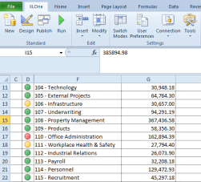
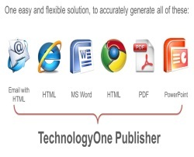
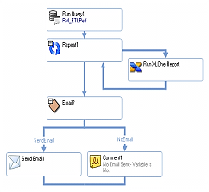
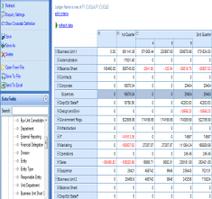
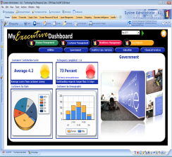
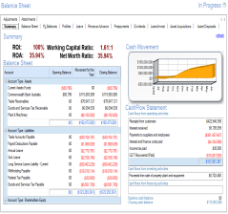
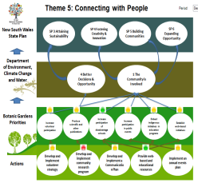
Solution Approach - CPM
Reporting
Automation
Business Intelligence
Strategy and Planning
XLOne Enterprise
Business ETL
BI Analysis
BI
Dashboards
Enterprise Budgeting
Performance Planning
Publisher
Corporate Performance Management
Notes:
The agile approach is further supported by the range of plugins available to enhance EIP. For example, an organisation may start by putting in place the simple metrics and KPIs important to one part of the business. From there, the business can add the TechnologyOne Budgeting and Forecasting plugin to close the loop between review, analysis and action. Then layer the TechnologyOne Performance Planning plugin to add long term sustainability planning. The list goes on, as with each step the business extends its reach towards genuine Corporate Performance Management .

Slide 8
What is needed is an automated solution that:
Extracts data from a variety of disparate sources
Collates information
Prompts for action
Allows commenting
Provides real time reporting
Can be updated at any time
Is intuitive and easy to use

Slide 9
Key Capabilities to be Delivered
Automatic upload of Council financial data into the Reporting Solution
Ability to map council chart of accounts structure to the CIPFA approved structure within the Reporting Solution
Provision of dashboards, milestones and reporting on the status of the Annual Report Production
Creation, management and full auditability of working papers and disclosure notes as well as the key reports that form the basis of the Annual Report
Flexible approval hierarchy on sections of the report and the full report itself
Electronic access to the CIPFA “Bible” and “Checklist” to help ensure CIPFA compliant report ?
Creation of draft and final reports which conform to the Council’s chosen layout and branding
Allow approved 3rd parties such as external auditors to access the solution and view the working papers

Slide 10
Solution Design
Council
Mapping
Report Production
Timetable
Annual Report
Does this match to TB
Reporting on Report Production
Summary Data
Statement of Responsibilities
Explanatory Foreword by the Chief Financial Officer
Report Sections
Report Type
Note Number
Requires Text?
Requires Out years?
How Many Years?
System Calc?
Note

Slide 11
Future ?
Council
Mapping
Report Production
Timetable
Annual Report
Does this match to TB
Reporting on Report Production
Summary Data
Statement of Responsibilities
Explanatory Foreword by the Chief Financial Officer
Whole of Govt. / LFR Reporting
Report Sections
Report Type
Note Number
Requires Text?
Requires Out years?
How Many Years?
System Calc?
Note

Slide 12
CPM Manages Production of the Annual Report
Council export data in format easiest for them
Council / CIPFA map data extract to Reporting Solution standard input format
ETL updates warehouse tables or core ledgers within T1
ETL can be configured to control production process, e.g. sending emails to prompt users to complete tasks by dates
Additional reporting and queries available within T1 including reporting packs and approvals
Performance Planning used to add commentary and approvals and create final report

Slide 13
Key Components of the solution

Slide 14
Demonstration

