Slide 1
Scotland’s new devolved tax powers
Alison Cumming
Head of Tax Policy, Scottish Government
CIPFA Scotland Conference, 26 March 2015

Slide 2
Scottish approach to taxation
Taxes should be… | What Adam Smith said…
Certain | The tax which each individual is bound to pay ought to be certain, and not arbitrary. The time of payment, the manner of payment, the quantity to be paid, ought all to be clear and plain to the contributor, and to every other person... The Wealth Of Nations, Book V Chapter II Pt II, p. 825, para. 4.
Convenient | Every tax ought to be levied at the time, or in the manner, in which it is most likely to be convenient for the contributor to pay... The Wealth Of Nations, Book V Chapter II Pt II, p. 826, para. 5.
Efficient | Every tax ought to be so contrived as both to take out and to keep out of the pockets of the people as little as possible, over and above what it brings into the public treasury of the state… The Wealth Of Nations, Book V Chapter II Pt II, p. 826, para. 6.
Proportionate to the taxpayer’s ability to pay | The subjects of every state ought to contribute towards the support of the government, as nearly as possible, in proportion to their respective abilities... The Wealth Of Nations, Book V Chapter II Pt II, v. ii, p. 825, para. 3.

Slide 3
Scotland Act 2012 – Overview
Measure | Start | Revenue estimate (2015-16)
Replace Stamp Duty Land Tax with Land and Buildings Transaction Tax (LBTT) | 2015-16 | c. £380m
Replace UK Landfill Tax with Scottish Landfill Tax (SLfT) | 2015-16 | c. £117m
Scottish Rate of Income Tax | 2016-17 | c. £4.5 bn if rate set at 10p/£
Power to devolve more taxes | …
Capital borrowing | 2015-16 | Annual - 10% of capital budget(£304m), Aggregate limit - £2.2bn
Revenue borrowing | 2015-16 | Annual - £200m Aggregate - £500m
Block grant adjustment | 2015-16; 2016-17 | One-year agreement for devolved taxes Principles agreed for SRIT

Slide 4
Land and Buildings Transaction Tax

Slide 5
Revenue Scotland
Jan 2015
Non-Ministerial Department
Feb 2015
Guidance published
Feb 2015
Sign-up for online portal and SLfT registration
April 2015
Devolved taxes ‘go-live’
December 2014 Board appointed

Slide 6
Scottish rate of income tax
The Scottish Additional Rate
The Scottish Higher Rate
The Scottish Rate
The Scottish Basic Rate

Slide 7
Scottish rate of income tax
All rates (basic, higher, additional) reduced by 10p for Scottish taxpayers
Scottish Parliament sets rate each year by resolution
If set at 10p, Scottish taxpayers will pay the same tax as others in the UK Scottish rate income tax revenue goes to Scottish Government – block grant funding from UK reduced by tax take from 10p reduction
Tax on dividend and savings income not included
April 2016 start date
UK Government responsible for wider income tax structure
HMRC still administers and collects
Scottish Government pays for HMRC costs of implementing and running the Scottish rate
Gift aid applied at UK rate
Pensions relief paid at Scottish basic rate

Slide 8
Devolved taxation – post-Smith
 | Scotland Act 2012 | Smith
Devolved taxes | Land and Buildings Transaction Tax Scottish Landfill Tax | Scottish Air Passenger Duty Scottish Aggregates Levy
Partial devolution / Shared taxes | Scottish rate of income tax | Income tax rates and thresholds (NSND)
Assigned revenues |  | VAT 10 pence of standard rate of VAT 2.5 pence of reduced rate of VAT (But no powers to set the rate)

Slide 9
Devolved taxes – Forward look
UK Government Command Paper Scotland in the United Kingdom: An enduring settlement, including draft legislative clauses, published on 22 January 2015 and subject to consultation
UK Government to set timetable for further devolution – matter for incoming administration after the General Election

Slide 10
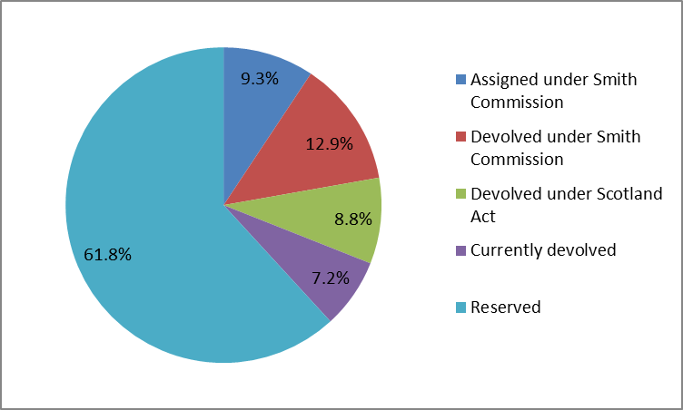
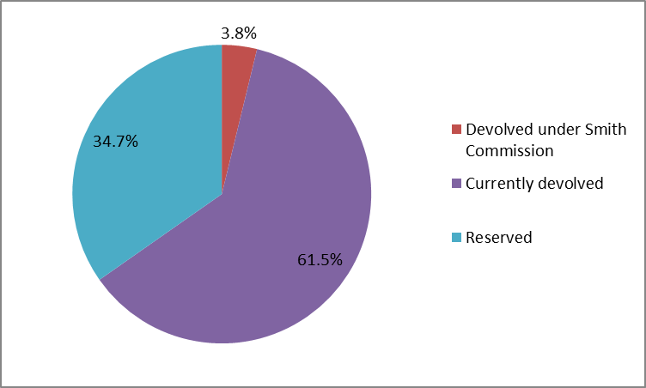
Devolved and reserved revenue and expenditure
Revenue
Expenditure
Source: Government Expenditure and Revenue Scotland (GERS) 2013-14 (March 2015)

Slide 11
Thank you
Any questions?

