Slide 1
Question Time hosted by Keith Aitken of Scotland and the Cabinet Secretary for Finance, Constitution and Economy First Minister of Scotland and the Cabinet Secretary for Finance, Constitution and Economy
Gil Paterson, SNP MSP
Gavin Brown, Conservative MSP
Gemma Doyle, Labour MP
Aileen Morton, Liberal Democrat Councillor
Adele Kane & Daniel Watson, Clydebank High School
Chris Dunn & Clare Threwal, Our Lady & St Patrick’s High School
Robbie Stirling & Hannah Mackenzie, Dumbarton Academy
Neve Stuart & Emma Anton, Vale of Leven Academy
Rachel Linden & Michael Gaughan, St Peter the Apostle High School

Slide 3
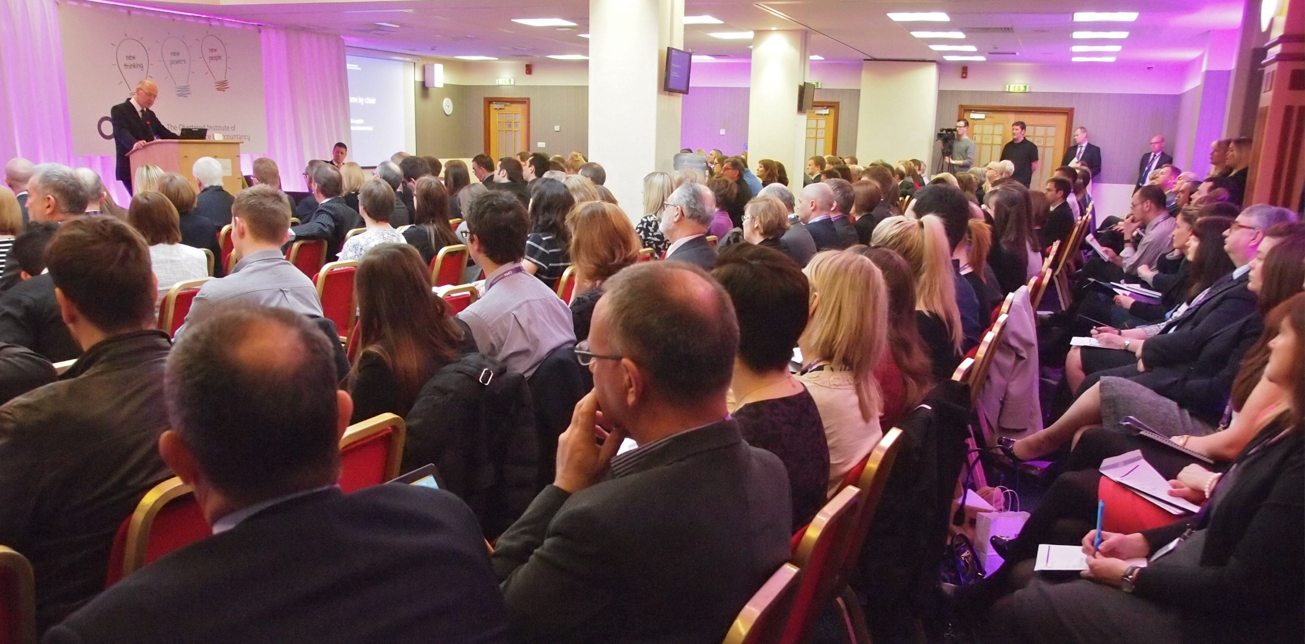

Slide 4
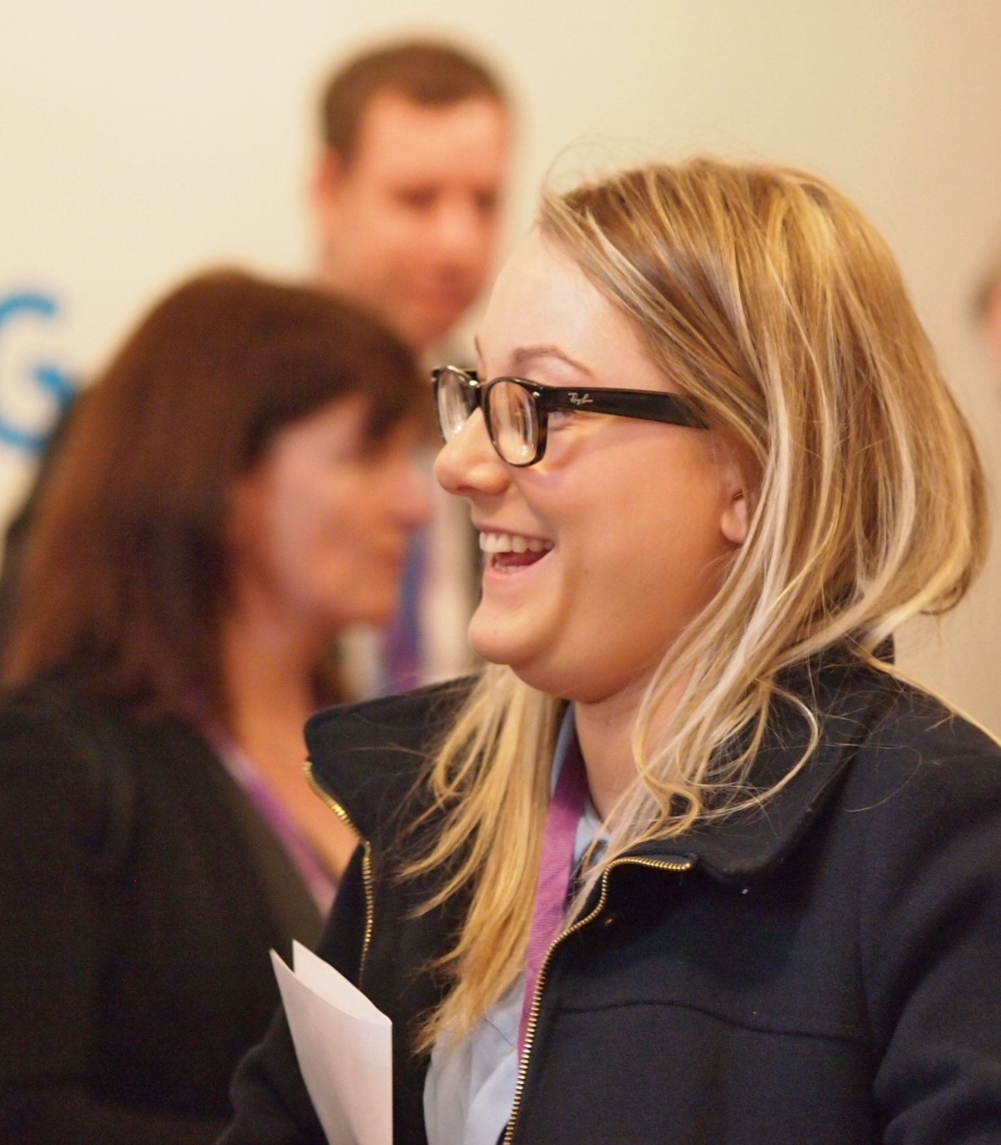

Slide 5
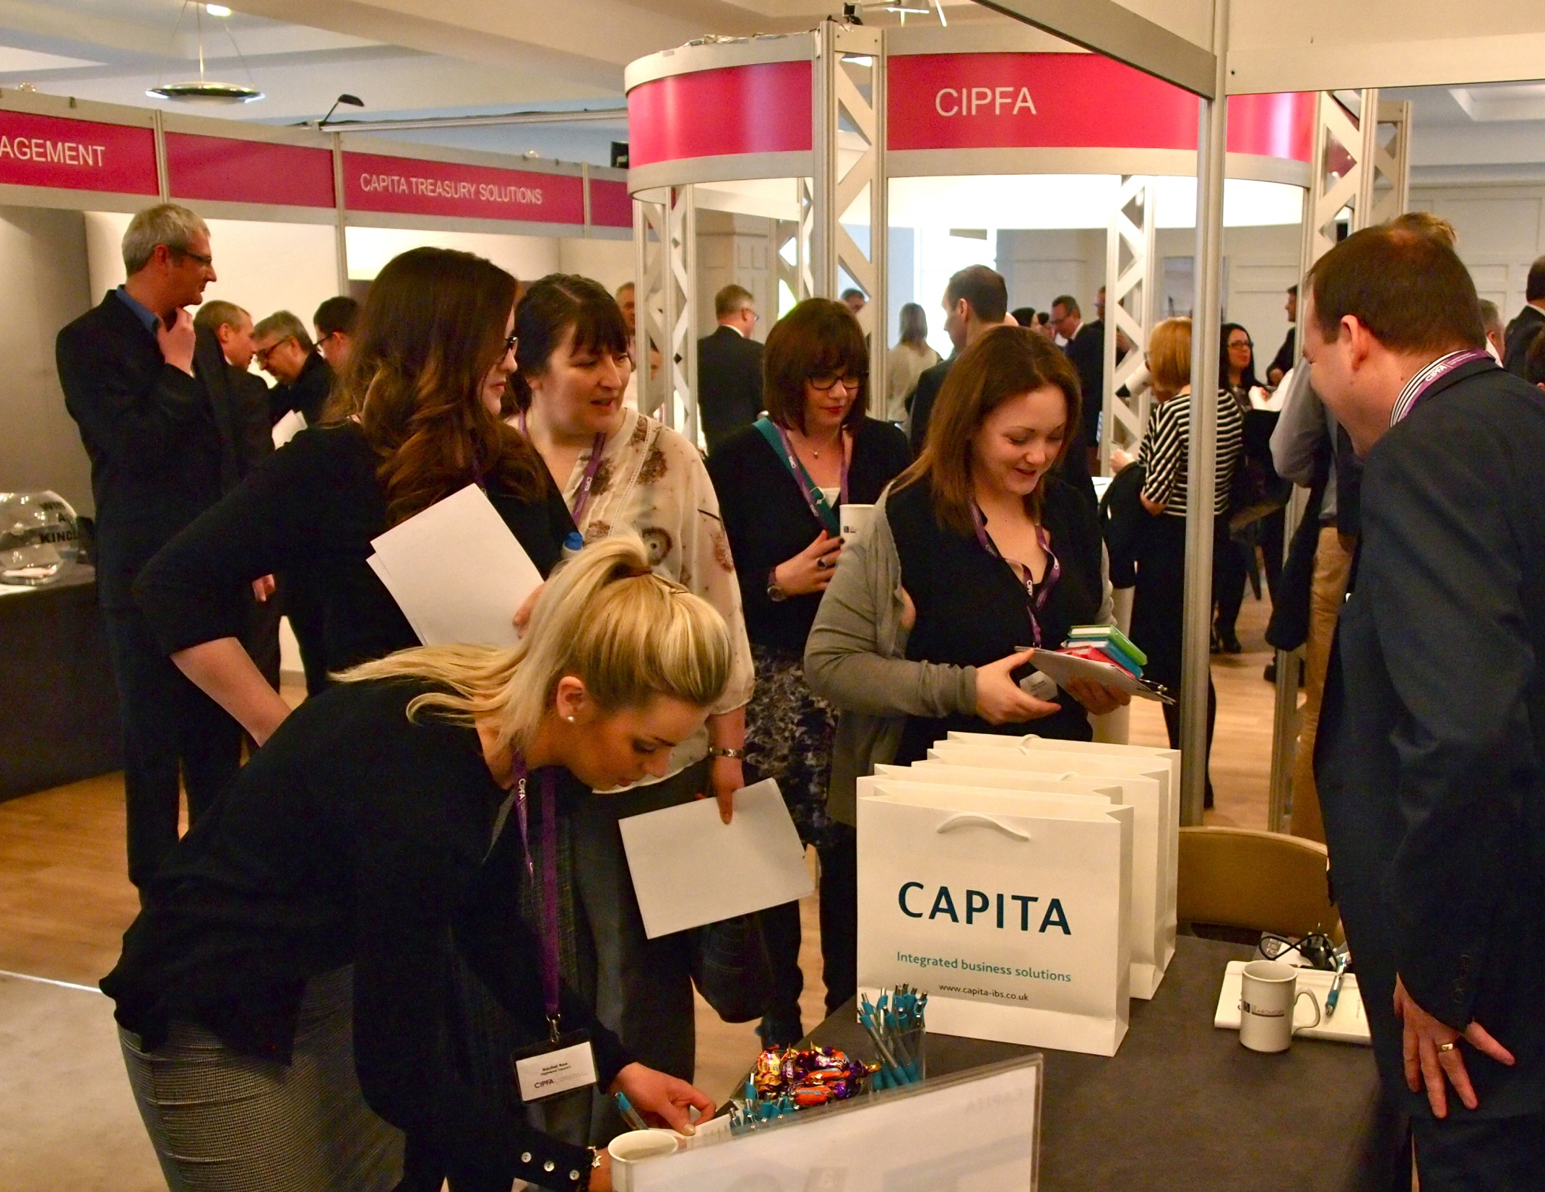

Slide 6
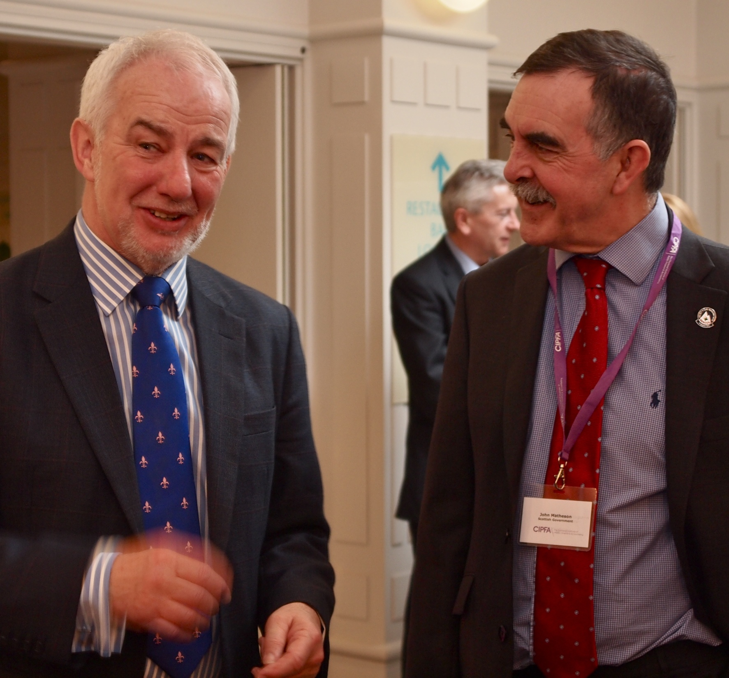

Slide 7
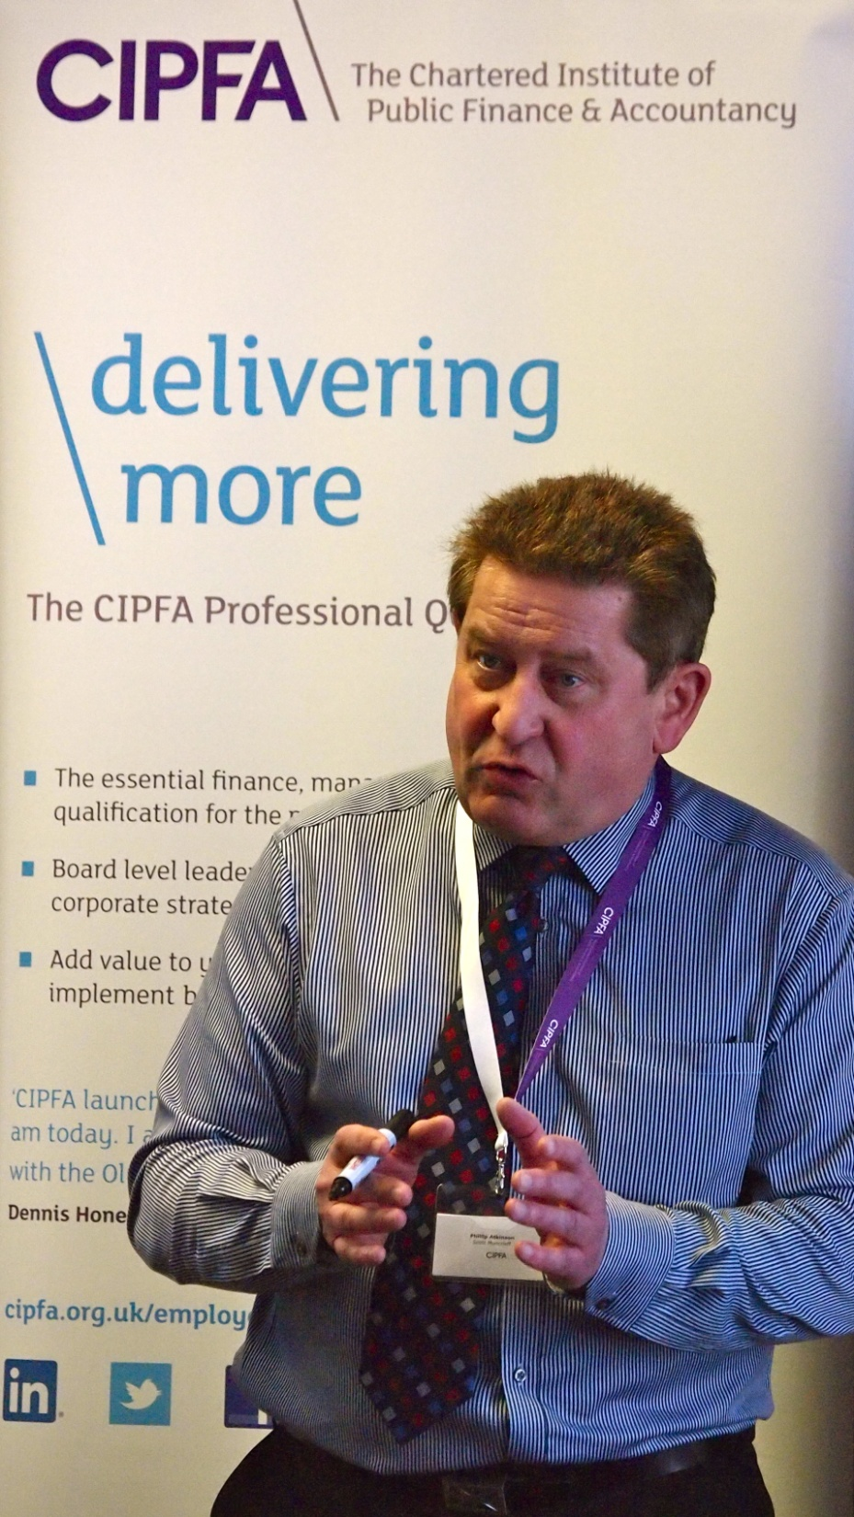

Slide 8
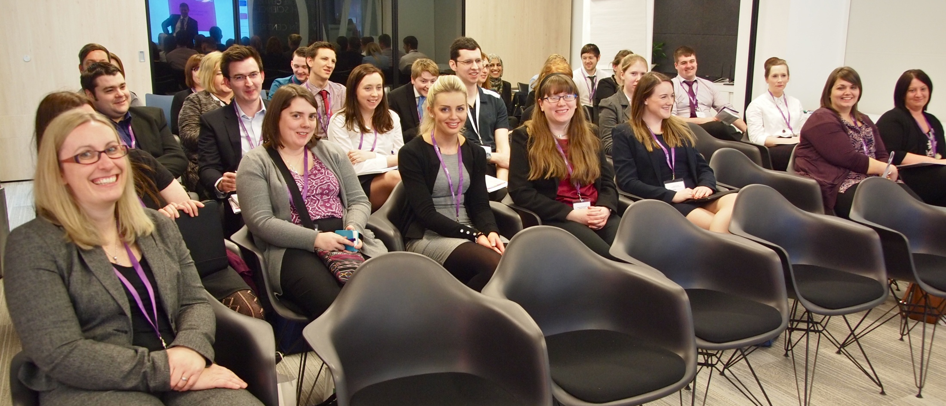

Slide 10
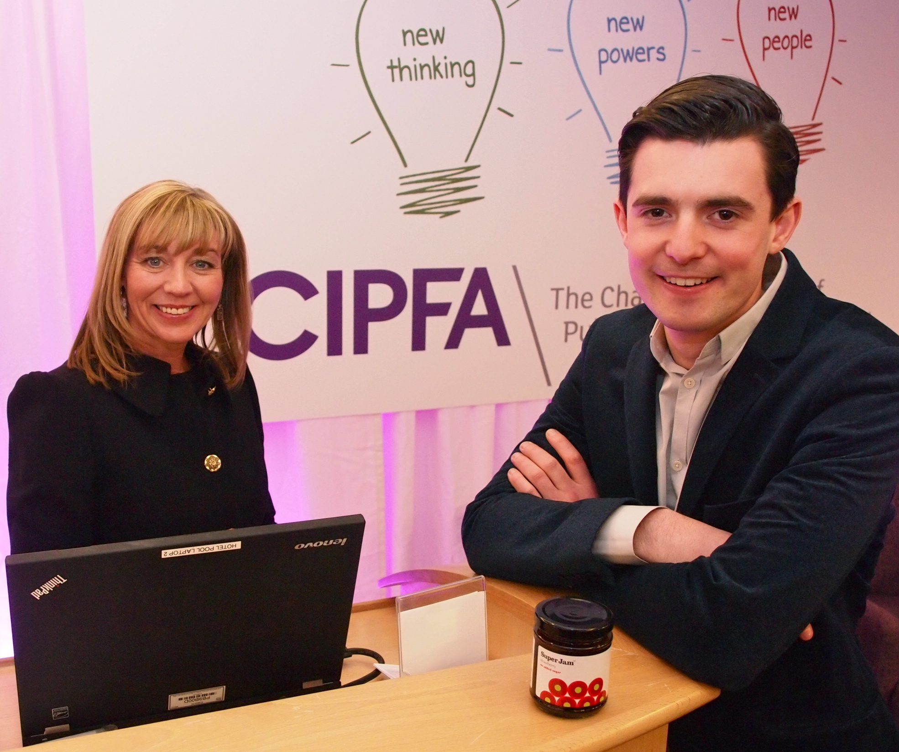

Slide 11
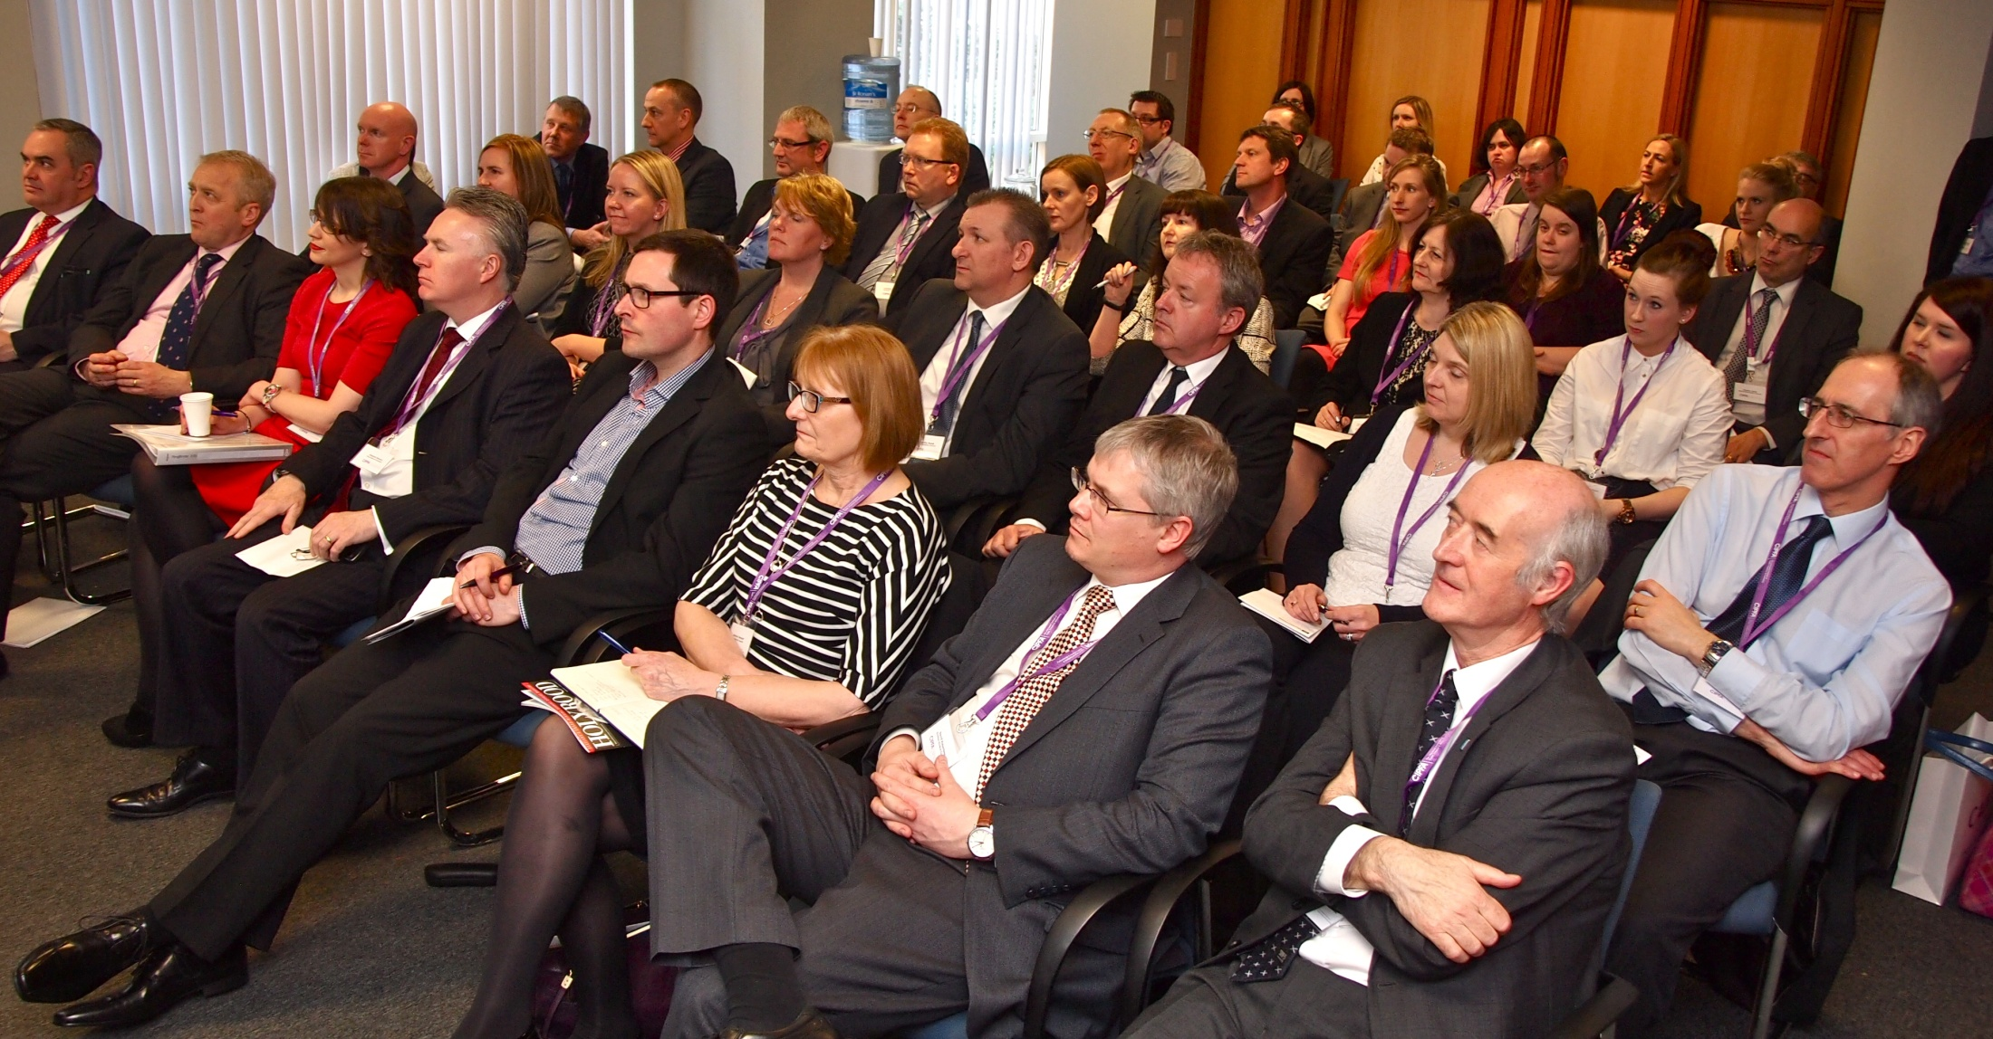

Slide 12
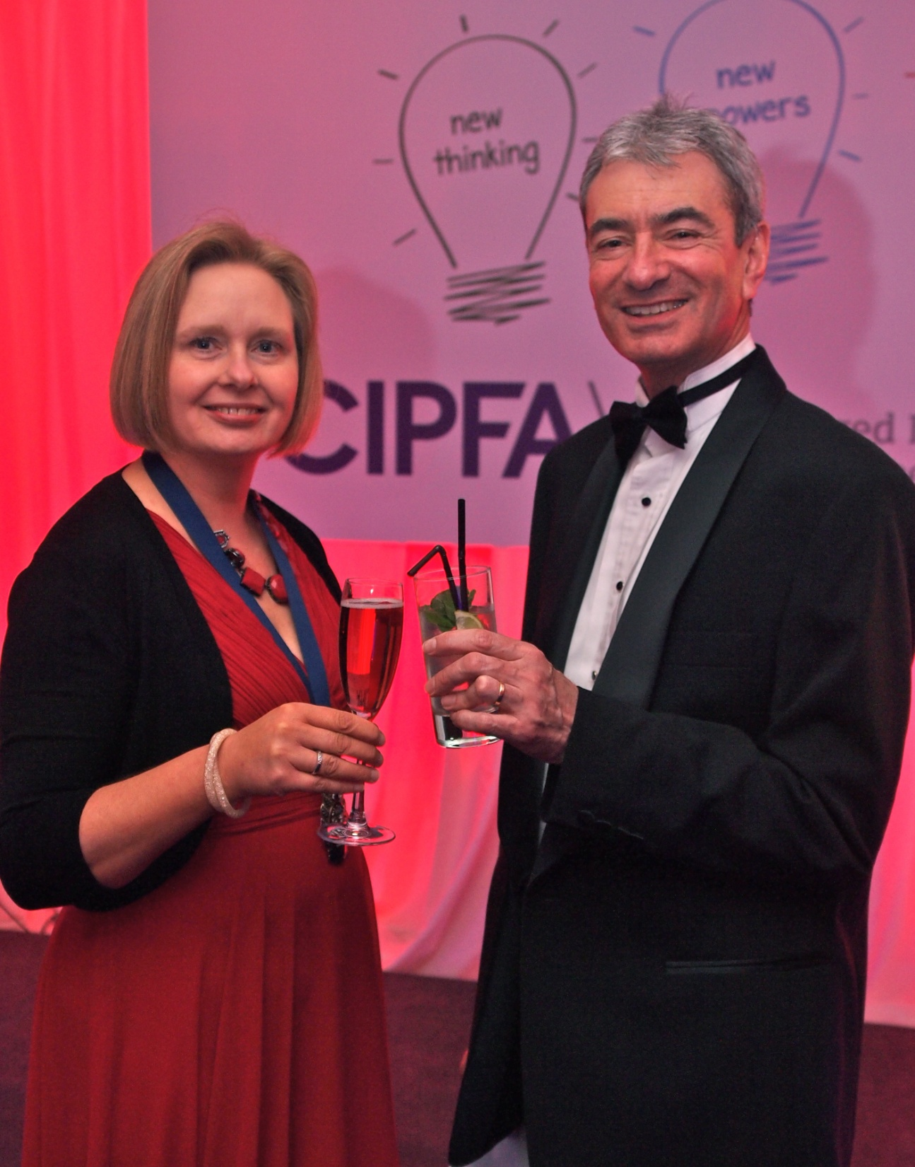

Slide 13
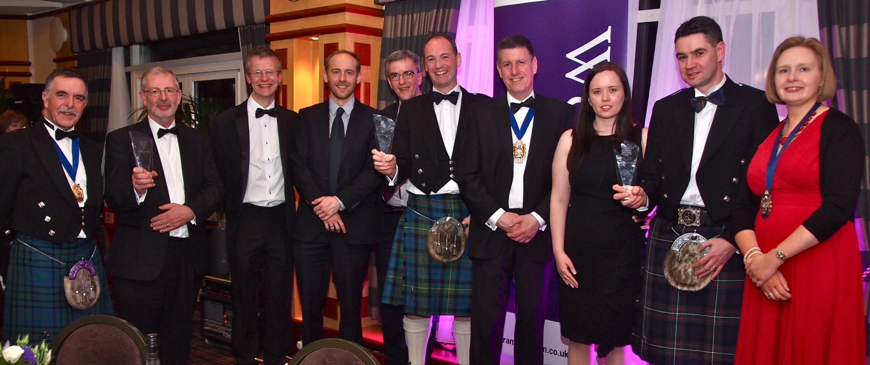

Slide 14
Close

