Slide 1
A Scottish Fiscal Framework
Sean Neill
Head of Fiscal Responsibility Division Scottish Government
CIPFA Scotland Conference, 26 March 2015

Slide 2
Elements of a Fiscal Framework
Elements of a Scottish fiscal framework
Sustainable funding model
Tools for managing risks
Credible fiscal rules
Independent fiscal institutions
Consistency with UK fiscal policy
A well designed fiscal framework will ensure that further devolution provides the right incentives & increases accountability - linking Scottish Government budget to Scottish economic performance
Fiscal framework must be robust, cohesive and provide the flexibility to develop and deliver distinct Scottish policies – within the UK fiscal framework

Slide 3
A Scottish Fiscal Framework
What is in a fiscal framework?
What does the Scottish Governments fiscal framework look like under Scotland Act 2012?
What did the Smith Commission say?
What does this mean for the Scottish Government and the design of a new fiscal framework?
Discussion

Slide 4
Scotland Act 2012
Measure | Start | Revenue estimate (2015-16)
Replace Stamp Duty Land Tax with Land and Buildings Transaction Tax (LBTT) | 2015-16 | c. £380m
Replace UK Landfill Tax with Scottish Landfill Tax (SLfT) | 2015-16 | c. £117m
Scottish Rate of Income Tax | 2016-17 | c. £4.5 bn if rate set at 10p/£
Power to devolve more taxes | …
Capital borrowing | 2015-16 | Annual - 10% of capital budget(£304m), Aggregate limit - £2.2bn
Revenue borrowing | 2015-16 | Annual - £200m Aggregate - £500m
Block grant adjustment | 2015-16; 2016-17 | One-year agreement for devolved taxes Principles agreed for SRIT

Slide 5
Fiscal Framework 2012
Sustainable funding model | Over 80% of funding from block grant Tax receipts from 2 devolved taxes and SRIT Block grant adjustment
Tools for managing risks | Cash reserve Consequential allocation Capital borrowing provision – 10% CDEL up to £2.2bn cumulative Borrowing for forecast errors - £200m pa - £500m cumulative Carry forward unspent balances of 0.5% RDEL and 1.5% CDEL
Credible fiscal rules | Linked to SA 1998 – SG has to produce a balanced budget Revenue funded investment subject to self-imposed rule (annual costs within 5% of budget)
Independent fiscal institutions | Role of the Scottish Fiscal Commission in providing assurance on the robustness of SG tax forecasts
Consistency with UK fiscal policy | Part of overall UK fiscal framework

Slide 6
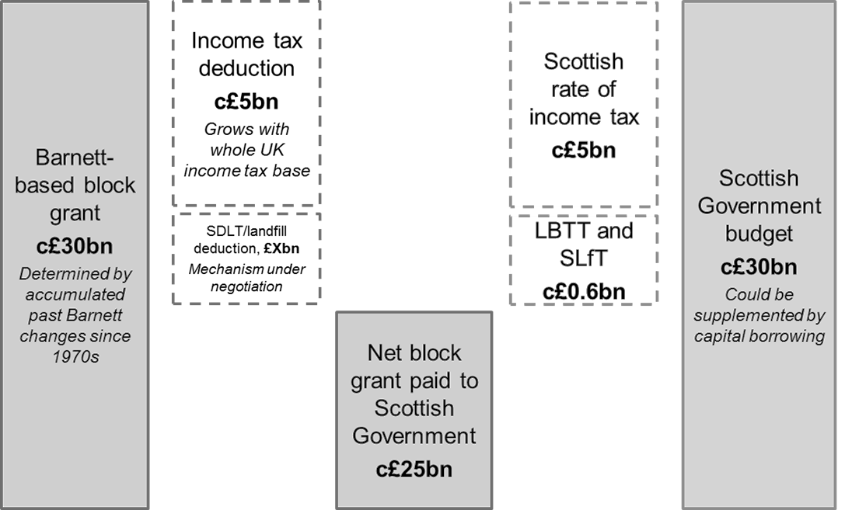
Scotland Act 2012 Funding Model
£0.5bn
c0.5bn

Slide 7
Smith Recommendations
Fiscal Framework
Agreed by the Scottish and UK Governments Part of a UK Fiscal Framework Underpinned by ‘no detriment’ principle
Tax | Welfare | Borrowing
Rates and bands of Income Tax Assignment of 10p/£1 VAT raised in Scotland Air Passenger Duty Aggregates Levy | Benefits for carers, disabled people and those who are ill Benefits included in the Regulated Social Fund Powers to create new benefits and top up reserved benefits | Revenue borrowing – to ensure stability and provide safeguards to public spending in the event of economic shocks Capital borrowing – to support capital investment and to consider how this could fit with a prudential borrowing regime.

Slide 8
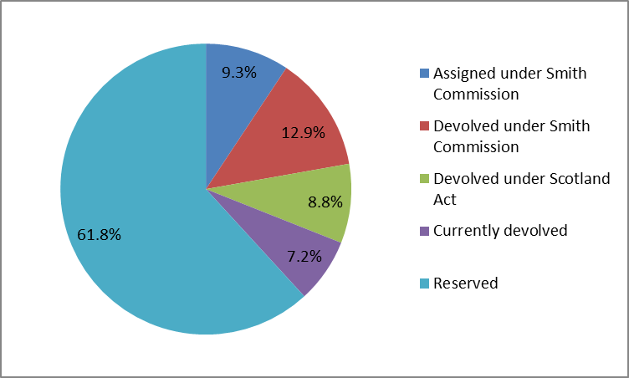
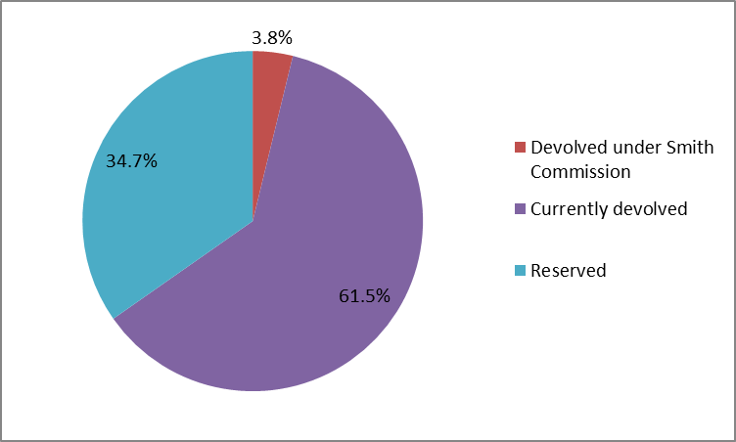
Financial Impact of Smith
Revenue
Expenditure

Slide 9
Revised Fiscal Framework
Sustainable funding model | Barnett Formula will continue to operate No detriment as a result of the decision to devolve further power No detriment as a result of UK or Scottish Government policy decisions post-Smith Scottish Government should have powers to support capital investment
Tools for managing risks | The UK Government will manage risks which affect the whole of the UK The Scottish Government should bear economic responsibility for its policy decisions
Credible fiscal rules | Updated Scottish Fiscal Framework consistent with UK Fiscal Framework Borrowing powers should be consistent with fiscal rules
Independent fiscal institutions | Scottish parliament should expand and strengthen independent scrutiny

Slide 10
How to design a new fiscal framework for Scotland
Step 1: Smith Agreement sets out new tax/spending powers Step 2: Smith Agreement summarises where risks are held Step 3: Evolve funding model to reflect new powers/risks Step 4: Determine tools for SG to manage these powers/risks Step 5: Fiscal rules and institutions to ensure sustainable outcome
Powers
Funding
Tools
Rules
Risks

Slide 11
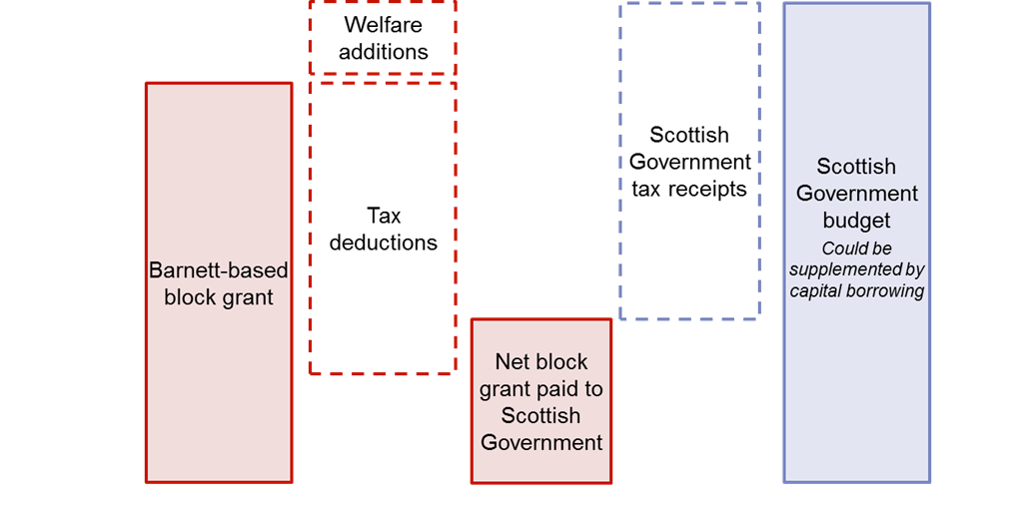
Post-Smith Funding Model

Slide 12
Next steps
UKG continues to prepare the Bill for introduction to the UK Parliament
Discussions on non-legislative areas of the Smith Commission Agreement – need to move in parallel
Technical discussions with HMT
Stakeholder engagement
22 Jan
Draft clauses published
07 May
UK General Election
TBC
Queen’s speech

