Slide 1
\
CIPFA Scotland Conference 2015

Slide 2
Welcome by chair
Christine McLaughlin
CIPFA Scotland Branch Chair

Slide 3
Keynote address
John Swinney
Deputy First Minister of Scotland and the Cabinet Secretary for Finance, Constitution and Economy

Slide 4
\
Workshops

Slide 5
Privatisation – more to learn nothing to fear?otland and the Cabinet Secretary for Finance, Constitution and Economy First Minister of Scotland and the Cabinet Secretary for Finance, Constitution and Economy
David Watt
CEO Institute of Directors, Scotlandand the Cabinet Secretary for Finance, Constitution and Economy First Minister of Scotland and the Cabinet Secretary for Finance, Constitution and Economy

Slide 6
\
Workshops

Slide 7
A different Scotland? of Scotland and the Cabinet Secretary for Finance,
Professor John Curtice
University of Strathclyde of Scotland and the Cabinet Secretary for Finance, Constitution and Economy First Minister of Scotland and the Cabinet Secretary for Finance, Constitution and Economy

Slide 8
The Two Halves
The (continuing) constitutional debate
The political fallout

Slide 9


Poll of Polls: 17/09/2014
The figure to the right shows the average Yes and No vote in the last six polls to have been conducted. The figure below shows how this average has shifted during the campaign. 'Don't know' responses are excluded and all calculations have been rounded to the nearest whole number.
Each dot on this graph represents the last reading of the average of six. Note that the spacing is not representative of the actual time between poll readings.
www.scotcen.org.uk
@ScotCen
www.whatscotlandthinks.org
@WhatScotsThink

Slide 10
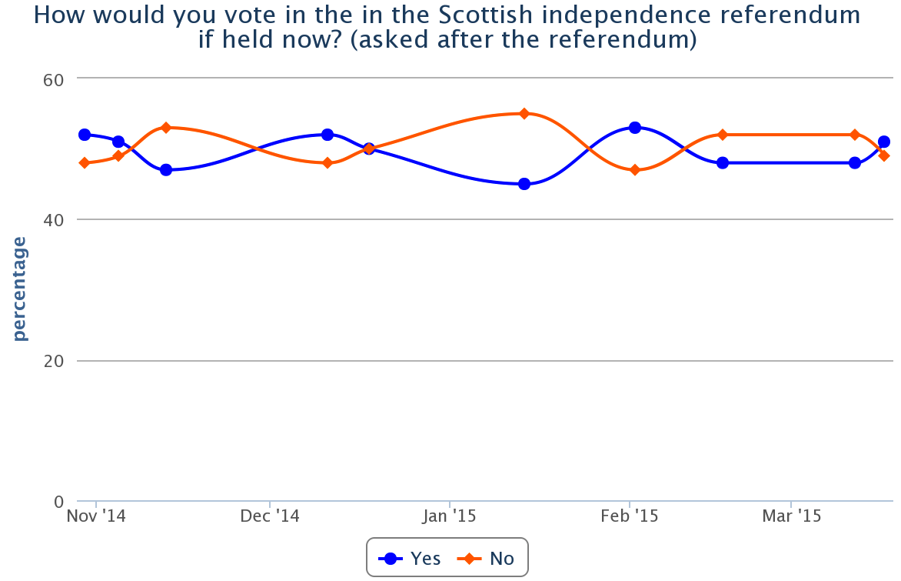
Post-Referendum Readings
Source: whatscotlandthinks.org

Slide 11
Who should make decisions
2012 Data | Scottish Parliament | UK Government
Health | 66 | 24
Schools | 63 | 11
Welfare benefits | 64 | 19
Tax Levels | 56 | 36
Defence/Foreign Affairs | 34 | 59
Source: Scottish Social Attitudes 2012

Slide 12
To Devolve or Not?
 | Scottish Government | Westminster Government
Working Age Benefits | 71 | 22
Income Tax | 67 | 25
Other Taxes | 67 | 24
Minimum Wage | 60 | 33
Health & Safety | 60 | 32
Abortion, Embryo Research | 50 | 40
State Pension | 47 | 45
Broadcasting | 43 | 45
Source: YouGov 27-30.10.14

Slide 13
Modest Expectations
 | Devo Max |  | Independence
 | More/Better | Less/Worse | More/Better | Less/Worse
Pride | 42 | 3 | 51 | 4
Voice | 35 | 15 | 38 | 25
Economy | 30 | 20 | 30 | 34
Public Services | 30 | 21 | 32 | 30
Std. Living | 27 | 15 | 27 | 28
Pensions | 22 | 9 | 22 | 13
Tax | 4 | 48 | 6 | 56
Source: Scottish Social Attitudes 2013

Slide 14
Should Scotland Pay Her Own Way?
Thinking about public services, such as health and education, that are nowadays the responsibility of the Scottish Government, how do you think these services in Scotland should be paid for….
…out of a sum of money decided by the UK government and funded out of taxes collected across the UK, or
…out of taxes decided and collected by the Scottish Government in Scotland?

Slide 15
Paying own way just wins!
Source: Scottish Social Attitudes

Slide 16
Pool or Separate Risk?
Source: Scottish Social Attitudes

Slide 17
Reluctance to pay a different rate of Income Tax…
Source: Scottish Social Attitudes

Slide 18
…or to receive a different state pension
Source: Scottish Social Attitudes

Slide 19
A Positive Legacy?
Source: YouGov/Edinburgh Univ. Feb. 2015

Slide 20
Post-Referendum Scotland
Source: whatscotlandthinks.org. Running ave of last 4 polls

Slide 21
Possible Seat Implications

Slide 22
Labour Defection
Source: YouGov/Survation/TNS BMRB/ICM

Slide 23
Labour’s Problem
Around two in five (40%) of those who voted Lab in 2010 voted Yes in the referendum.
Around four in five (80%) of all those who voted Yes in the referendum (including 75% of 2010 Lab Yes voters) now back the SNP (compared with around 10% of No voters).
Less than 10% of Yes voters are backing Lab
Only around 45% of No voters are backing Labour

Slide 24
How Lab to SNP Voters Compare
Source: British Election Study Panel Sept. 14 wave

Slide 25
Less Convinced That Lab Back Redistribution
Source: British Election Study Panel Sept. 14 wave

Slide 26
Conclusion
There is a clear appetite in principle for a devolution settlement under which Scotland runs most of its domestic affairs.
But there is less clear acceptance of the implications of ‘devo max’.
The referendum has energised Scotland’s voters, who are inclined to vote in much the same way in the general election – but with very different consequences.

Slide 27
\
Lunch followed by
Workshops

Slide 28
The adventures of jam boy.. of Scotland and the Cabinet Secretary for Finance, Constitution and Economy First Minister of Scotland and the Cabinet Secretary for Finance, Constitution and Economy
Fraser Docherty
Founder, Superjam of Scotland and the Cabinet Secretary for Finance, Constitution and Economy First Minister of Scotland and the Cabinet Secretary for Finance, Constitution and Economy

Slide 29
\
Workshops

Slide 30
New partnership thinking of Scotland and the Cabinet Secretary for Finance, Cabinet Secretary for Finance, Constitution and Economy
Geoff Paul
Director of Planning, Northumberland County Council

Slide 31
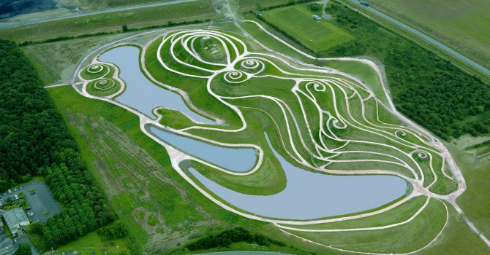


Geoff Paul
Director of Planning Economy
and Housing

Slide 32

Devolution
The vow
The expansion
The reaction
The players
The impact

Slide 33
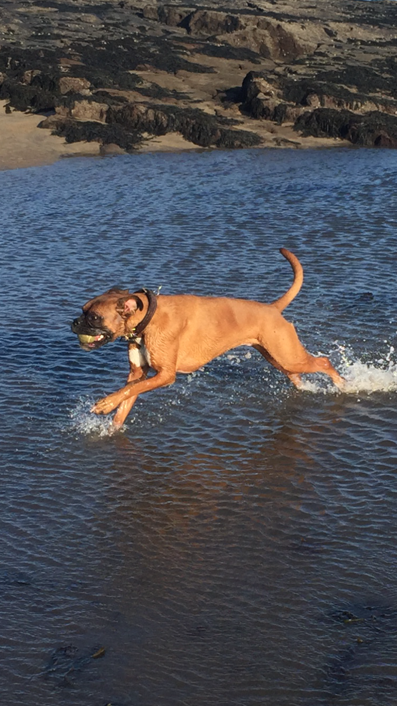

Slide 34
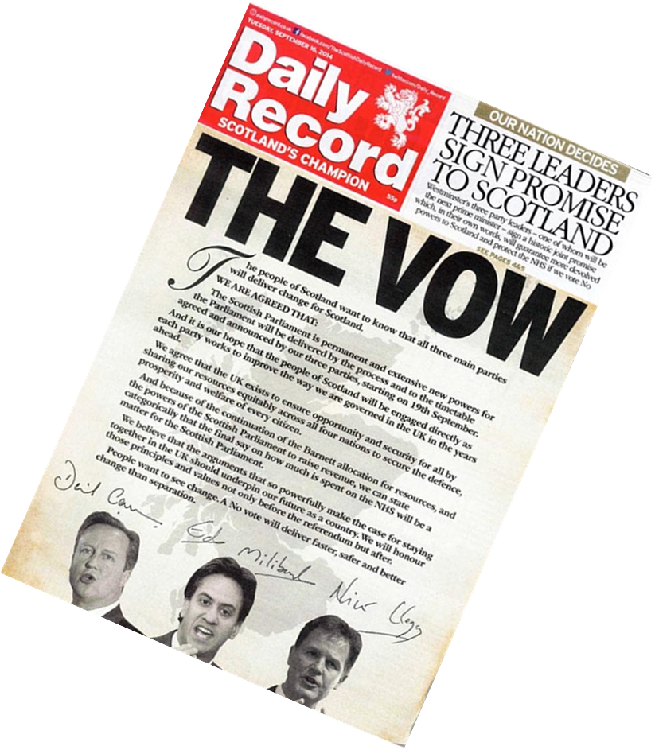
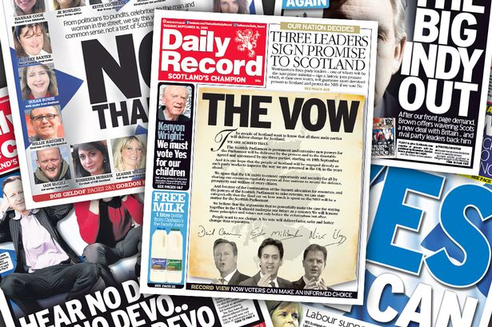

Slide 35
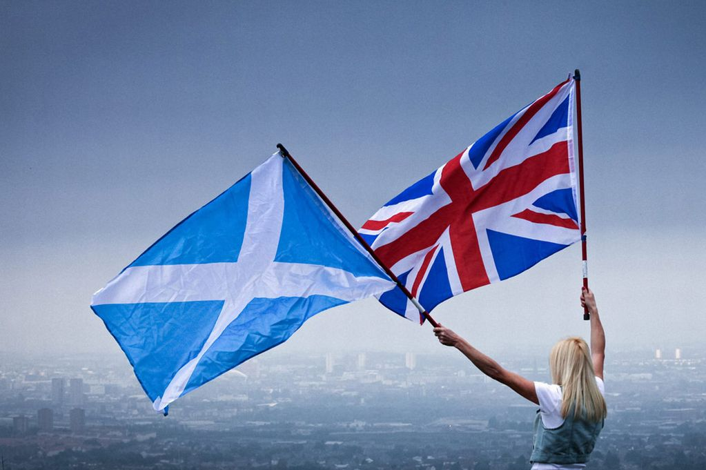
 | Percent | Votes
Yes | 44.7% | 1,617,989
No | 55.3% | 2,001,926
84.59% Turnout

Slide 36
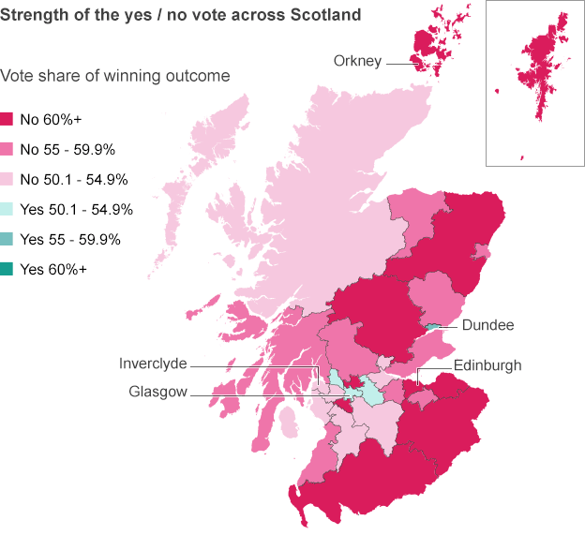

Slide 37
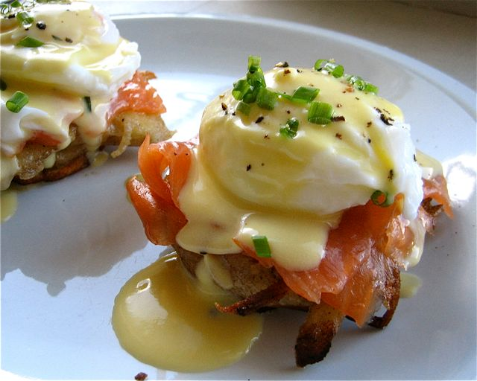

Slide 38
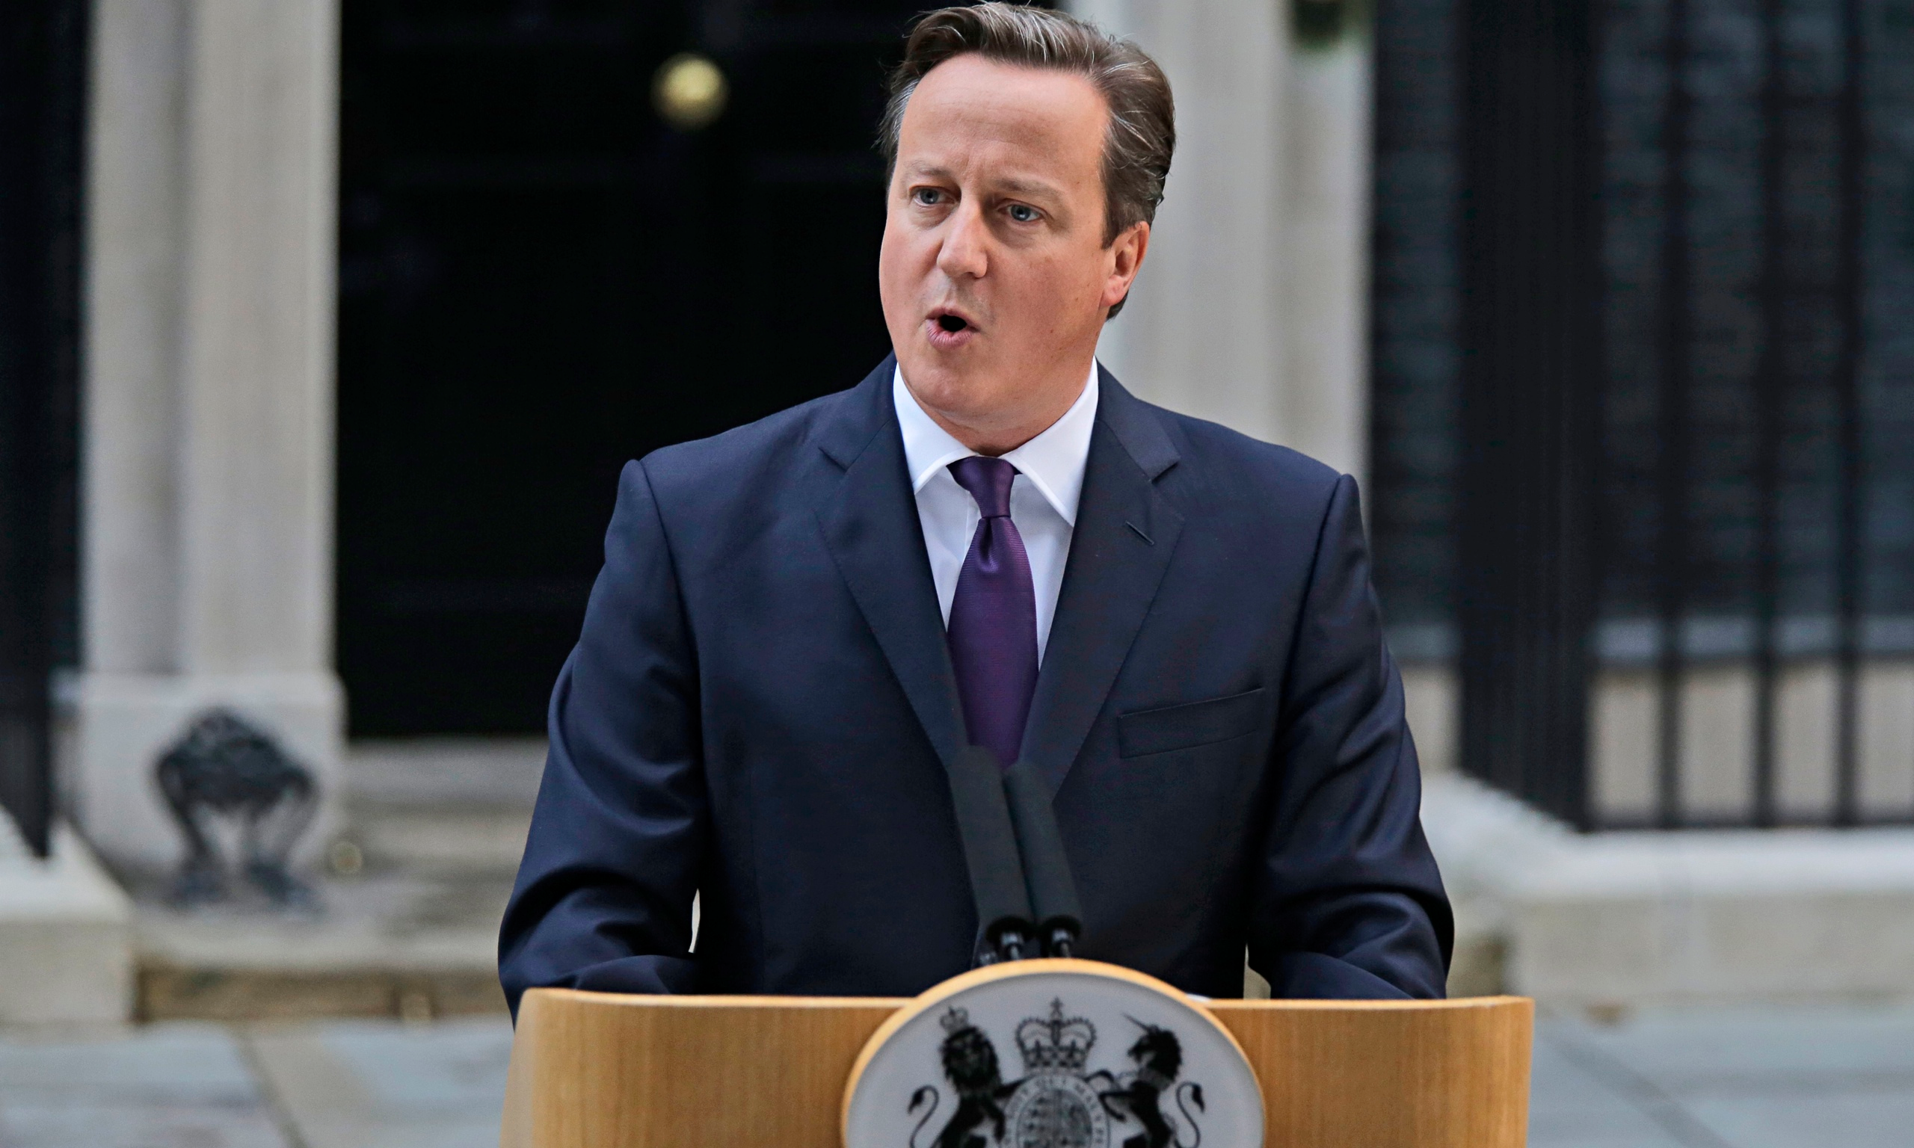

"We have heard the voice of Scotland - and now the millions of voices of England must also be heard. The question of English votes for English laws - the so-called West Lothian question - requires a decisive answer.
"So, just as Scotland will vote separately in the Scottish Parliament on their issues of tax, spending and welfare so too England, as well as Wales and Northern Ireland, should be able to vote on these issues and all this must take place in tandem with, and at the same pace as, the settlement for Scotland."
David Cameron, day after the referendum vote

Slide 39
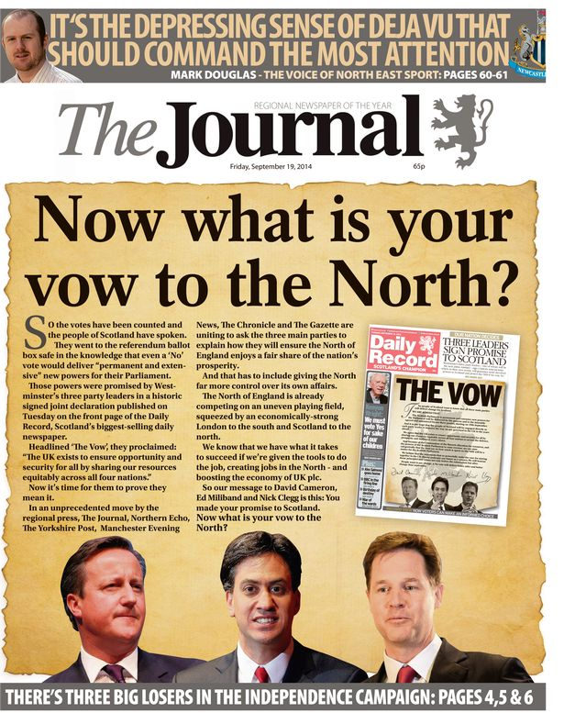
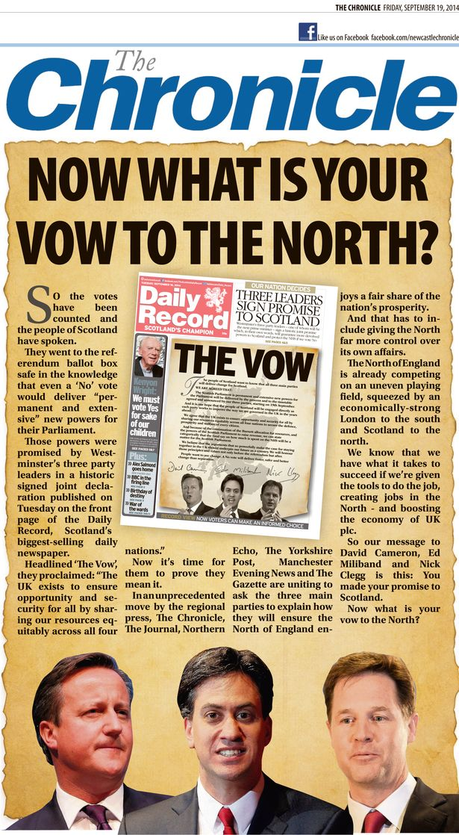

Slide 40
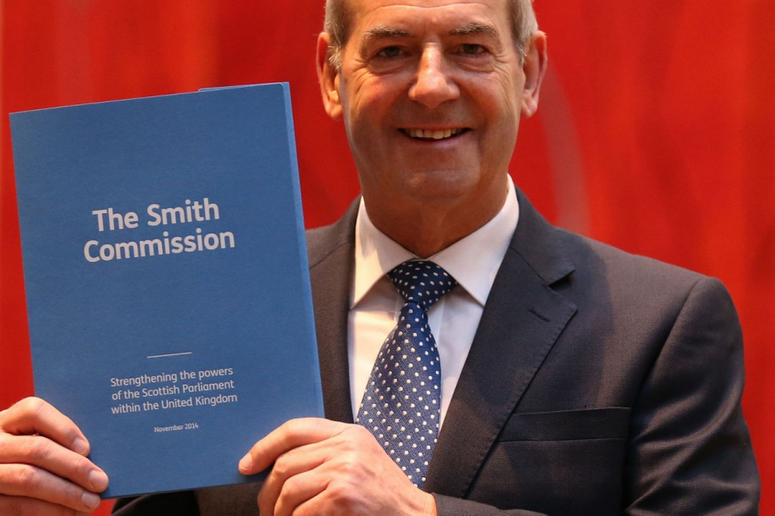

Slide 41


Constitutional settlement for the governance of Scotland
Delivering prosperity, a healthy economy, jobs, and social justice
Stronger financial responsibility of the Scottish Parliament
Principles of the Financial Framework

Slide 42
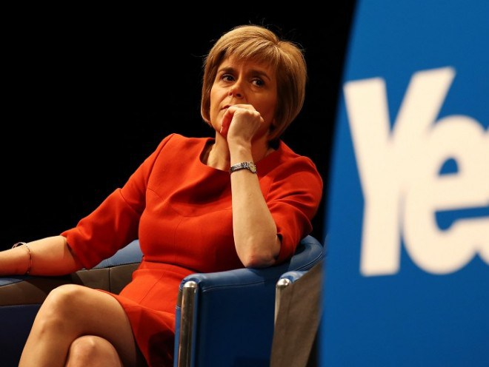

Welcome the proposals and pledge to use them when they are in place in the best interests of the Scottish people
But the proposals form the “rhetoric from the No campaign during the referendum” where we were promised “nothing less than a modern form of Scottish Home rule”
“Regrettably, less than 30% of our taxes will be set in Scotland and less than 20% of welfare spending will be devolved to Scotland – this is continued Westminster rule”
Alex Salmond subsequently confirms that he is to stand for election to Westminster

Slide 43
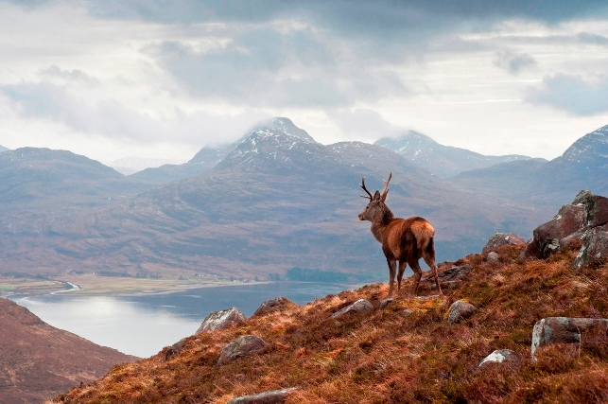
Scottish
Affairs Committee
‘’The Smith Agreement represents the best of both worlds’’
  It presents Scotland with much greater powers over taxation and welfare whilst allowing Scotland to benefit from pooling risk and resources across the wider tax base of the whole UK.
  It clearly fulfils the “vow” now the focus should be on implementation and the complex negotiations on developing an effective fiscal framework

Slide 44
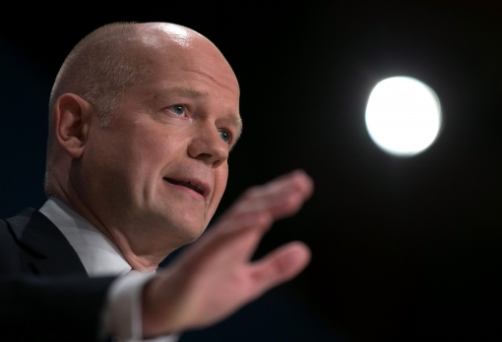
England Response 1
EVEL
William Hague
announces four options
English MPs only
Committee stage
English / Welsh veto
Grand Committee

Slide 45
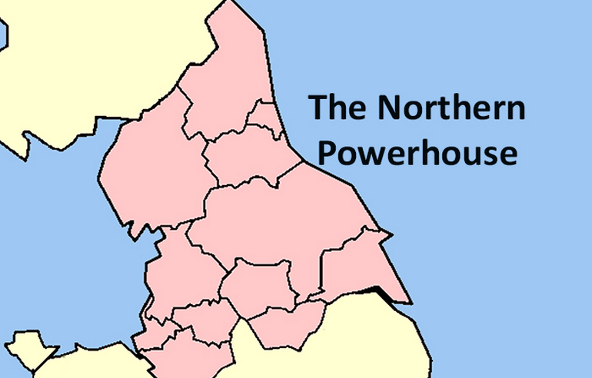




England Response 2
Northern Powerhouse
North East
Combined Authority
Greater
Manchester Deal
Sheffield City
Region Deal

Slide 46

England Response 3 – Birmingham, Bristol, Cardiff, Glasgow, Leeds,
Liverpool, Manchester, Newcastle,
Nottingham, Leeds.
‘Modern Charter for Local Freedom’ - 800th Anniversary Magna Carter
Freedom to decide, invest and deliver
What is good enough for nations is good enough for cities

Slide 47
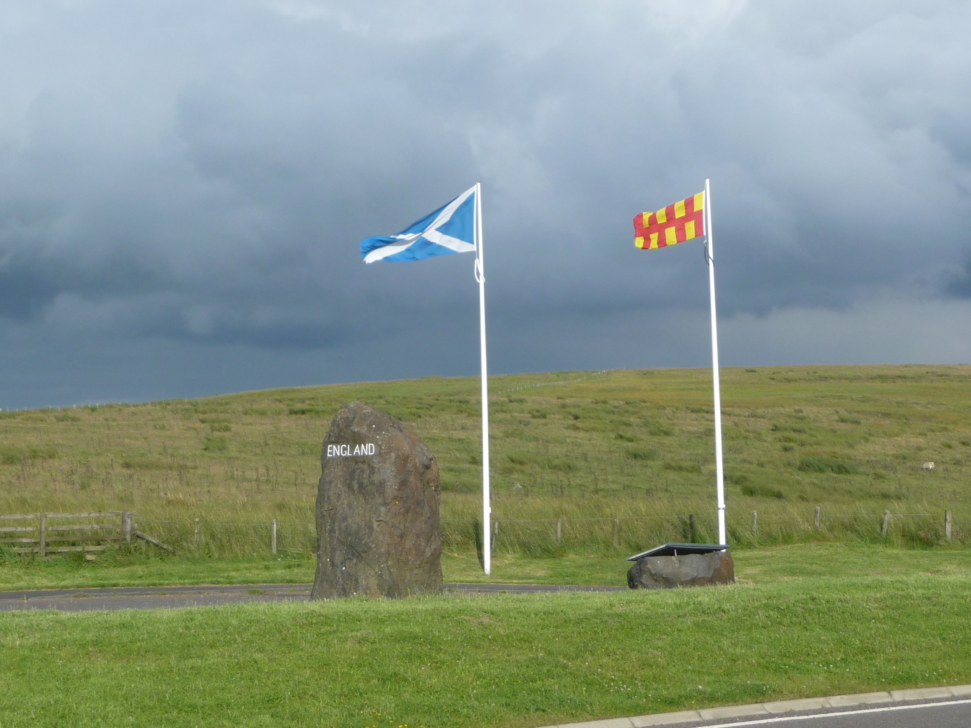
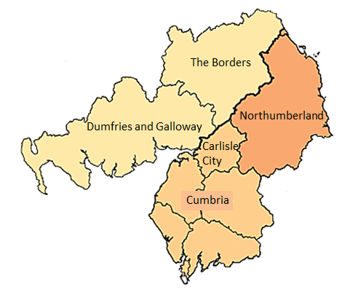
Borderlands

Slide 48
A local authority alliance
    Common challenges
      Economic growth focus
      Potential for a Borderlands Deal? LEP ? Development Agency ?
An uneven playing field:
    “Post code lottery”
      student fees, inward investment, business support, APD, etc
    Scottish Borders and Dumfries and Galloway relationship with the Scottish Government but little evidence of any devolution of additional powers to them
    Cumbria is a two-tier authority with its own stand-alone LEP Northumberland also a rural county but unitary and part of the North East Combined Authority – likely to benefit from increased devolution but face challenges from Scotland , Manchester, Sheffield.

Slide 49

APD is the highest aviation
tax in the world

Slide 50
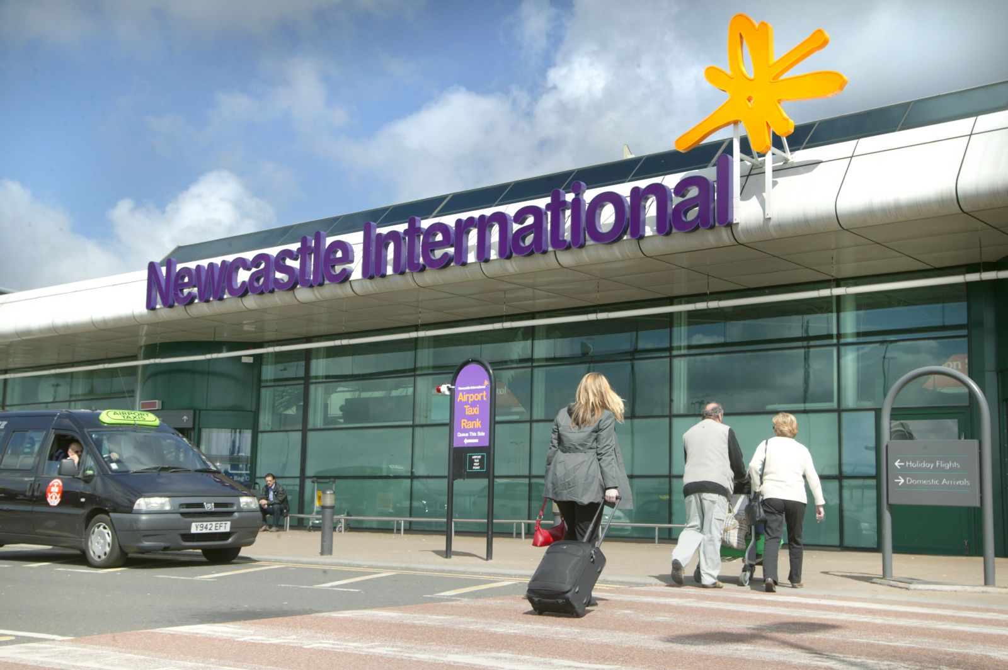
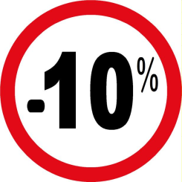
3,200 onsite jobs
8,000 jobs in the NE region
£650m a year to the NE economy

Slide 51


Slide 52


Slide 53
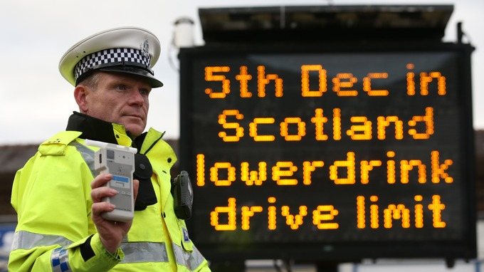

Slide 54


Slide 55


Slide 56

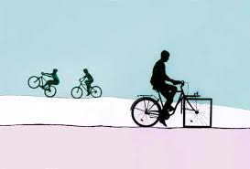




The Economic Tour of Britain
Team
Scotland
Team
Manchester
Team
North East

Slide 57
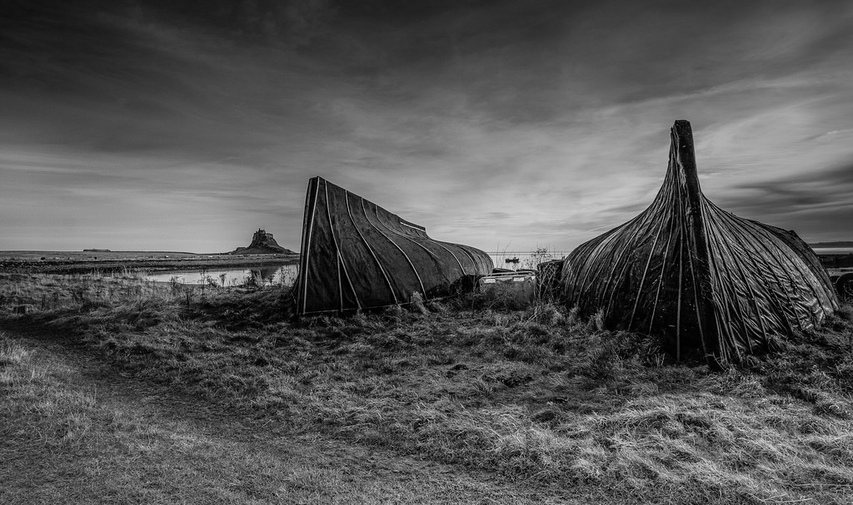

Slide 58
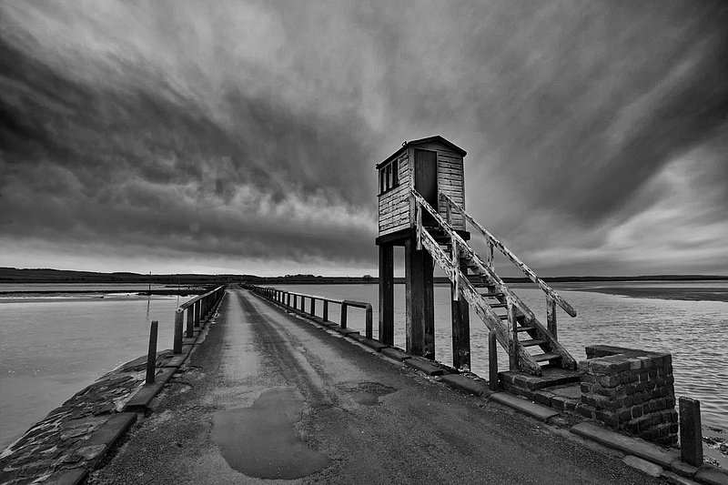

Slide 59
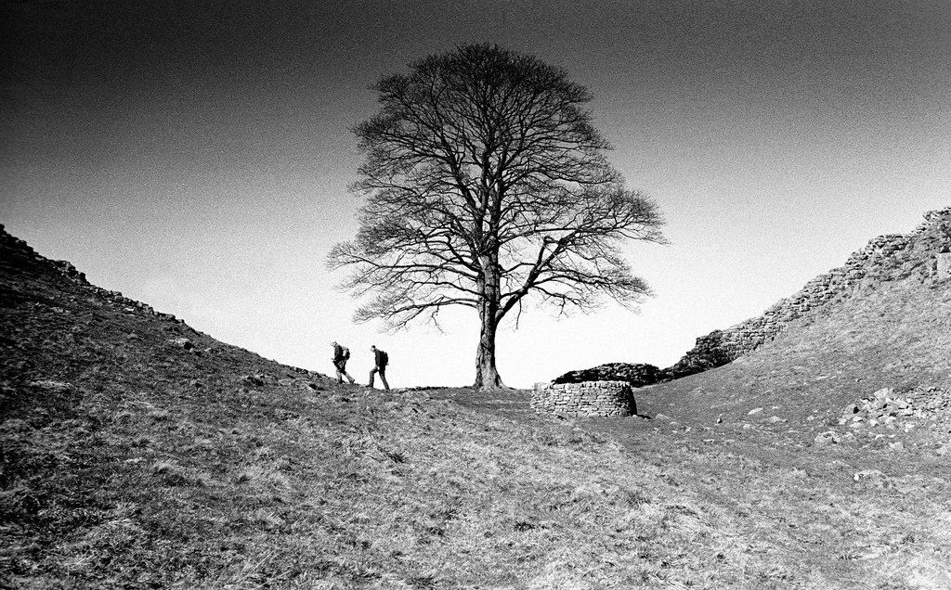

Slide 60
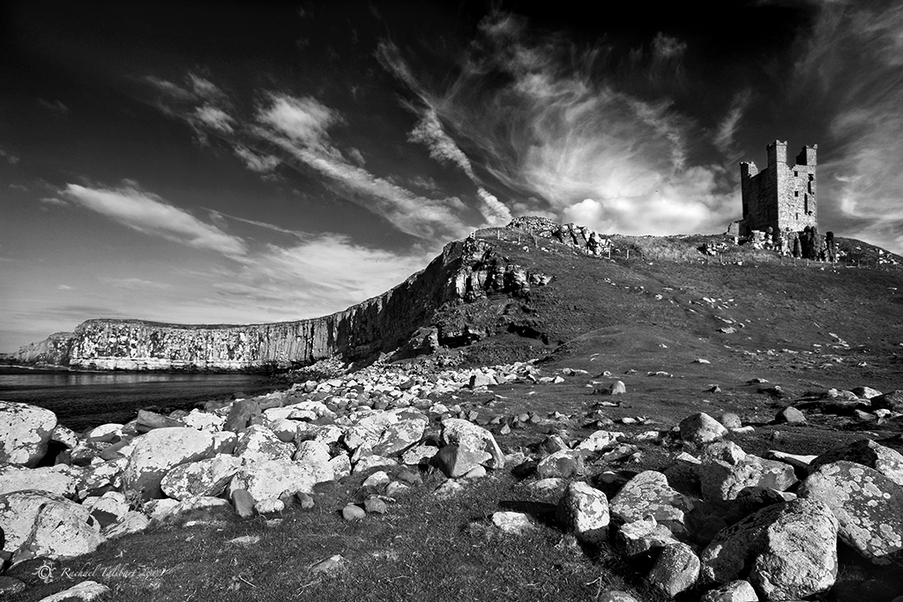

Slide 61

Geoff Paul
Northumberland County Council

Slide 62
Close

