Slide 1
/PFI – the cost of the past – savings for the future?
March 2015

Slide 2
Agenda
Introduction and Background
What is PFI and why was it introduced?
PFI – Good or Bad?
Are existing deals “fit-for-purpose”?
Traction and Way Forward
Summary
Notes:
Presentation of around half an hour
Q&A at the end

Slide 3
Introduction and Background
Alan Jessop
Senior Consultant
CIPFA Business Limited
Alan.Jessop@cipfa.org
The Public Accounts Committee chair, Margaret Hodge MP has been quoted as describing PFI as
'.. hugely expensive’
Notes:
30+ years experience in, first, Project Finance then
Developed into PFI/PPP
Involved in all aspects from debt to equity; private and public sector; Scotland and England
Have a reasonably unique experience having worked in both England and Scotland
Built two businesses North of the Border
Most recently involved in advising Public Sector bodies on how to drive efficiencies and savings into PFI schemes
Many soundbites but this one is pertinent

Slide 4
Scotland’s Fiscal Position
2013/14 Net fiscal balance: -12.2% of GDP (£16.4bn) excluding North Sea revenues or -8.1% if geographic share included
2013/14 government expenditure down 4.2% in real-terms
Future projections show the deficit falling but remaining above 10% (compared to 4% for UK)
Oil prices have fallen and remain lower than the last few years
Devolved tax raising will place further fiscal pressures
Institute for Fiscal Studies – March 2015
Notes:
Scotland suffering the same and possibly greater fiscal pressures
Pressure on public spending
WILL NOT GO AWAY

Slide 5
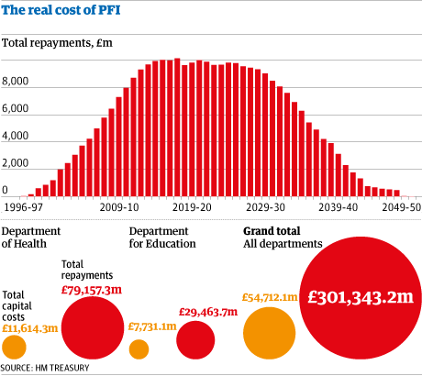
Costs of PFI
Guardian July 2012
Notes:
Significant annual unitary payments
Currently annual payments are around £9 billion and this lasts well into 2030’s
Set against general background of savings and efficiencies for the public sector so why should PFI be excluded from a detailed review/renegotitation

Slide 6
What is PFI and Why was it introduced?
Recommended vehicle for delivering procurement of (mainly) serviced accommodation projects
Historic under-investment in UK Infrastructure
Private sector innovation and investment sought
Government wanted costs (borrowings) to be off-balance sheet
Business case approval had to take account of value of risk- transfer to private sector
UK-wide over 700 projects undertaken with capital value of £55 billion
Scotland –
85+ projects completed;
Capital costs in excess of £5 billion;
Annual commitments (at close) in excess of £1 billion
Health, Education, Roads, Waste, Government Accommodation

Slide 7
PFI – Good?
It is wrong to assume that PFI is automatically a bad thing – costs are simply more visible
Sectors such as Health and Education have benefitted from accelerated building programmes that would not have been funded through traditional means
East Lothian Schools – completed despite failure of building contractor; additional funding provided by all funders
Building condition through contractual requirements will be maintained throughout the project life
Detailed specifications and procurement forced the Public Sector to think before buying
Public sector procurement is (historically) poor, costly and prone to lengthy delays…………….
Notes:
Building condition – maintenance and replacement budgets are often the first to be reduced leading to poor condition and eventually early replacement at high capital costs
Detailed specification should mean less need for later variations or changes – invariably these are expensive
Barbican Centre – 1100% cost overrun
Chelsea and Westminster Hospital – 180% cost overrun

Slide 8
PFI – Good?
A classic, recent and local example of Public Sector procurement:
The Scottish Parliament Building
1997 - Original cost estimate (White Paper) - £10-40 million
1998 – Cost Revision - £50 million (“construction management model”)
1999 – Cost revision - £109 million
2000-2006 – various changes to specification; contractual dispute and ongoing design issues
2007 – Out Turn – Final costs of £414.4 million; buildings completed 3 years late
2014 – annual maintenance costs running at £1.7 million; buildings not performing to design or user needs
Notes:
OOPPSS!

Slide 9
PFI – Bad?
There are numerous examples of high incremental costs – the “£500” electrical socket; high costs of change and review
Contracts are highly complex, inherently inflexible, weighty and difficult to interpret and manage
Contractual provisions are often not applied correctly
Resources often not dedicated to contract/project management
Conflicts of interest abound with self-monitoring not working
Long term contracts tied to fixed inflator; irrespective of actual market changes:
Notes:
Whilst the initial contracts were subject to long negotiation and review and changes, additions or additional work became open-house for the private sector as the public sector had to deal with them
People who negotiated and therefore understood the deals no longer involved
One-legged man finds it difficult to kick himself up the backside
Continual application of RPI or similar leads to miss-match – particularly against wage costs……………………

Slide 10
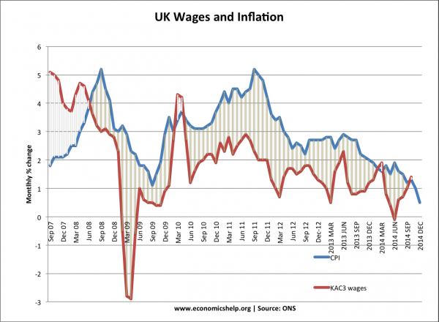
Notes:
Blue line is inflation and red-line is wage inflation; whilst the inflation line is CPI it does show the divergence – probably of the order of 10% in the past seven years
Contracts subject to RPI but actual costs to private sector are not; for many service lines up to half of those costs are wage related

Slide 11
Are existing deals “Fit-for-Purpose”?
RPI versus the “real world”
Outdated service specifications
Asset utilisation
Public sector default
Refinancing
Portfolio gains
Contract management
Prepayment maybe a costly option:
Notes:
Central funding is under severe pressure but contract costs always increase
Service specifications may no longer be appropriate to current requirements or ability to pay
Change in school rolls; healthcare provisions are changing; ageing population; more radical solutions
Public sector default is now viewed by funders as the greatest current risk
Refinancing – has been deemed a no-go area but potential exists to both tinker with the existing terms but also to have a more innovative approach – portfolio finding; use of bond markets for bundles of projects; sub-participation by public sector in existing debt. However it should be noted that DAO 02/14 published earlier this month clearly states that such a move should be regarded as "novel, contentious or repercussive".
Contract management should be more co-ordinated and staff involved on the public sector side encouraged to share information and experience – again centrally driven

Slide 12
Are existing deals “Fit-for-Purpose”?
Three examples of projects “repurchased”:
Skye Bridge – Original capex (1995) - £39 million; 27-year concession; would revert once equity return hurdle met; tolls set at level of existing ferry; Repurchase (2004) - £27 million
Inverness Airport – Original capex (1999) - £9.5 million; 25-year concession; included airport expansion once passenger numbers reached hurdle; based on passenger charges; Repurchase (2005) - £27.5 million
West Lothian College – Original capex (1999) - £18 million; 25-year concession; designed to cope with high levels of growth in student numbers; Repurchase (2006) - £27.5 million
Notes:
Skye Bridge – local pressure to refuse to pay tolls; tolls were set at level of existing ferry service but highest in Europe at the time; project did not fail; political rationale for prepayment
Inverness Airport – advent of low-cost airlines meant no/little growth in landing charges; commercial income had been included in the concession; felt to be a disincentivised structure for bringing new airlines to area; project did not fail; markets changed and no flexibility in contract or attempt to renegotiate; passenger numbers actually fell and are currently 10% below 2005 levels
West Lothian College - £11 million funding gap due to lower growth in higher education students; project did not fail but market growth not as projected; raw economics show saving of £1.5 million against funding gap/capex

Slide 13
Traction and the Way Forward
Code of Conduct
Best Value Provisions
New funding models:
Non-Profit Distributing
HUB
PF2
New major infrastructure investments
Pooled funding
Innovation?
Notes:
Lots of cost saving initiatives “south of the border”
Areas of current contracts that can be applied and used in anger
Private sector has signed up to new models for delivery and is thus receptive to savings and efficiency initiatives
Infrastructure will lead the spend out of recession and will require funding and private sector expertise – failure to deal with historic issues will lead to lower work in these important areas
Smaller projects were bundled historically; why not do this with funding?
Utilise the expertise and innovation that launched the market 15-20 years ago to drive the savings and efficiencies now required

Slide 14
Summary
Review – services, assets, performance
Revise – current needs, ability to pay, current market
Reprice – benchmark, market test, negotiate
Renegotiate – all changes,
Refinance
Repay
Speak to CIPFA!
Notes:
Be proactive and undertake a bottoms-up review including actual service delivery –
Which is likely to be less then contracted
Ensure all reports are being received and reviewed
Engage with users for their actual needs; not a wish list
Review the impact of many years of RPI
Engage with the private sector – they know this is coming and have to react
Don’t rule out any options – they may not be realistic but they focus the mind
Get a good advisor to assist

