Slide 1
Local Government Finance – The Past, Present and Future
The Society of District Council Treasurers
Nicola Morton, Head of Local Government Finance
17 March 2022
www.local.gov.uk

Slide 2
Contents
Trends in revenue funding
Trends in revenue spending
Cost pressures on local government
What the future holds

Slide 3
Funding Landscape since 2010

Slide 4
Core Spending Power against Inflation

Slide 5
The Importance of Council Tax
Note: decrease in 2012-13 due to adjustment as Council Tax Support Funding of £3.3bn rolled in

Slide 6
Council Tax Levels Over Time

Slide 7
How Service Expenditure is Funded

Slide 8
Trends in Revenue Spending

Slide 9
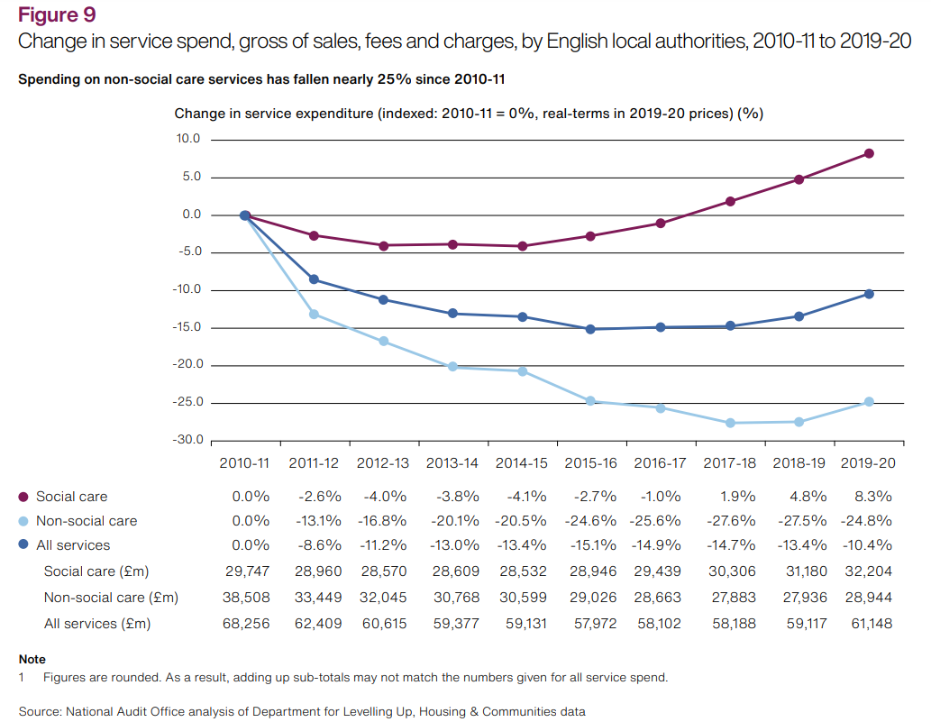
Council Spending on Services Over Time

Slide 10
Adult Social Care Financial Challenge

Slide 11
Cost Pressures

Slide 12
Cost Pressures (pre SR 2021 and excl. COVID-19)
 | 2022/23 £bn | 2023/24 £bn | 2024/25 £bn
Cost pressures | 2.5 | 5.7 | 7.8
Existing adult social care provider market pressures | 1.5 | 1.5 | 1.5
Existing pressures on children's social care | 1.0 | 1.0 | 1.0
Existing pressures on homelessness | 0.2 | 0.2 | 0.2
Addressing the public health service underfunding | 0.9 | 0.9 | 0.9
SEND deficits not met by funding | 0.6 | 0.6 | 0.6
Total core revenue funding need | 6.7 | 9.9 | 12.0

Slide 13
What the future holds

Slide 14
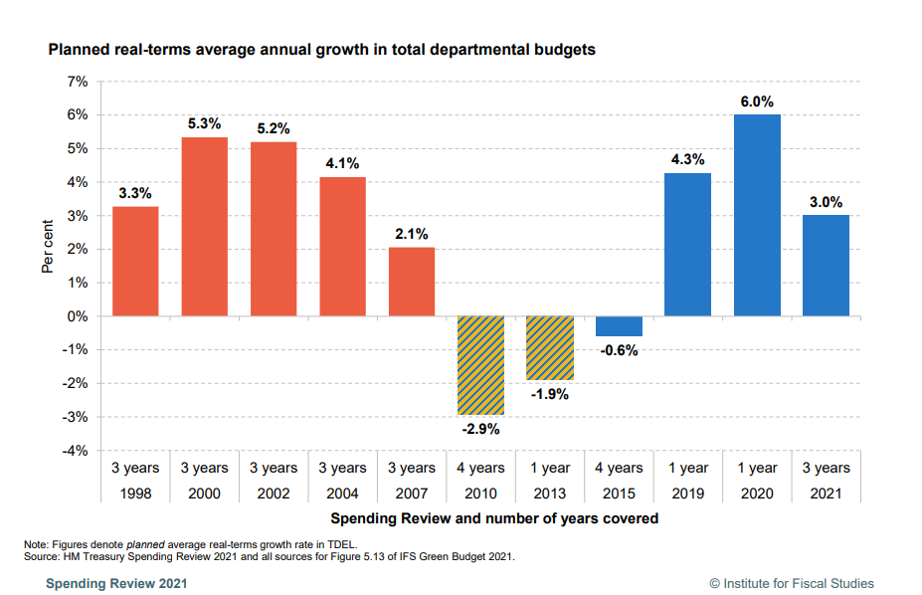
SR 2021 in Context of Past SRs

Slide 15
Spending Review at-a-glance
 | 21/22, £bn | 22/23, £bn | 23/24, £bn | 24/25, £bn | Average Real Terms annual growth, 21/22 to 24/25
Local government core spending power | 50.4 | 53.5 | 55.2 | 56.9 | 3.9%
LG DEL (Includes Adult Social Care Reform) | 9.1 | 10.8 | 12.1 | 12.7 | 9.4%
LG DEL (Excludes Adult Social Care Reform) | 9.1 | 10.6 | 10.7 | 10.7 | 5.9%
NHS England, day-to-day | 136.1 | 151.8 | 157.4 | 162.6 | 3.8%
Department for education, day-to-day | 70.7 | 77.0 | 79.2 | 80.6 | 2.2%
All government departments, day-to-day (RDEL) (excludes ringfenced COVID-19 funding) | 384.9 | 435.2 | 442.5 | 453.7 | 3.3%

Slide 16
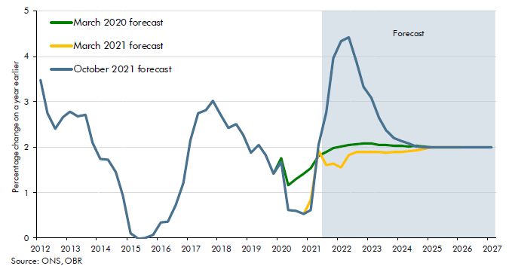
Economic Outlook – Inflation (CPI)

Slide 17
Financial Planning Horizon Over Time

Slide 18
The Future: Sources of Uncertainty
Squaring the circle: Reform and a multi-year settlement
Fair Funding Review
Interactions with other policies
Environment Bill reforms
Business rates retention?
New Homes Bonus
Levelling up
Adult social care reform
Business rates reset

