Slide 1
CIPFA European Annual Seminar Key Challenges and Initiatives for FEE
Olivier Boutellis-Taft
14 October 2014

Slide 2
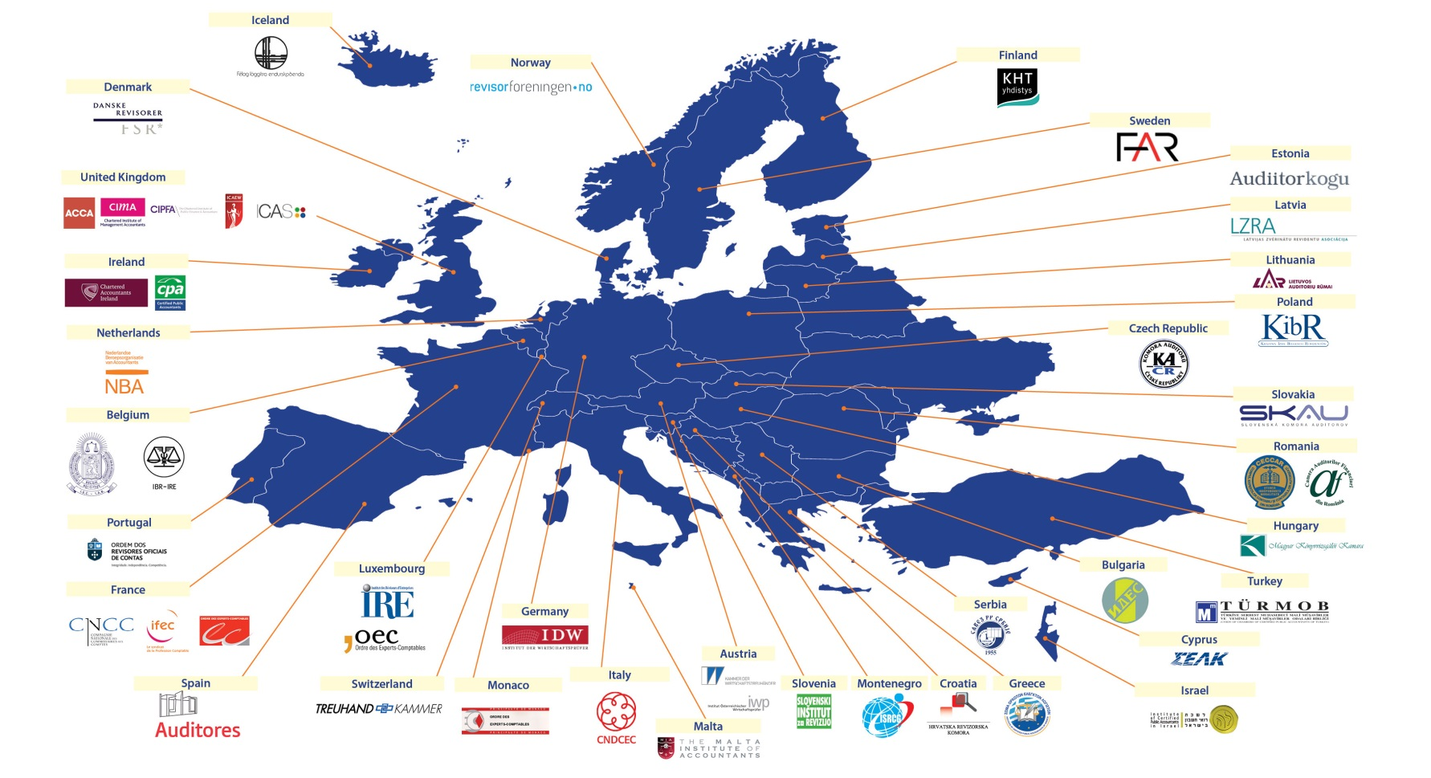
FEE federates professional institutes across Europe
47 professional institutes
36 European countries, including all EU 28
800.000 professional accountants

Slide 3
FEE adds value to Members
EU & international regulation, public policy, standard setting etc.
Representation toward stakeholders
Analysing and informing public policy developments
Promoting cooperation among Members
EC, EP, Council, ESMA, EBA, EIOPA, IOSCO - IASB, EFRAG, IIRC, IFAC, IAASB, IESBA, IPSASB, CAGs, PCAOB, OECD etc.
Facilitates consensus between Institutes, accountancy firms (big & small)…

Slide 4
FEE‘s challenges
Professions‘ structure
Members‘ background
Participants‘ language
FEE‘s resources
Countries‘ differences

Slide 5
FEE’s work
Tax
Banks
Insurance
Public
Sector
Professional
Ethics and
Competences
Accounting
Corporate
Reporting
VAT
Future of
Corporate
reporting
IAASB
Exposure
drafts
Audit
And
Assurance
ANTI
Money-
Laundering
Company
Law And
Corporate
Governance
PCAOB
SMP
Forum
Sustainability
Auditor
Comm
Future of
Audit and
Assurance

Slide 6
FEE’s strategic priorities
Audit
&
Assurance
Corporate reporting
Public finance

Slide 7
Public finance
Showcase profession’s public interest commitment
Provide expertise
(tax policy, reporting, assurance)
Create & seize opportunities

Slide 8
Public Sector: A strategic priority for FEE
The profession has an important role in public sector:
Policy debate, governance model, standard setting and legislation
Advice on implementation, transition plans, IT
Accounting, reporting, assurance
Notes:
We believe that the profession has an important role to play in public sector
Policy debate etc.
Once standards or legislation are in place: advice on implementation etc.
Once standards or legislation are implemented: core expertise of the profession is needed on accounting etc.

Slide 9
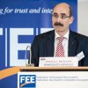
FEE‘s Public Sector Group
26 members from 15 countries (still expanding)
Priority areas and a range of important topics:
Accounting and reporting
European Standards
International Standards
Assurance
Performance Audit
Compliance Audit
Sustainability Audit …
Notes:
In order to deliver on this important area, FEE runs the Public Sector Group
26 members from 15 countries, we are still expanding, trying to encourage our member bodies to appoint additional representatives
Priority areas derive from the services that the profession provides

Slide 10
EPSAS and IPSAS
EC consultations, Conference, Task Forces
IPSASB consultations, joint meeting
EC plans: Communication, Framework Regulation, Standards
Notes:
EC consultations: Suitability of IPSAS (result: EC recommended EPSAS), EPSAS Governance – FEE responses available on the FEE website
EC Conference: Towards implementing EPSAS - Speeches of FEE CEO Olivier Boutellis-Taft and of PSG Chair available online
EC Task Forces: TMB is active (on behalf of FEE)
EC plans:
EC Communication October 2014
EU Framework Regulation 2015, which would (a) define governance and key principles and (b) confer standard-setting powers to EC
EC would adopt standards as binding acts (end 2015 – 2020)
Input to IPSASB: we analyse and contribute, also available on FEE website

Slide 11
FEE‘s further initiatives in the EPSAS debate
Series of roundtables on public sector accounting in 2014
FEE issues EPSAS paper
International standards are the preferred solution
EPSAS could be acceptable if a list of conditions is met
Notes:
EPSAS – which would need to be developed – give rise to a number of concerns, for example:
An isolation of the EU on global financial markets if financial statements are not comparable on international level;
A duplication of work in an area where international standards are already available;
A lack of chances for a timely solution due to the EU legislative process where 28 Member States need to agree;
A risk of making the standard setting process vulnerable to political tinkering.
However, taking into account that there is an urgent need for a reform of public sector accounting with the objective of greater transparency and accountability and that mandatory accruals accounting and harmonised public sector accounting standards are one of the key instruments which can contribute to achieving it, EPSAS could be acceptable to encourage EU Member States to move towards accrual accounting and increase the quality of their reporting.
Nevertheless, a number of conditions would need to be met:
The EPSAS governance structure and the standard-setting process would need to be fully transparent and include broad stakeholder participation as well as public consultations;
The governance and the standard-setting process should be independent, protected from any undue inﬂuence, should not fall hostage to national interest and should effectively prevent potential political tinkering;
The solutions that have been chosen should be transparent and sufﬁciently explained;
In order not to fall behind the level of transparency already reached in some Member States and the European Commission itself who are already using internationally accepted standards (IPSAS or IFRS conversion), EPSAS should be as close to IPSAS (IFRS) as possible, any divergences and reasons to diverge should be clearly disclosed, explained and justiﬁed;
Once approved, the standards should be consistently applied and all Member States should provide as a minimum the detail and quality of information required by the approved standards.

Slide 12
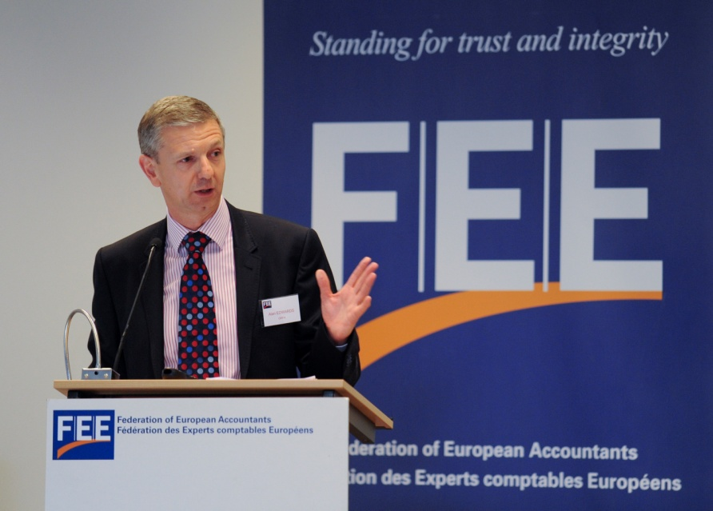
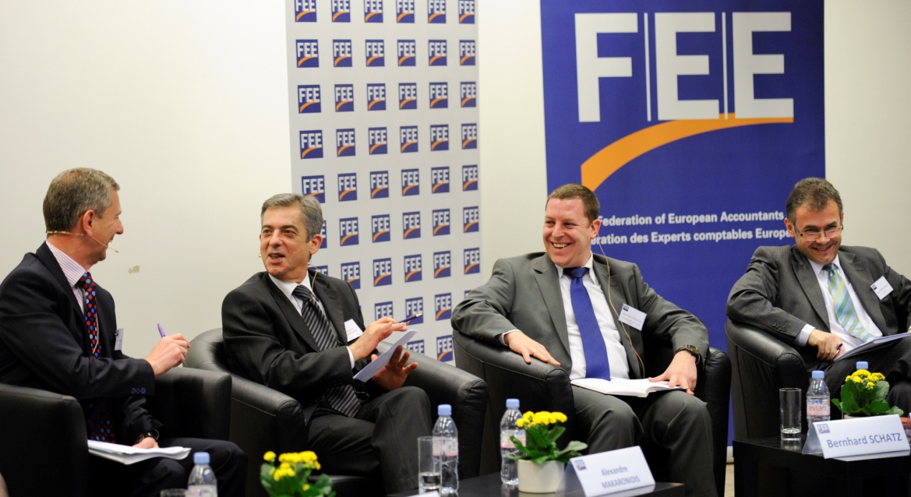
Thank you!
Coming soon: FEE Briefing Paper on Public Sector Accounting Standards
Notes:
Series of roundtables:
All information available on the FEE website: programmes, presentations, summaries, photos, videos (on this occasion: many thanks to Alan and his continued engagement as deptuy chair of the PSG and as fantastic moderator during the roundtables)
FEE issues paper on EPSAS: available in hard copies and online
Coming soon: FEE briefing paper on public sector accounting standards = factual information about the following topics:
Why does the European Commission deal with EU Member States’ public sector accounting?
Why does the European Commission suggest developing European Public Sector Accounting Standards (EPSAS)?
How did the EPSAS project proceed?
The FEE position on EPSAS
What are the next steps in the EPSAS project?

Slide 13
Stay connected
FEE website
Monthly e-newsletter
Connect with European Professional Accountants
@FEE_Brussels
@FEE_SMP
+FEE Brussels

