Slide 1
SES Performance Scheme: Driving Performance Improvement in European ATM /ANS
CIPFA Meeting
Peter Grififths
PRB Chairman
15/10/2014

Slide 2
Content of the presentation
The Performance Scheme (PS)
The Performance Review Body (PRB)
The Theory
ANS in aviation context
Performance Plans
US- EU OPS Comparison
Future performance improvements
Human Factor
Conclusions

Slide 3
The Performance Scheme (PS)
One of the key pillars of the SES by setting EU-Wide and Local targets, performance monitoring and corrective actions .
The PS is organised around fixed Reference Periods (RP). RP1 runs 2012-2014, RP2 runs 2015-2019.
Targets set are legally binding for EU Member States.
The Performance Regulation principles:
  4 Key Performance Areas (KPAs): Safety, Capacity, Environment, Cost Efficiency.
  Incentives/cost efficiency linked with Charging Sch.
  Staff representation consultation .

Slide 4
The Performance Review Body (PRB)
The PRB Reports to the EC in accordance with provisions of 390/2013 (the Performance Regulation).
The purpose of the PRB is to assist the EC in PS implementation and NSAs on request.
Competence, impartiality and independency.
Main key tasks are:
  Advise EC in setting EU-wide performance targets.
  Asses National/FAB Performance Plans (and the NM).
  Monitor the performance of the system in the 4 KPAs.

Slide 5
ANS in aviation context
Safety
6% | 6-12%
6% | 6%
Punctuality
Environment
Financial
Orders of magnitude
for illustrative purposes
Orders of magnitude of turnover
Notes:
ANS are a small part of aviation as you can see on the graph on the right.
However, they have a strong influence on aviation performance.
First, ANS must support the strong growth of aviation, 4-5% per annum, which is well above GDP growth, and an important element towards the Lisbon agenda.
Next, ANS has a strong impact on aviation performance in many respects:
ANS are essential to ensure aviation safety
Their economic impact is high: €8 B of user charges in 2007, + several billions euro in indirect costs due to delays and non direct routes, all paid by airspace users.
ANS have a non-negligible environmental impact, with an influence on 0.3% of global emissions.
There is also a social dimension: 57000 people are working directly in ANS.
It is important to decouple ANS impacts on performance from air traffic growth. In other terms, the risk of accident, costs, delays, environmental impact and also staff numbers should not grow in line with traffic to ensure a sustainable growth of aviation.
Having set the scene, I will address ANS performance under the following KPA: safety, capacity/delays, flight-efficiency, environmental impact, and cost-effectiveness.

Slide 6
Basic Adams Model of Risk
Opportunity
Reward
Management Process
Balancing Decisions
Unwanted Event’s
Risks
For further reading the reference text is: Risk John Adams UCL London 1995 ISBN 1-85728-067-9 HB and 1-85728-068-7 PB

Slide 7
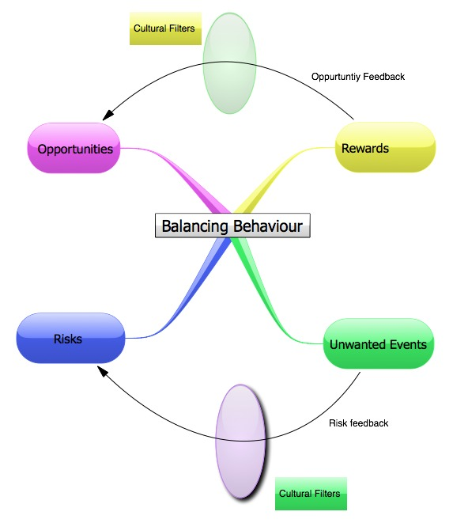
We make decisions on opportunities and risks based on perceptions from our culture. These perceptions apply filters to our model.

Slide 8
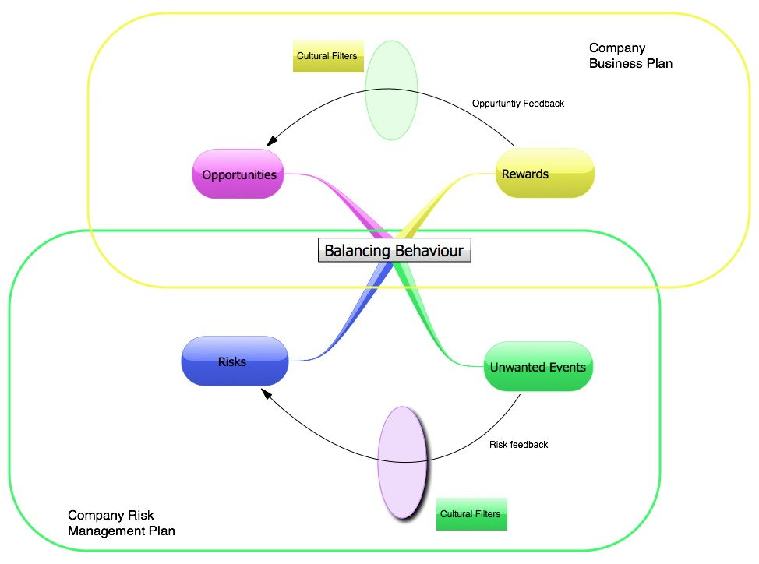
The operating loops provide mechanisms which provide systemic management of our companies. The two loops must balance within a risk tolerance boundary.

Slide 9
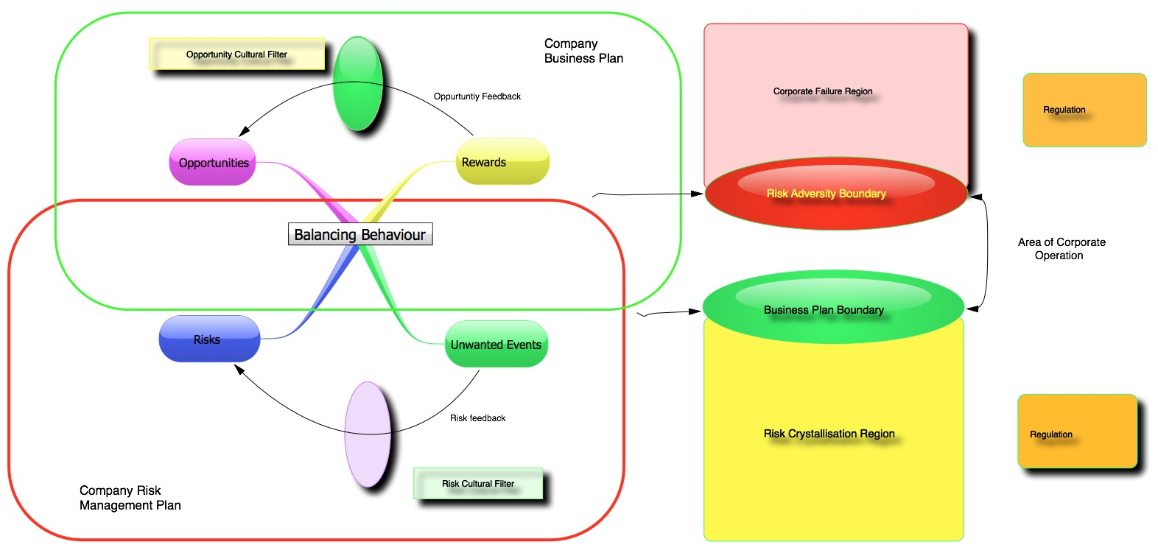

The two loops must balance within a risk tolerance envelope. Corporate reporting systems ensure we remain within the risk tolerance boundaries.

Slide 10
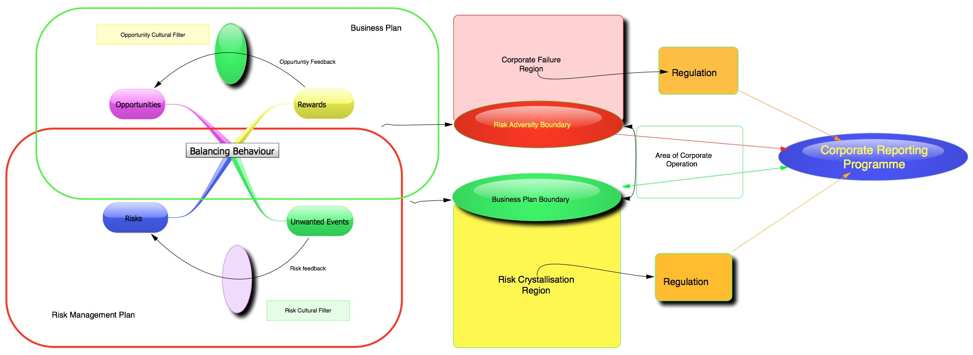

Slide 11
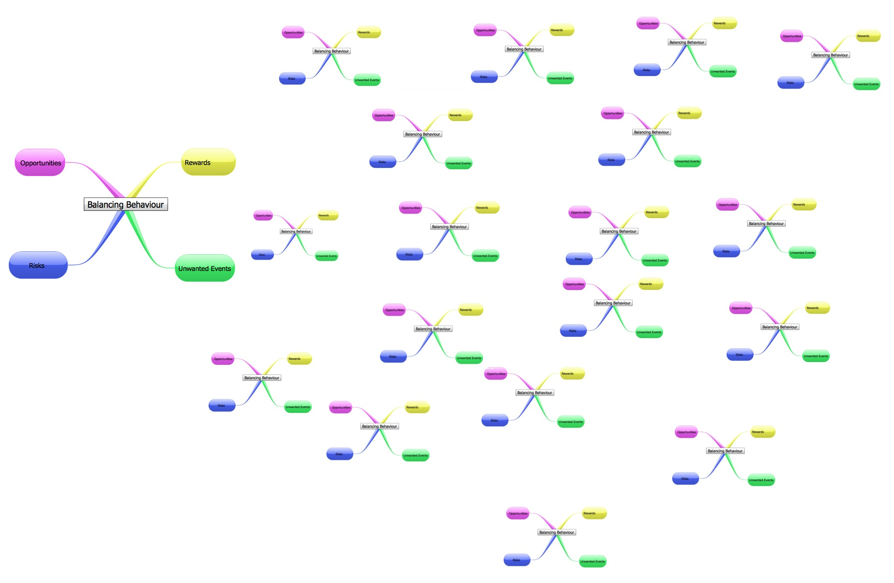
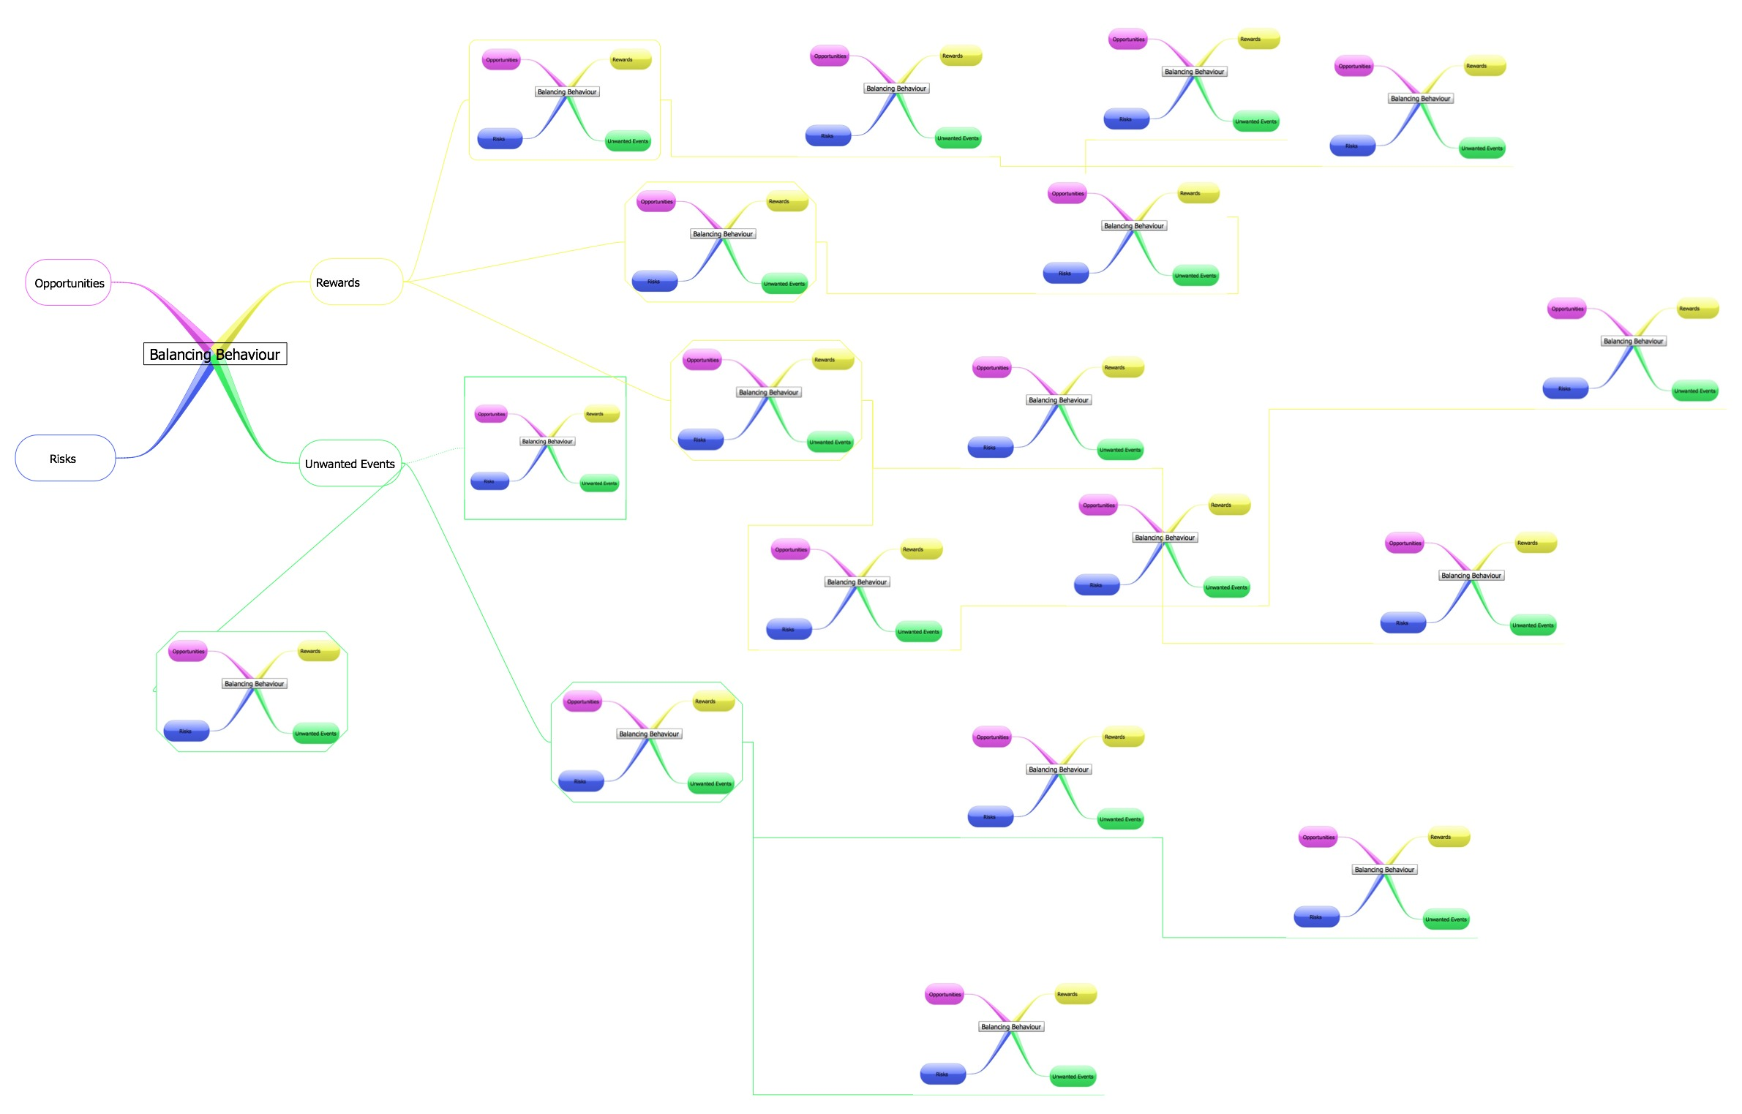
At the same time others are making similar decisions all of which impact on others and you. Thus constant review is necessary to ensure that the original decisions are still correct.

Slide 12
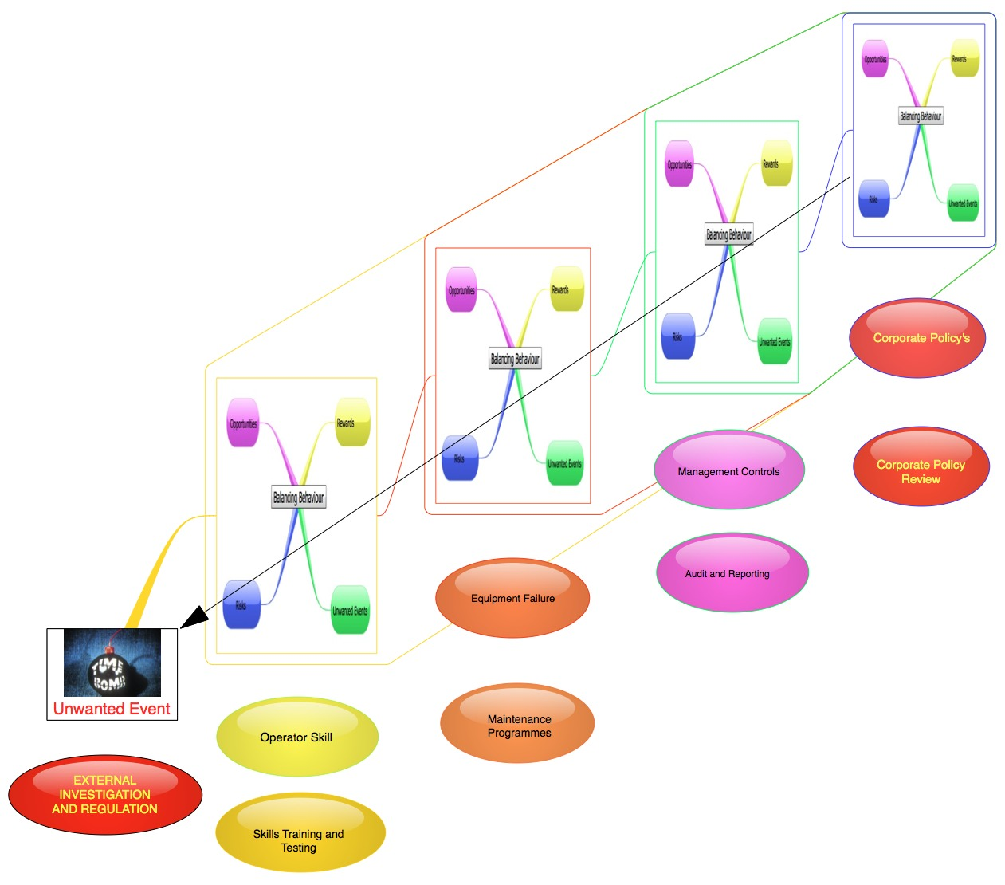
Reasons causation (Swiss Cheese) model suggests when these events line up unwanted events occur. Along with the Adams model we can see how this would happen. His investigation into accidents holds true for other company internal or external situations.
For further reading the reference text is: Reasons Accident Causation Model, Prof Jim Reason, University of Manchester email: reason@psy.man.ac.uk.

Slide 13
ANS in Aviation context
Airborne ANS
All KPAs but Safety expressed in economic terms
SES targets address all 3 KPAs (en-route) and Safety
Estimated TEC ≈ €10.5 B (SES area, 2012)
  ANS-related Airborne equipment to be added
  TEC fully borne by users of European airspace
Performance improvements, more accurate data, different area (SES): lower TEC estimates
ATFM delay and flight-efficiency cost estimates must not be interpreted as ANS inefficiency
  Trade-offs between KPAs
  Optimum is not 0: Minimise TEC
  within acceptable bounds of safety and security
Flight-efficiency
En-route: 1.0 B
TMA, taxi: 1.2 B
2.2 B
ATFM Delays
ER: 0.5, Apt: 0.3
0.8 B
ATCO
2.0 B
Total
User cost
(ground)
€ 10.5 B
Support costs
Other staff
Other operating
3.5 B
User
Charges
€7.5 B
CAPEX
Depreciation
Cost of capital
1.2 B
Other costs
ECTL, MET, NSA
0.8 B
Estimated TEC 2012 (SES)

Slide 14
Performance Plans
SES targets for all 4 KPAs in RP2
(En-route)
Performance also monitored in TMA
Monitoring

Slide 15
Performance Plans
Reactive policy in the 90’s: delays going up while costs going down, and vice-versa
Balanced performance-oriented approach; both delays and unit costs down since 2000
Enforceable SES targets apply from 2012 onwards
Fast traffic growth until 2008: challenge for capacity, but helps cost-efficiency
  Traffic growth much lower now, even negative: Easier for capacity, harder for cost-efficiency

Slide 16
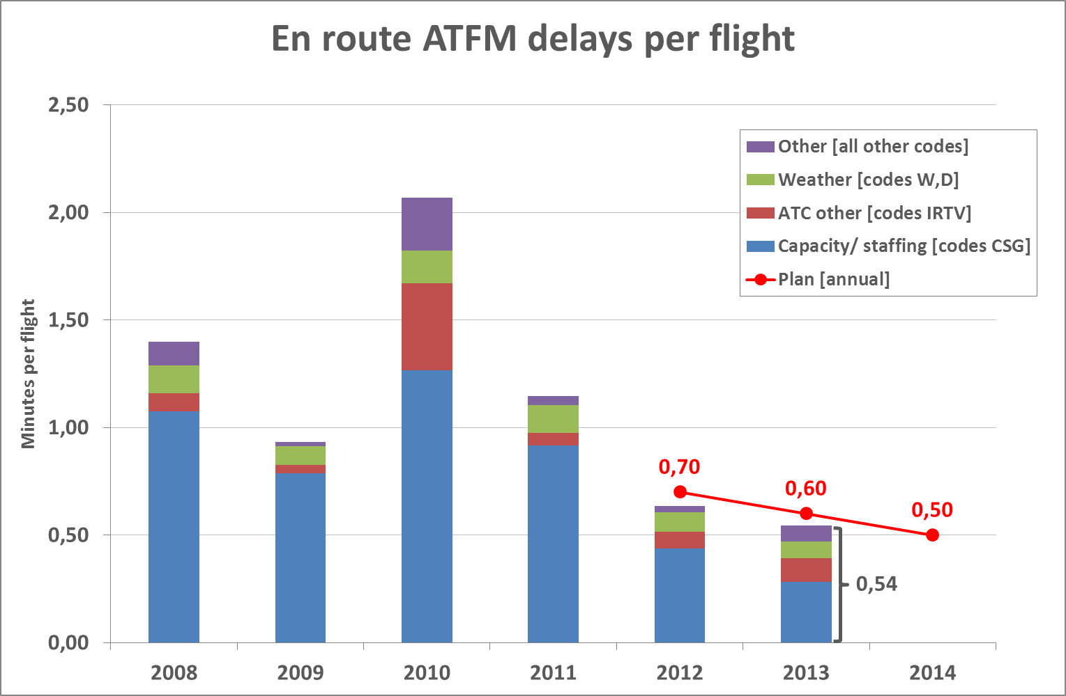
Performance plans
SES States
Challenging SES targets for 2012-2013 were met and even exceeded
Best level ever achieved in ATFM delays!
Challenging target for 2014 and beyond (0.5 min/flight), close to optimum

Slide 17
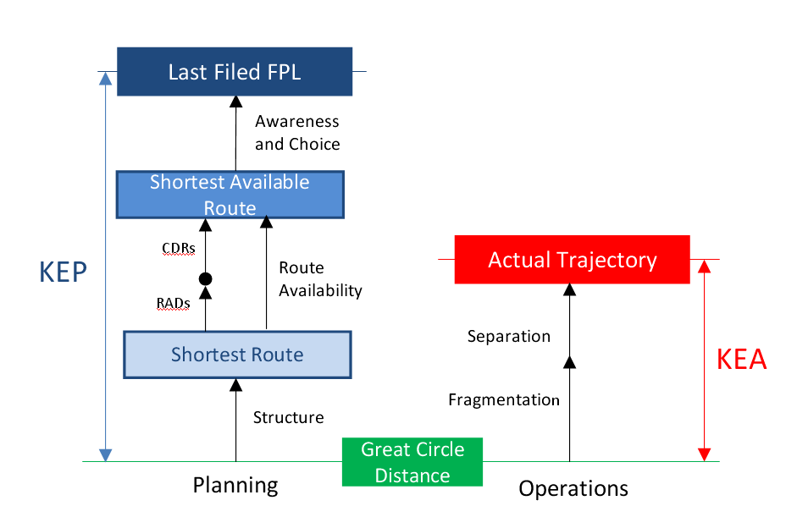
Performance Plans
SES area
Great Circle broken up using Achieved distance
KEP (FPL) and KEA (actual) vs great circle
  Excellent routing efficiency of ANS, certainly best of all transport modes (~ 3%)
  Yet significant economic impact (fuel burn, flight time)
  Impossible to reach 0% with full civil-military traffic load
Improvement in KEA compensates traffic growth (-21% from 2011 to 2019)
    Carbon-neutral growth of aviation (IATA goal due in 2020) already being met by ANS!
Network Manager’s flight-efficiency initiative, aimed at reaching SES targets
  Role of airlines in closing gap between FPL and actual route (predictability)
Further environmental indicators needed (Vertical, CO₂ efficiency…)
  Would require inputs on optimum flight from AOC

Slide 18
Performance Plans
Higher DUC starting point (€58.1) than DUR arising from aggregated RP1 plans (€54.9) in 2014, mainly due to traffic being significantly lower than planned.
Significant improvement under binding SES cost-efficiency targets
Spain played a large role in improvements from 2009 to 2012

Slide 19
Performance plans
~ 7.6B
Major savings from RP1-2 targets:
Some € 7.6B vs. 2012 baseline over RP2

Slide 20
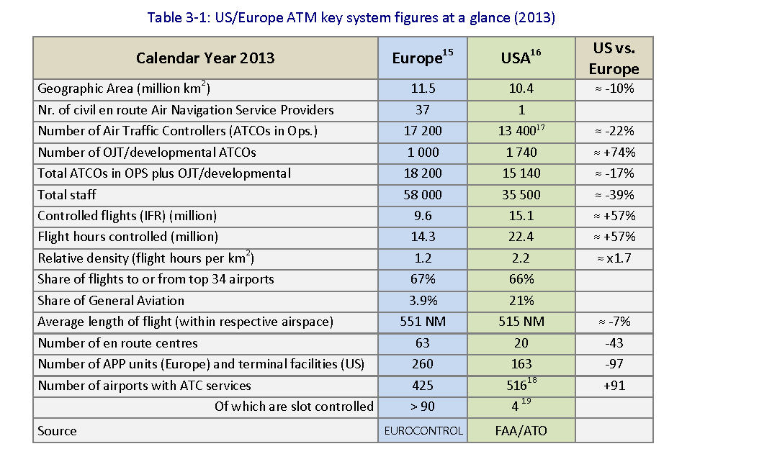
US-EU OPS comparison

Slide 21
US-EU OPS comparison

Slide 22
US-EU OPS comparison
  European unit costs decreased -13% over 2002-2011
  But still some 50% above US in absolute terms (US 34% below Europe)

Slide 23
US-EU OPS comparison
Flight-hours controlled
ATCO-hour
productivity
+55% in US
ATCOs
employment
Cost / flight-hour
- 48% in US
Unit ATM/CNS
provision costs
- 34% in US
ATCOs in OPS working hours
Support costs
per flight-hour
- 25% in US
ATCO in OPS
cost / ATCO-hour
-25% in US
€85 €163
€269 €348
€354 €511
Flexibility is key to ATCO productivity
Support costs: high share, mostly fixed,
opportunity for rationalisation, must be addressed!
Support
costs
ATCOs in OPS
Employment costs
+
ATM/CNS
provision costs
EUROCONTROL/PRU

Slide 24
Future performance improvements
Efficiency gains in individual ANSPs
Airspace improvements (e.g. free routes)
More flexible management of capacity to match demand (ATCO contracts)
New Technology
  PCP investment mostly on ground, can fit within current CAPEX
  Main impact expected in TMA, airport traffic
  Future deployment must have clear positive CBA,
  including Airborne ANS part of TEC
  Efficient SESAR deployment, e.g. joint procurement, maintenance
Rationalisation of service provision and oversight, including restructuring
Very significant further performance improvements achievable in true Single Sky

Slide 25
Human Factor (Cultural Filters)
One of SES 5 pillars
Staff consultation principle in PR
Key to any system drive to change
ATCO active involvement key to PS success:
  Consultation process
  Participation in safety improvement
  Introduction of new technology
  Process optimisation

Slide 26
Capacity (1/6) – Jan.-Sep.
JAN-SEP – not on track to meet the annual target!

Slide 27
Environment – Jan.-Sep.
KPI shows notable improvement in 2014

Slide 28
Cost-Efficiency – SU’s Jan-AUG
+4.2% actual 2014 vs. 2013
-4,7% actual 2014 vs. PP
5 States below -10%
3 States above +10%

Slide 29
Conclusions
Significant progress in European ANS performance
  Best ever ATFM delays achieved in 2013
  Flight-efficiency target leads to carbon-neutrality of aviation for ANS
  Unit costs going down significantly
But margins exist for significant further improvements
  European unit costs still nearly 50% above US’s
  SES targets for RP1-RP2 bring very significant further improvements
  Balance between KPAs is essential
Human factor
  Staff is the main asset to drive the change
  Win-win opportunity
  Change management is key to PS success

