Slide 1
CIPFA NE Region:
Financial Resilience Review
- an update for LA Practitioners
Cliff.Dalton@CIPFA.Org
Head of CIPFA Commercial networks
Tel: 07919 018754

Slide 2

Concern over Financial Resilience not new…

Slide 3
…And here’s why
The funding challenge - 10 years+ of austerity
Spending pressures & demand management
Concern of government and the NAO
CIPFA’s – Response & Support
When things go wrong (Northamptonshire +)

Slide 4
The Funding Challenge

Slide 5
The State of Public Sector Finances
Spending on public services which make up around 85% of government spending has fallen by 1% since 2010
Delivery of services at a lower cost than eight years ago, but many savings down to reduced service provision
Authorities continue to face increasing demand & reduced funding.
Brexit – say no more
Notes:
Efficiency helped by the pay cap in public sector

Slide 6
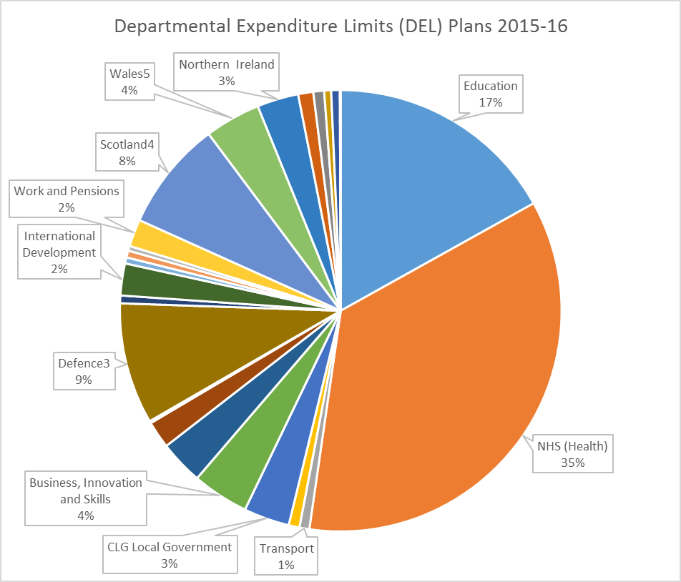

Local Government remains an unprotected DEL

Slide 7
Protected services
Notes:
Note: these are our estimates of what the additional protection will actually cost.

Slide 8
What austerity has meant for L.G.
Sustained real-term fall in gov’t funding
  56.3% reduction in grant since 2010.
Spending on local services
  waste collection, road maint, food safety, trading standards, libraries has fallen sharply
Less flexibility for some
  Children & ASC up to 75% of spend for some counties
Statutory service duties re-imagined
Service delivery not consistent with government policy

Slide 9
Fair Funding & Business Rate Review
Reform of RSG sluggish (quantum and distribution)
Business rate retention also being reviewed - 75% BR retention from 2020/21?
Key aims: simple v complicated; tariff v top-up; reset periods & added responsibilities
System reset may slip to 21/22 because of Brexit
What will the outcome mean at an individual authority level?
Notes:
TIMELINE:
December 2018 – consulted on Sharing risk and reward, managing volatility and setting up the reformed system
Spring/Summer 2019 – Indicative numbers published
Autumn/Winter 2019 – budget process starts
Spring 2020 – system takes effect
Realistic?

Slide 10
Spending Pressure & Demand Management

Slide 11
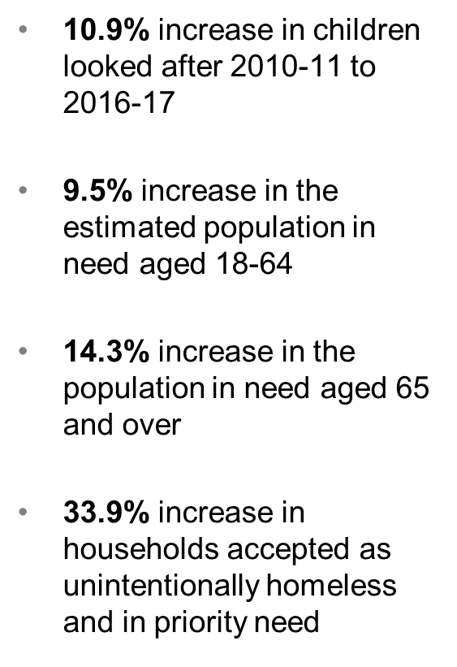
Demand management and forecasting
Source National Audit Office Report 2018

Slide 12
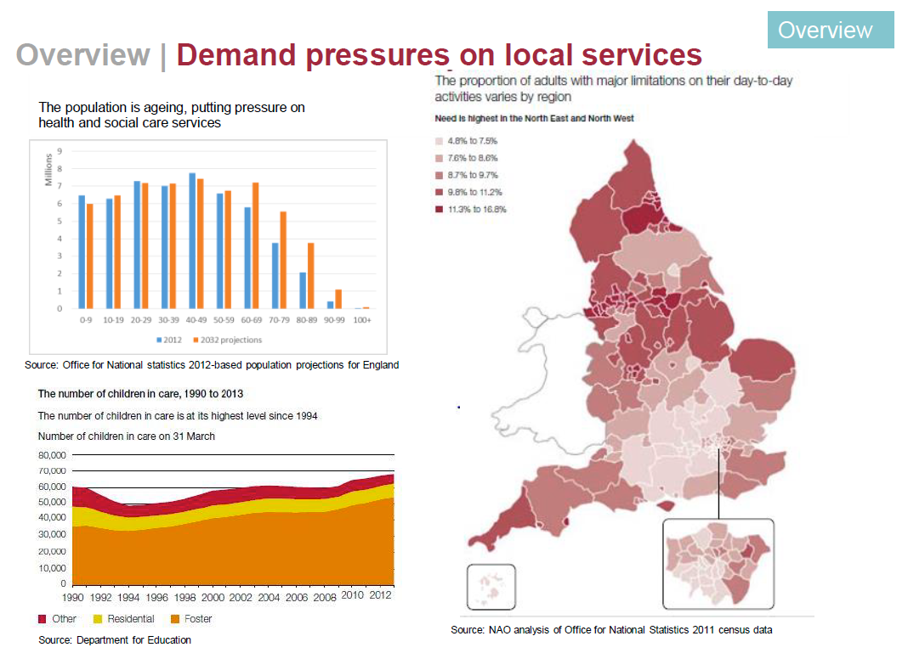
Drilling down the national, a social care example
Notes:
COUNTY COUNCILS AND UNITARY’S PROBABLY EXPECTING MORE FOR ADULTS & SOCIAL CARE UNDER FAIR FUNDING
WILL IT STILL HAPPEN / WHEN? – FF LAST REVIEWED PARYIALLY IN 13/14.
PROBABLY WILL HAPPEN BUT GOV’T MAY NEED TO BE MORE SENSITIVE TO WHO IS MOST AFFECTED?
PROBABLY FF NOT BEFORE 20/21
SAJID JAVID AT THE HELM STILL, BUT HIS SUPPORT FOR BRR NEVER SEEMED TOO STRONG – PERHAPS SMALL RISK OF A RETHINK

Slide 13
ADASS & ADCS – national spend profile
Social Care overspend of £366m in 16/7
More than double the in preceding year (£168m)
75% of councils overspend on children services (£605m)
Total spend pressure around £1bn for 2016/17 (£7m per council)
A trend continuing - £3bn overspend by 23/24
Social Care (green paper) on service delivery and a funding review, continues to be delayed
Copyright © CIPFA 2018 protected under UK and international law

Slide 14
Service pressures – impact of austerity to date
Copyright © CIPFA 2018 protected under UK and international law

Slide 15
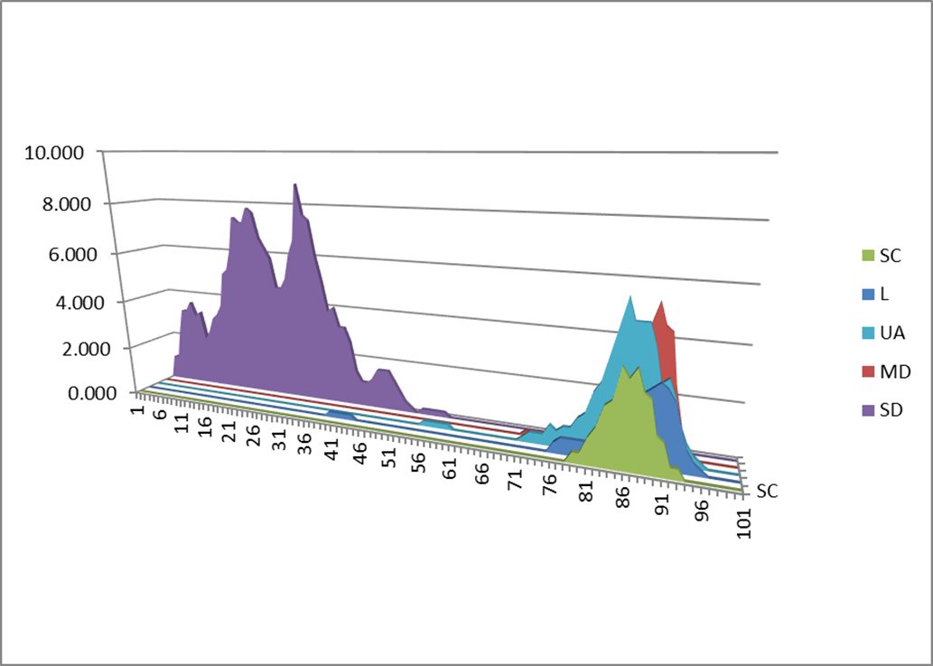
Typical impact on authority types
s.114 territory?
Where are you? – Do you know?
(Source: CIPFA FAS)
Copyright © CIPFA 2018 protected under UK and international law
Notes:
MOST BUSINESS RATE GROWTH UNDER LOCALISED MODEL BENEFITS DISTRICT COUNCILS (80:20 SPLIT)
NH BONUS FUNDING INCENTIVES
SPENDING PRESSURES MAINLY IN COUNTY SERVICES (CHILDRENS & SOCIAL CARE)
NO DIRECT LINK BETWEEN RESOURCE NEED AND SR ALLOCATION
NOT ALL AUTHORITIES ARE BOOMING (POTENTIAL TO GROW VARIES) – FUTURE FUNDING
UNCERTAINTY OVER FUNDING LEVELS AND CERTAINTY BEYOND 2020

Slide 16
Typically, councils are seeing…
Increasing challenge to balance the books, especially for Children / ASC councils
Pressure to generate income via more commercial activities (skills audit?)
Reserves a ‘balancer’ - not always planned
Gearing (% statutory services / GRB) more acute for some
Attitude to risk?
Officers encouraged to sign off questionable plans
  ‘Ethics under pressure’ – next session today from Margaret Pratt

Slide 17
CIPFA – Symptoms of financial stress
A rapid decline in reserves – using reserves to avoid cuts will only provide temporary relief
A failure to plan and deliver savings in service provision, so that councils are not living within their resources
Shortening of medium-term financial planning – a failure to plan ahead could indicate a lack of strategic thinking and an unwillingness to confront tough decisions
Firm objectives missing from savings plan, such as a saving plan with ‘still to be found’ gaps or consisting of targets rather than robust plans; this may also include a tendency for over optimism in timing and scale of savings
Tendency for unplanned overspends – carrying forward undelivered savings into the following year only creates the need for greater cuts in subsequent years.
Notes:
Exhibited by those not likely to have financial resilience

Slide 18
CIPFA’s – Response & Support

Slide 19

2 current Codes of Practice - not enough for current austerity challenges
Accounting: Backward focus
Prudential: Forward focus
Copyright © CIPFA 2018 protected under UK and international law
Notes:
While the content show what we cover it is important to keep these big issues in mind as everything we do in LG is balanced around these
Do we make decision that are good for all / for one
How do we encourage innovation and reward it while not leaving others left behind

Slide 20


CIPFA’s Code stocktake & further development
Professional Proper Practice
Primary/Secondary Legislation
Good Practice
CODE OF FINANCIAL
MANAGEMENT
---------

Slide 21
A new
Financial Management Code

Slide 22
CIPFA Financial Management Code
To ensure financial sustainability going forward, strong financial management is needed particularly where budgets consistently draw on unplanned reserves, a growth in over spending and a lack of medium and long term planning.
A series of principles will be supported by explicit standards.
The code will apply to all local authorities in England Scotland Wales and Northern Ireland including police and fire authorities as well as combined authorities.
While professional standards are being developed a series of finance based indicators are also being developed. The indicators, referred to as the Resilience Index, are by design a diagnostic tool to assist local authorities to understand their financial position.

Slide 23
Principles of Good F.M. - expanded

Slide 25
The Code Hierarchy
Principles
Financial Management
Standards
Statements of Standard Practice

Slide 26
The Code: An Outline Timeline
Stake holder group to agree content and terms of reference | July 2018
Research, recommendations on chapters content initial draft | October 2018
Road tester’s feedback | March 2019
Consultation on Draft Code | Spring 2019
Code ‘Franked’ by CIPFA | July 2019
Code Release | September 2019

Slide 27
A new
Financial Resilience Index

Slide 28
Why the index is needed?
PAC reports on sustainability
Northampton s.114 notice
NAO concerns over further failure
Worrying / diminishing role of s.151 officer
  Place at the top table
  Not always part of strategic decision makers
  CFO voice not always heard…

Slide 29
CIPFA advocates solid foundations and good practice
Getting routine financial management right
  Clear understanding of current position
  Compare performance with others
  Understanding of long term financial strategy
  Responsibility / clear ownership
Cost and service comparisons
  Should be routine and regular
  Clear understanding informed by numbers and PI
  Clear strategy on addressing issues
Notes:
If you exhibited the symptoms what was your cure and put you on the road to recovery

Slide 30
A view of the resilience index in beta form

Slide 31
A view of the resilience index in beta form

Slide 32
A view of the resilience index in beta form

Slide 33
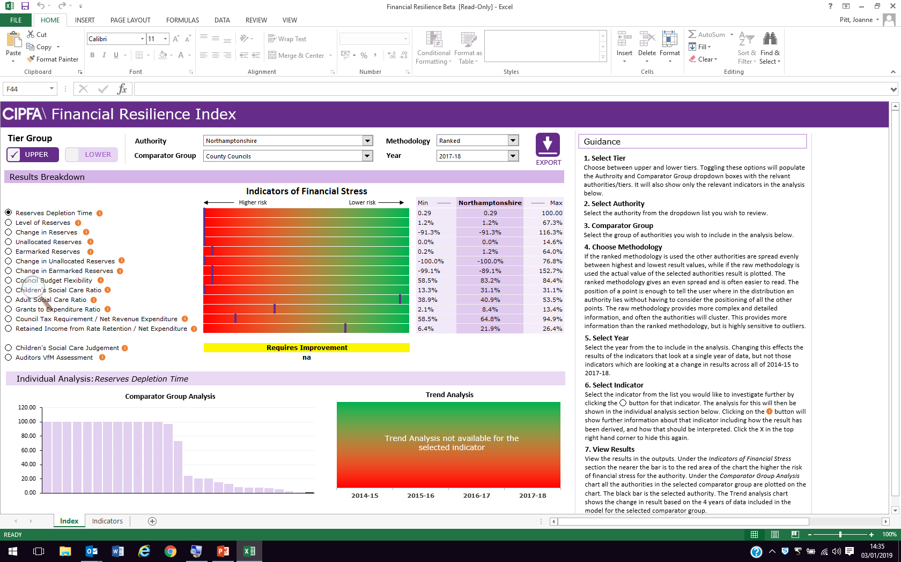
A view of the resilience index in beta form

Slide 34
Prudential & Treasury Management Code

Slide 35
National Audit Office Report(s)
Concern over the changing profile of spend (higher capital LT investment to ease ST budgetary pressure)
Loss of focus on what councils should be doing?
Criticism from PAC principally aimed at DCLG
“Authorities face a growing challenge to continue long-term investment in their existing assets. Capital strategies have begun to shift from focusing on managing assets, to generating revenue savings and commercial income.”
Copyright © CIPFA 2018 protected under UK and international law
Notes:
Local authorities meet the costs of their statutory and discretionary services through a combination of revenue and capital expenditure. Revenue spending covers day-to-day costs such as wages. Capital expenditure relates to investments in assets such as buildings and transport infrastructure. In 2014-15, authorities spent £38.1 billion on revenue to support services and £12.3 billion on capital (excluding education).

Slide 36
Prudential Code updated 2018
Principles of Code apply to Mayors, combined authorities and group entities
Encouragement of local indicators
Requirement to consider explicitly separate ring-fenced funding streams
Development of a clear capital strategy
Copyright © CIPFA 2018 protected under UK and international law
Notes:
With these views in mind, and given the significant changes in public service delivery since last published, CIPFA (following a two-stage consultation in 2017) has revised the Prudential Code to make it fit for today’s and tomorrow’s local authority.
Main changes in the Code include:
Strong agreement (91%) that the principles of PC also applied to mayors and combined authorities but with a recognition that given the diverse structure of these organisations some flexibility should be retained over the application of indicators, with use of additional local indicators encouraged. Principles also apply to residual parent liabilities of subsidiary undertakings within group accounts, i.e. PC principles apply to the impact of subsidiaries on the level of risk and sustainability of the parent LA.
Recognised that limitations exist regarding funding streams from which capital expenditure can be financed. The revised PC requires consideration of affordability of borrowing in respect of all ring-fenced funding streams (including HRA) to be met through use of local indicators. No longer a specific list of HRA requirements, but as it’s material there remains a clear need for separate HRA indicators where you have an HRA.
Mixed response to proposals to remove the indicator relating to council tax impact – idea was to allow focus on a longer term and more informed view of affordability rather than relying upon the use of an indicator which does not represent the actual ability to raise Council tax. 74% were in favour, and the Code will allow LAs to retain as a local indicator if desired.
Main change is requirement to develop and report a capital strategy (84% support) – next slide

Slide 37
New Capital strategy
Full council to approve annual capital strategy
Sets out LT context in which capital expenditure and investment decisions are made
Consideration to risk & reward and also impact on achieving priority outcomes
Links to treasury management strategy
CFO to report explicitly on deliverability, affordability and risk associated with capital strategy
Copyright © CIPFA 2018 protected under UK and international law
Notes:
Council wide responsibility - In order to demonstrate that LA takes capital expenditure and investment decisions in line with service objectives and properly takes account of stewardship, value for money, prudence, sustainability and affordability, authorities should have in place a capital strategy setting out the long term context in which capital expenditure and investment decisions are made and gives due consideration to both risk and reward and impact on achievement of priority outcomes.
It is vital that those charged with governance understand the long term context in which investment decisions are made and all financial risks to which the authority is exposed. With LAs having increasingly wide powers around commercialisation, more being subject to group arrangements and increase in combined authority arrangements, it is no longer sufficient to consider only the individual local authority but also the residual risks and liabilities to which it is subject.
The development of a capital strategy allows flexibility to engage with full council at the time the budget is set to ensure that the overall strategy, governance procedures and risk appetite are fully understood by all elected members. It should be tailored to the authority's individual circumstances but should include commentary on capital expenditure, investments and liabilities and treasury management. The capital strategy should include sufficient detail to allow all members to understand how stewardship, value for money, prudence, sustainability and affordability will be secured.
In developing the capital strategy a balance should be struck between the amount of detail included and accessibility to the key audience. The main focus will be providing a high-level overview of the strategic approach to capital expenditure and investment decisions, with links where appropriate to Treasury Management Strategy.
CFO to report explicitly on the deliverability, affordability and risk associated with the capital strategy and where appropriate have access to specialised advice to enable them to reach their conclusions. (NB commentary and reference to the strategy can be made in the budget report where more appropriate to do so).

Slide 38
Treasury Management Code update 2018
Code covers non-TM investments – but they are not sole responsibility of treasury teams
Recognition that for non-TM investments the principles of placing security and liquidity above yield (SLY) may not be appropriate in all cases but decision should be explicit
Clarity over delegation to avoid duplication
Copyright © CIPFA 2018 protected under UK and international law
Notes:
Same consultation process and publication date as Prudential Code – although awaiting DCLG consultation outcomes on updated Statutory Investment Guidance before publishing sectoral guidance notes which include clarification on some TM indicators. For that reason not all changes may be possible for setting 2018/19 TM strategy. CIPFA recommend that changes be made to reporting of these TM indicators as soon as reasonably possible, and must be fully implemented from 1 April 2019.
Minor tidying of TM indicators to align with financial reporting (12 months rather than 365 days to allow for leap years) – bit of a ‘given’ really – will be picked up in LA Guidance.
Final version of TM Code acknowledges that non TM investments are clearly separate – extension of principles of the Code but they are not the responsibility of treasury teams. For some non-TM investments, principles of placing security and liquidity above yield may not always be appropriate - but that decision should be explicit as need to be clear about the risks.
Clarity over delegation – allows detailed TM work to be done outside of Full Council but FC still responsible - need to avoid any duplication
Organisations designations under MIFID II included – was an oversight in the consultation papers
Additional areas identified for LA Swectoral Guidance, which will follow once DCLG finalise statutory guidance

Slide 39
Recovery…
Clear plans for delivering savings
Single consolidated living document
Linked with budget and medium term financial plan
Distinguish between the different types of savings
    Clear delivery
    In principle
    Proposed
    Thoughts
Managing reserves
  Use

Slide 40
Austerity is changing behaviour in many authorities
Greater use of trading powers (ASDV)
Closer scrutiny of fees & charging options
Treasury Management (financial investment)
Capital Investment (pushing Prudential regime)
Partnership, transformation expectations
More aggressive savings ‘assumptions’
Less rigour on service spend areas (and some extension of optimism bias)

Slide 41
CIPFA’s Ethics Code

Slide 42
Regulatory Code applies to CIPFA members (directly & indirectly)
Duty to work “in the public interest”
Accountants are required to adhere to 5 principles
A revised Code issued spring 2018
Significant pressure (65%+) placed on CFO’s to sign off plans, budgets and/or business cases
CIPFA to launch new councillor network – Sept ‘19

Slide 43
A new
Resources Funding Model

Slide 44
Financial Planning & Resilience…
Far more achievable when more certainty over future financials and trends (income and expenditure).
CIPFA’s new Resources Model takes care of the income side of things
Notes:
7 main funding streams within the RO forms
First 5 are part of net expenditure – last two are netted off gross service expenditure to produce net current expenditure – i.e. are service income
3 different levels of assumption available

Slide 45
What the model does (1)
Projects forward 7 major resource/income streams between 2018-19 and 2024-25
  Council Tax
  Retained Business Rates
  Grant income (incl. RSG, Police Grant, Grants inside AEF)
  Interest & Investment income
  Use of reserves
  Sales, fees & charges
  Other service income
Provides 3 levels of assumption options
  CIPFA central view (default)
  Drop-down options (broad trends over the time period)
  User input (ability to change each figure for each year)
Notes:
7 main funding streams within the RO forms
First 5 are part of net expenditure – last two are netted off gross service expenditure to produce net current expenditure – i.e. are service income
3 different levels of assumption available

Slide 46
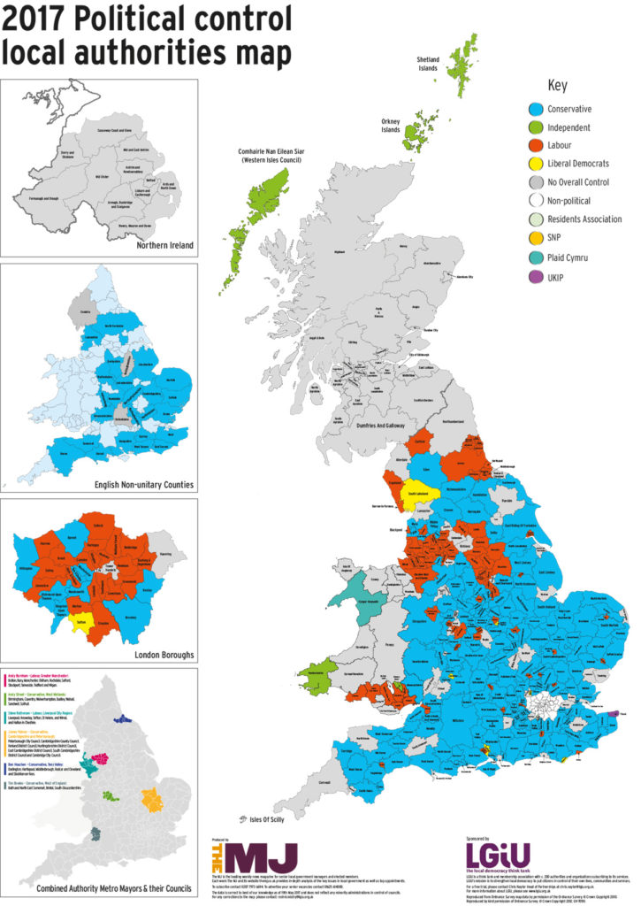
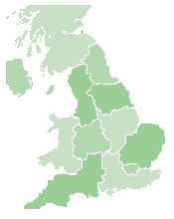
What the model does do (2)
Covers all local English local authorities including:
  Counties
  Districts
  Unitary Authorities
  Metropolitan Districts
  London Boroughs
Provides the ability to compare against comparator groups
  Authority type
  Region
  Nearest neighbours
  User defined
  Fire & Rescue Authorities
  Police & Crime Commissioners
  National Park Authorities
  Waste Disposal Authorities
  Combined Authorities
Notes:
Coverage = all English LAs
Ability to compare with others (need to see how important this feature is for users)

Slide 47

What the model does not do
Predict the outcome of the Fair Funding Review
Predict the outcome of the 75% BRR scheme
Profess to know what the Spending Review may hold in stall for local government
Provide anything other than informed assumptions
Provide actual funding figures (beyond 18-19)!
Notes:
Some health warnings!
Exclusion of grants outside AEF and education grants as LAs has no control over them
Not predicting outcome of FFR or what 75% BRR scheme looks like – or outcome of SR19
Important point is that these are forecasts based on assumptions – not actual funding figures!

Slide 48
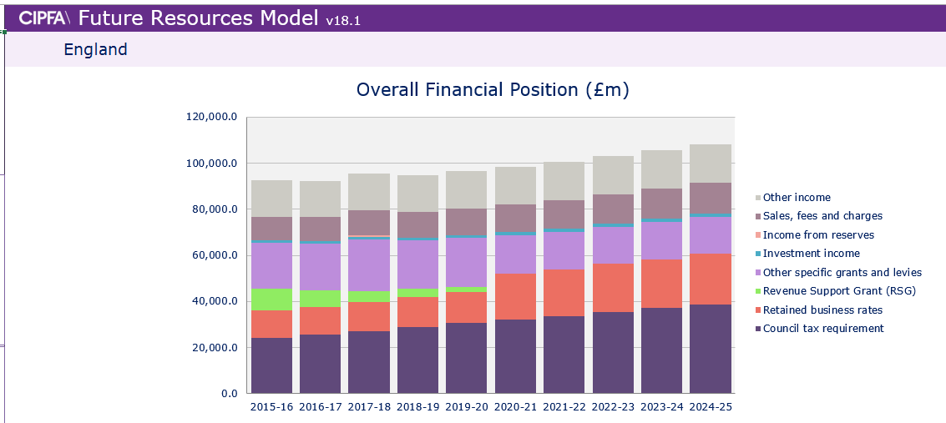

Slide 50
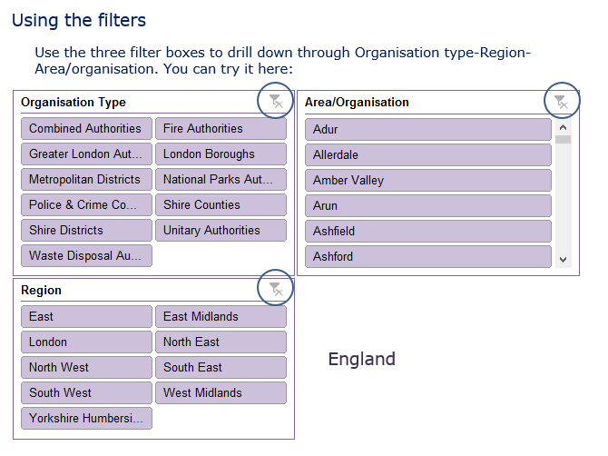

Slide 51
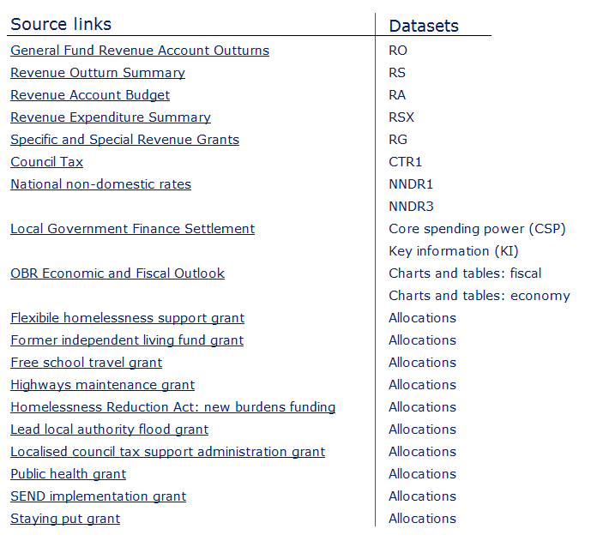

Slide 52
External assurances (audit)

Slide 53
NAO reports
Qualified conclusions on VFM unacceptably high and increasing
Proportion of local public bodies whose plans for keeping spending within budget are not fit-for-purpose
A risk to public money and undermines confidence in how well local services are managed.
Local bodies need to demonstrate they are managing organisation effectively, and take local auditor reports seriously
Those charged with governance need to hold their executives to account for taking prompt and effective action
Copyright © CIPFA 2019 protected under UK and international law

Slide 54
Other developments
NAO will be consulting on a new Code of Audit Practice during 2019, for adoption in 2020
NAO has published a report on Local Government Governance, this includes findings on the adequacy of local governance arrangements
The Kingman report on the Financial Reporting Council in December 2018 recommended that “arrangements for local audit need to be fundamentally rethought”
Copyright © CIPFA 2019 protected under UK and international law
Notes:
NAO report on governance is imminent
Kingman report: Independent Review of the Financial Reporting Council commissioned by Secretary of State Business, Energy and Industrial Strategy

Slide 55



Where things have gone wrong ☹

Slide 56
The Northampton Diagnostic
Financial Rigour
  Structural revenue deficit not addressed for several years
  Savings plans set but never achieved and no clear plan
  No assessment of statutory minimum spend
  Plans for savings in non-statutory services reversed
  Authority’s 2018/19 budget-setting process was flawed – KPMG Advisory note
Financial Sustainability
  Council Tax not pushed into referendum territory
  Reliance on a drawdown of reserves
  Reliance on other ‘one-off’ funding options (earmarked reserves, write back of general provisions, MRP reassessed, use of s.106 developer contributions)
Notes:
NORTHAMPTON DIAGNOSTIC – S.114 NOTICE (LGA ’88) – 2ND FEB ‘18
KPMG STATEMENT OF REASONS
UNBALANCED BUDGET FOR SEVERAL YEARS.
HEAVY RELIANCE ON ‘ONE-OFF’ MEASURES NOT SUSTAINABLE TO MITIGATE STRUCTURAL DEFICIT IN REVENUE BUDGET
SAVINGS REQUIREMENT SET OF £65M IN 2016/17. AND NO TRANSPARENT PLAN ON HOW TO ACHIEVE
RESERVE LEVELS BY JANUARY 2018 WERE @ £17.8M

Slide 57
The Northampton Diagnostic
Demand management
  ASC & Children services significant and repeated overspend
  No clear strategy to identify and manage demand-led budgets
  No link between demand forecasting and departmental budgets
  No identity between statutory & non-statutory spending areas
  No clear ‘alternative methods’ of managing demand of these high spend areas
Innovation & Transformation
  Creation of ASDV (Northampton Trading Ltd & Olympic Care) incurred significant costs and caused operation and organisational disruption – services set to be reintegrated
  Doubt on whether capitalised revenue was under qualifying transformation criteria
  Heavy use of ‘Capital Flexibilities Direction’ (capitalising large revenue costs under ‘transformational projects’

Slide 58
The Northampton Diagnostic
Lack of prudence in financial planning
Absence of robustness in discharging the accountability & transparency of statutory guidance
Transformation projects – not sufficiently overseen, monitored & reported by those charged with governance of process
Strained relations (and trust) between officers and members
Notes:
CAPITAL FLEXIBILITIES DIRECTION – S.15(1)(A) LGA 2003

Slide 59
CIPFA NE Region:
Questions?
Cliff.Dalton@CIPFA.Org
Head of CIPFA Commercial networks
Tel: 07919 018754

