Slide 1
Service Delivery Models
Mike Suarez
Chief Executive
Cheshire East Council
5th December 2013

Slide 2
Content
Local context
National context
What’s out there in terms of approaches/ models?
Cheshire East Approach
Case Studies
  (ASDV) Alternative Service Delivery Vehicles
  Partnerships
  Outsourcing
  Shared Services
Conclusions

Slide 3

Ninth largest unitary in England
Population of c372,000, forecast to
rise to 384,000 by 2029
Average household income is £32,600pa –
15% above the GB average. Wide variations from £18,000 in some parts of Crewe to about £65,000 in areas such as Prestbury in the north.
Tatton Park is the most visited attraction, delivering an annual net output to the local economy of at least £8.8 million.
Cheshire East contributes 6.7% of GVA to the North West regional and hosts more businesses *17,400) than any other unitary authority in the region.

Slide 4
Cheshire East
Beautiful place to live
  from Tatton to great schools
Great place to work
  17,400 businesses
Vision: resident and business led organisation
Economic Prosperity Key Driver
Strategic Response – Commissioning Council founded on five outcomes and prepared to adopt a “best of breed” approach

Slide 5
An era defining moment for Local Government!
No real growth expected in UK public sector spending for at least 10 years
The second wave of Government austerity funding costs in 2015-17 anticipated to be as high as before
By then, the rising costs of Social Care and Waste will take 80% of many Councils’ spending
Our demographics are changing with the growing number of elderly people increasing pressures on Council provision
Public expectations are high with Councils expected to do more for less and to achieve greater value-for-money
Demand for services is high with some mixed expectation of uniform provision

Slide 6
How is Cheshire East responding?
Strengthening the Top Team
Reshaping the Council, so that it works as a single organisation
Better defining the role of the organisational centre
Helping people reduce or break their dependency on public services – through prevention and early intervention, reablement and support to live independently, and enhancing their ability to do more for themselves
Separating the design of services from their provision and using new ‘vehicles’ to deliver services differently
Learning new skills, using new tools, and changing how people work, to improve productivity
Better purchasing of goods and services, and better use of land and property, to reduce costs
Reducing wasted effort and duplication

Slide 7
Delivery Models
New models are emerging - examples include:
The Easy Council
The Co-operative Council
The Strategic Commissioning Council
Wide-scale outsourcing

Slide 8
With similarities within each model
Outcome focus
Working with citizens, users and residents to co-design services
A harder split between service commissioning and service provider functions
Smaller corporate centres
Leaner structures
The emergence of matrix management
Relationship management to the fore

Slide 9
Cheshire East Council: “Working Together” to meet the needs of residents and businesses with our staff and partners
Identified eight approaches to commissioning, eg from mutuals to outsourcing
Going to cover five areas
  Wholly owned companies
  Trusts
  Partnerships
  Joint Ventures
  Outsourcing

Slide 10
Bringing the model to life – shaping the Council
Role of Members
New structure/operating model
Management Review – roles and responsibilities
‘Core’ integrated multi-disciplinary team
  10% of the Council’s resources (400 staff)
The remaining resources directed to maintain essential front line services
Matrix management - the end of silo working
Opportunity for new pay structure and PRP
Notes:
Strategic Commissioning strengthens the role of elected Members – it is all about their relationship with local residents, who should have a stronger voice and input into commissioning decisions in future. We need to (and still are) getting them ready for this.
Members will need to ensure that what is commissioned really reflects the priorities and preferences of our local communities, and that they are able to facilitate putting the necessary changes in place quickly.
Identified a set of clear principles for carrying out a management review to ensure we didn’t fall into the old traps of simply reflecting outmoded structures based on professional groupings. The old structure of two large “Directorates” for People and Place based services had served its time. It created silo working and prohibited us becoming a fully agile organisation ready for change.

Slide 11
What does this mean for Residents?
Flexible responsive services tailored to the needs of residents
Increased investment in services
Better value for money and more choice for residents
New local employment opportunities
Services that continue to be accountable and transparent

Slide 12
What does this mean for Staff?
Longer term job security in the rapidly changing jobs market
Empowering staff to develop and implement new ideas
Services that fully utilise the entrepreneurial skills of staff
Staff will be central to shaping the future of their service
Staff will be supported to diversify skills sets in order to improve the customer experience for residents, business and service users

Slide 13
Guiding principles for our new operating model
Clear individual accountabilities for groups of related ‘functions’
Larger spans of control
Less hierarchical – authority based on outcomes and project priorities (devolved)
Clarity around statutory accountabilities as part of the ‘core’ of the Council
Emphasis on the leadership of change, engagement of staff and entrepreneurial skills
Notes:
All jobs were newly created
Thorough assessments – Penna – to test for these new skills
formal authority will be devolved so that assessments and decisions can be taken and executed where they need to be made, as close to the frontline as possible, in order to produce better performance and more speedy and responsive action;
the role of “corporate support services” is to facilitate and support frontline service change and innovation, within an effective framework of identified and well-managed risk;
the clear expectation of consistent and visible compliance with agreed values and behaviours, as part of a new organisational culture and as a catalyst for change;
the effective securing, organisation and deployment of all (collective) resources, in ways which increase “public value” in securing priority outcomes for local people, as part of a single “Team Cheshire East” approach;
every role exists to enable delivery of the objectives and added value of the whole organisation, from the perspective of our local residents and communities;
management roles enable local people and our partners to interact with us easily and effectively; and
common processes and tasks are done in one way, by one team, without duplication elsewhere or hand-offs to others, both internally and externally, with quality assurance at both the beginning and the end.

Slide 14
Strong emphasis on agreed values and behaviours as a catalyst for change
In designing new roles, clear focus on adding value to the whole organisation, from the perspective of local residents and communities
Clear split between Corporate Support Services and Provider/Delivery/Commissioning roles

Slide 15
Our Commissioning Plans
Phase One completed
Tatton Park Enterprises
Engine of the North
Phase Two in progress for April 2014
Leisure Trust
Environmental Services
Bereavement Services
Shared Services SLE
Phase Three and beyond

Slide 16

The journey so far
A great start to a very ambitious
Programme CEC and our new ground
For example - Tatton Park Enterprises
A new catering service
Operating since November 2012
Highly successful
Performing well beyond our plans
Turnover up £200k = 20%
Net contribution to the running of the Park up 39%
Ensuring a sustainable future for the service & the historic landmark

Slide 17
Example 2 - Engine of the North
To:
Develop our land assets
Maximise opportunities for business employment & housing growth
Attract investment through improving connectivity & infrastructure
Sustain growth by development works to create strong resilient local communities

Slide 18
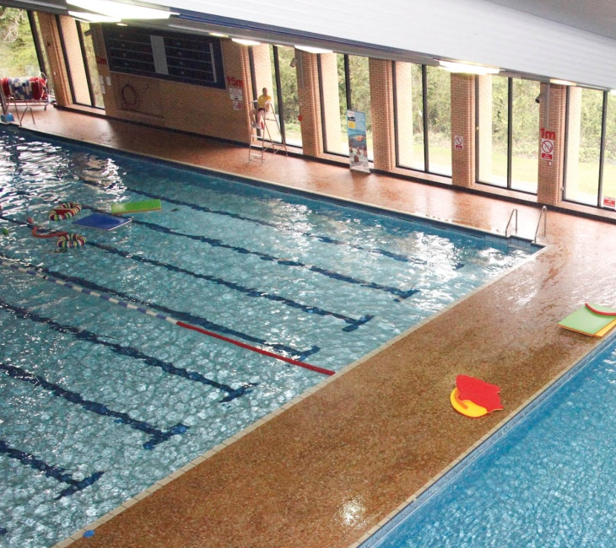
Leisure Trust (Everybody Sports & Recreation Ltd)
Including leisure centres and sports
development
Focusing on improving the health and
wellbeing of local residents
Whilst improving the current leisure offer
Savings on VAT and NNDR
Investment in facilities – new lifestyle centre programme
And the refurbishment of our facilities

Slide 19
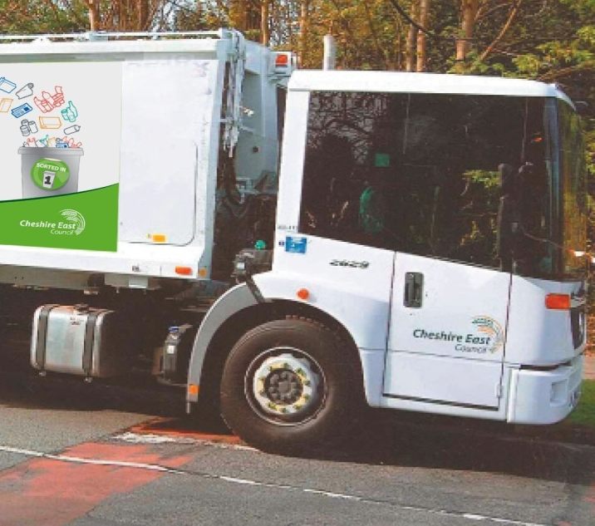
The next leg of our journey
Environmental Operations (ANSA)
Including Waste Management Fleet
and Street Cleaning
VFM through £2.5m of savings identified by 2016
Whilst delivering to the same high standards
An improved service with
  Reduced landfill costs and impact
  Increased investment in our fleet
  Promoting a sustainable environmental future for Cheshire East

Slide 20
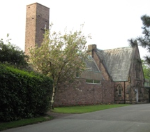
Bereavement Service (ORBITAS)
Investment in new low emission burners across our crematoria
Further investment planned in these key facilities
Greater choice
With a broader range of services being offered
And delivered with a dignified and sensitive approach

Slide 21
Jointly-Owned Company:
Cheshire Shared Services SLE
Shared Services delivered jointly between Cheshire East and Cheshire West &Chester Councils by Joint Committee
Covers ICT, HR and Finance Shared Services
Separation between client and supplier
Fosters a commercial culture
Enables capacity growth
Generates savings whilst retaining Council control
Teckal exemption permits parent Councils to commission services from the SLE without going through a competitive procurement provided the parent Councils retain ownership and strategic control of the SLE

Slide 22
Partnership: Four4Adoption
Four4Adoption is an award-winning partnership between four local authorities
Working together to make the adoption process as seamless and effective as possible for children and prospective parents
Cheshire East is a member of the Four4Adoption partnership alongside Tameside Metropolitan Borough Council, Trafford Council, and Stockport Metropolitan Borough Council
The partnership aims primarily to encourage more adoptive parents
Improving the suitability of the matching process by utilising a wider area pool
The partnership triumphed in the ‘Best Local Authority’ category at the British Association of Adoption and Fostering awards in November 2013

Slide 23
Outsourcing: Ringway Jacobs
In October 2011 Ringway Jacobs were awarded Cheshire East’s contract to deliver Highways Service for the Borough. This encompasses maintenance, construction, traffic management, and road safety. The contract is for a period of 5 years, with the possibility of it being extended for up to 7 years - dependant on performance.
The contract is based upon the principle of integration between the public and private sector, with staff coming together to deliver a seamless customer experience that draws upon the skills and capacity of each organisation.
The partnership is seen as an example of national best practice in managing a public and private venture to achieve superior service outcomes, and is only the second example of such a contract nationwide.

Slide 24
The Future – Phase Three and beyond
We will continue to explore new approaches to delivering services
Wherever we can improve the customer service
Or offer better VFM
Potential options including a Transport Company to look at
Grant funding for sustainable transport initiatives
Continued investment in our walking and cycling infrastructure
Handing transport assets to the community

Slide 25
What we have learnt?
Be open minded on approach to procurement
To invest time in being prepared
To develop the required capacity and capability
To be ready for the pace and scale of change
To implement the best solution to deliver for our residents, businesses and services users
To design robust and enabling decision making and governance arrangements
Notes:
Be ready – 4 strands of activity – SC – ICF – Delivery & Framework/support – develop the processes – agree the principles - answer the questions
- also be clear as to what SC is – won’t be the same from one LA to the next
Capacity – get the right people into the 4 teams – use experienced people from outside to guide – resource support services
Capability – develop your awareness & competence – as discussed earlier – commercial awareness etc – bring people in
Pace & Scale – be prepared – manage expectations – the pace – comms comms comms
Best of Breed – to SC – know how you will do it – options appraisal – CBA – business case
Decision making – keep process simple – detailed B Case - LGA 2003 – ODPM – KPM – good challenge in the organisation
Governance – standard stuff re Shareholding etc - but take good advice – the contract to tie down governance-wise – detailed method statements KPIs etc – but also the reporting audit and any scrutiny – need ICF to be involved at this stage – 2 sides of the table – 2 levels of F CP rules – depending whether contracting authority or not – industrial or commercial character – if contracting then public procurement rules apply – etc

Slide 26
To manage through our Intelligent Client Function and the contracts/specifications
To develop suitable business/financial systems
To be clear on the ongoing provision of support services
How to treat our Assets and their maintenance
Clarity around the employment position
And finally no one has all of the answers and there is no one model that will fit all circumstances
Notes:
Contractual arrangements – 4 elements – strategic – tailored – detailed method statement – KPIs – fit for purpose
Business/Financial systems – longer term issue for Oracle and others – a new offer? – short to mid term need to stay with current system – group accounts – control environment – otherwise new costs – duplication – interchanges – inputting etc – our info to the necessary standards
Support Services – catch 22 – commercial freedom v org reduction – managing to control costs and support staff - incubation period – financial system – TUPE to come back to
Assets – who retains the asset – who maintains – do we have sufficient budget to transfer with responsibility – tapering the responsibility – Trafford example – leases and rents what to charge and the issues – Charitable Trusts and retaining the asset
Employment – engagement and buy-in as earlier – flexible re TUPE as our own companies – support services largely not to transfer – considering plans to incentivise performance

Slide 27
The Journey continues ...

