Slide 1
Town centre development
Presentation by:
Rebecca Hudddleston
Head of Customer Transformation
Date
08/09/2017

Slide 2
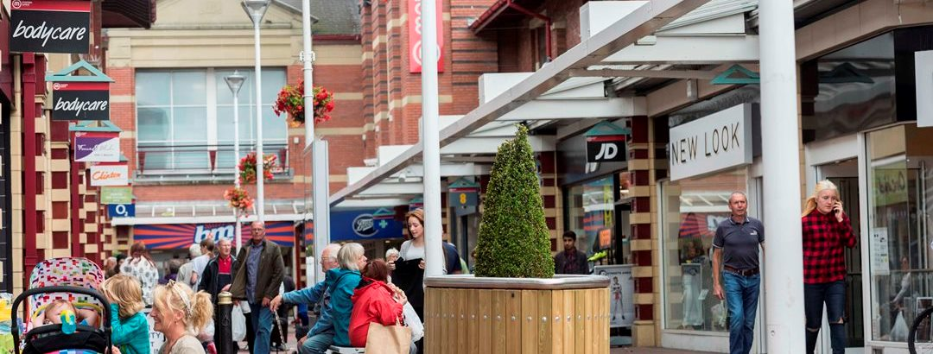
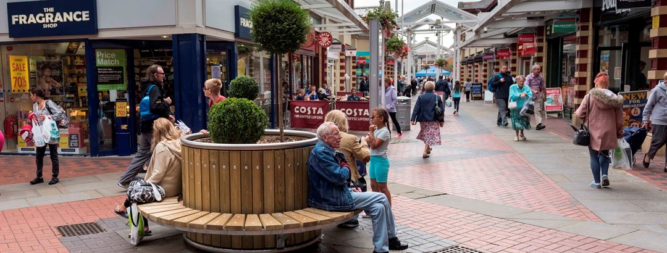
Market Walk
Built in the mid 1990’s
35 Units
26 National retailers
Lease agreements secure for 5-7 years
Well positioned near:
Low cost parking
Bus and train stations
Indoor and outdoor markets
Notes:
Existing strengths – low vacancy rates 4.7% in 2014 against a NW average of 14.2% and national average of 11.9%
Some of the lowest parking charges
2.25m people with half hour drive
Affluent area

Slide 3
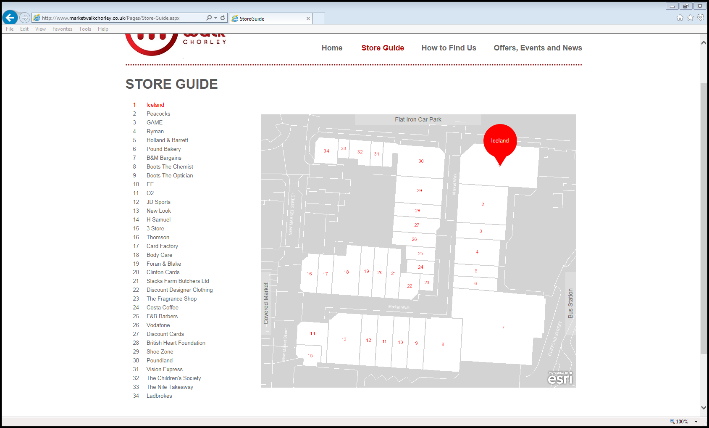

Slide 4
Background to the purchase
A vibrant town centre is a key priority set out in the Council’s Corporate Strategy and Economic Development Strategy.
Deloitte were commissioned to refresh our Town Centre Masterplan in 2013.
During this process in September 2103 they discovered that the existing owners were looking to sell Market Walk.
This opportunity was discussed at a Full Council meeting and agreement was given to:
Entering into an exclusivity deal
Carrying out due diligence - £50,000 budget
Establishing a member steering group to oversee the process
The Council purchased Market Walk for £23 million in November 2013.
Notes:
The property is currently owned by Orchard Investments who hold it pursuant to a fixed 2 year investment vehicle which expires in autumn 2013. The investment vehicle requires Orchard to either re-finance or sell MWSC by the end of November 2013.

Slide 5
Financials
 | 2013 | 2017
Purchase price/valuation | £23m | £21m
Voids | 6% | 0%
Net income | £383k pa | £900k pa
Financing £23m over 50 years
Voids over 25% would mean the scheme is no longer viable
The increase in net income is due to:
All the units being filled
Better terms agreed with tenants
Internal borrowing
In sourcing the shopping centre management

Slide 6
Outcomes achieved
The market walk shopping centre is now:
Full - no vacant units
Earning more - improved lease terms agreed with existing long term tenants such as JD sport
More vibrant and a focus point for numerous events
Online - better communications and marketing with information about offers and events
Better maintained
Cleaner

Slide 7
Market Walk Extension
Notes:
Cllr Bradley

Slide 8
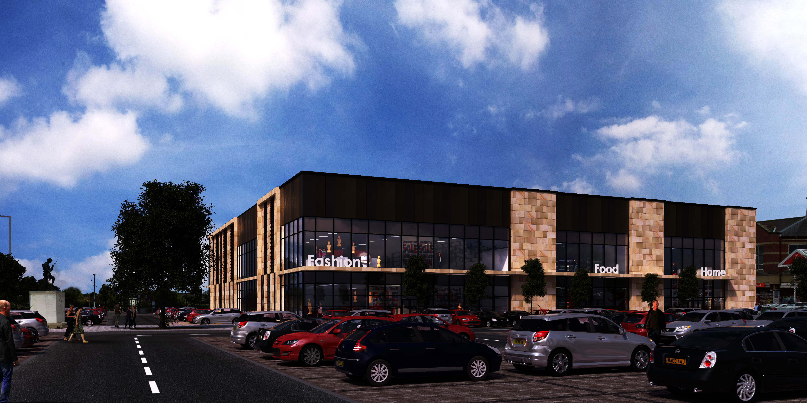
Notes:
Gary Hall

Slide 9
The vision
To improve the retail and leisure offer in the town centre, attracting quality national retailers and more visitors, creating growth and opportunities for the future.
Notes:
Cllr Bradley

Slide 10
High Level Timeline
Purchase of Market Walk – Nov 13
Feasibility study approved – May 14
Full planning application submitted – April 15
Full planning application approved – Sept 15
S73 application submitted - Jan 17Pre construction services agreement signed – Jan 17
Flat Iron Market relocated – July 17
Main build due to start – Oct 17
Reconfiguration of the Flat Iron car park – May 17
Opening Christmas 2018
Notes:
Stakeholder consultation x 2
Car parking study commissioned
Market consultant commissioned
Lettings
Regular reports to members

Slide 11
Financial Case
The feasibility study demonstrated that a return could be achieved albeit not on the level that a private developer may accept.
It is expected to recover its costs and result in modest returns as well as achieving an improved offer to the town centre and developing the local economy.
Our MTFS includes £400k net income from 2019/20 onwards
Build Costs - £10.7m
This will be financed through a combination of developer contributions, reserves, CIL and receipts and prudential borrowing (up to 50 year term, based on asset life).
The rate of return for the scheme is 4.71%
Net distributable income - £434k pa based on full occupancy
Value of the development on completed and at full occupancy - £11.9m
It is also expected to have a positive impact on the rental income and development value of the existing MW centre.

Slide 12
Wider Benefits
The development enables the Council to take more of a lead in reinvigorating the town centre by bringing quality national retail and leisure opportunities to the town to complement existing market and independent traders. As well as delivering a sustainable revenue income there are numerous wider benefits that are Council are aiming to achieve, these include:
Job creation – approx 200 anticipated
Attracting more visitors to the town centre and encouraging them to stay longer
Improving the night time economy
Increasing footfall in the town centre, benefitting existing shops and traders
Developing a land mark building
Improving the public realm in the town centre
Increasing resident satisfaction in the town centre offer
Notes:
Business rate income
On market days town centre footfall has increased by 60%

Slide 13
Chorley’s approach to income generation
Chorley Council are progressing a range of projects which will deliver the Council’s priorities as well as generating sustainable revenue income. Some examples include:
Market walk
Primrose gardens retirement scheme
Digital health park
Enter the utility supply market
Establish a housing company
Notes:
Grant thornton
Improving the economy
Clean, safe and healthy communities
Involving residents in improving their local area and equality of access for all.
Primrose - £9m – independent living for those aged over 55 years with some care and support provided to those who need it.
Digital ofice - £8m bringing together digital health and health care
£300k returns by 18/19

Slide 14
Questions
Rebecca.huddleston@chorley.gov.uk
01257 515779

