Slide 1
North West CIPFA Student Network
NW:CSN

Slide 2
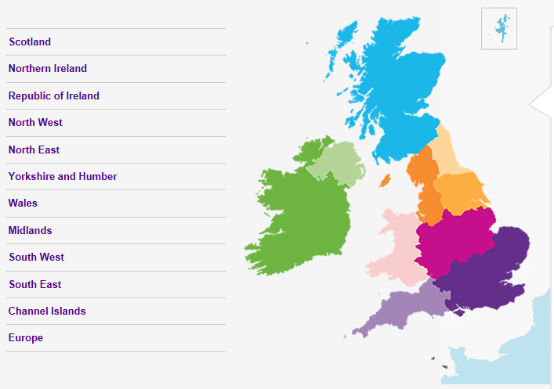
CIPFA Regions

Slide 3
CIPFA North West Regional Society
Society Council
Northern and Southern Members Groups
Audit, Risk & Governance Group
Senior Management Group
Student Network

Slide 4
What is the North West CIPFA Student Network?
“The purpose of the CIPFA Student Network is to give students globally a voice within CIPFA, working with and challenging CIPFA on behalf of all students to enhance the student experience”

Slide 6
Volunteering with NW:CSN
Provide support to students
Bring about positive changes
Promote NW:CSN
Represent the Student Network at regional events
Meet like-minded individuals
Shows your commitment as a finance professional
Builds confidence and develops skills
Contribute to the regional development plan
Highly rewarding

Slide 7
NW:CSN – An overview of the past 12 months
Feb 17 | Excel Training Course, PQ Magazine Awards
March 17 | AGM
April 17
May 17 | Revision funding with CETC, Strategic Level Revision Day
June 17
July 17 | Drinks Reception at CIPFA Annual Conference
Aug 17
Sept 17 | Revision funding with CETC
Oct 17 | Launch Student Instagram account
Nov 17 | Regional Conference, Strategic Level Revision Day
Dec 17 | Community Day, Exam Report to CIPFA
Jan 18 | Community Day
Feb 18 | Community Day, PQ Magazine Awards

Slide 8
Upcoming events
Soft Skills Day
Excel Training Day
Strategic Level Revision Day
Community Days (monthly)
Sixth Form Business Games
Annual General Meeting

Slide 9
Annual General Meeting (AGM)
This year’s AGM will be hosted at Wigan Council:
Friday 2nd March 2018
AGM from 1:30 – 4pm
With lunch served from 12:45
Wigan Council – Wigan Town Hall
Library Street, WN1 1YN
Please contact us on NorthWestStudent@cipfa.org for further information if you wish to attend

Slide 10
For further information about anything in this presentation or if you would like to volunteer please get in touch:
@nw_csn

