Slide 1


CIPFA Scotland Public Finance Conference 2015
It’s a (pensions) revolution!
Richard Warden
Catherine McFadyen
26/27 March 2015

Slide 2
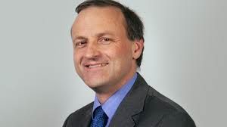


Agenda
    Freedom and choice
Member take-up in LGPS?
Impact on LGPS funds
Notes:
Steve Webb, Pension Minister – major reforms – auto-enrolment, cessation of contracting-out (single state pension & triple lock g’tee), & now freedom & choice

Slide 3
Freedom and choice

Slide 4
Freedom and Choice
George Osborne:
“This Government believe that individuals should be trusted to make their own decisions”
“From April 2015, everyone over the age of 55 with defined contribution pension savings will be able to access them as they wish subject to their marginal tax rate.”
“I am pleased to say the reforms have overwhelmingly been positively received.”
Dispatches, Channel 4
“Biggest financial experiment any British Government has ever made.”

Slide 5







Which pension schemes are affected?
Private sector
Unfunded public e.g. NHS
Funded public e.g. LGPS
Notes:
So I have mentioned already that the LGPS and private sector employers and their members will be able to benefit from freedom and choice.
However, members of the unfunded schemes will not.
Why not you might ask, why would a government proposal not cover the majority of public sector pension scheme members?
Well there is no pot of access, so the transfer values would all come out of tax revenues immediately rather than being spread over the remaining lifetime of scheme members.

Slide 6




How does it work?
Freedom and choice
Tax considerations
Individual in Defined Contribution scheme at age 55
Unlock cash via Defined Contribution scheme
Individual in Defined Benefit scheme at age 55
Notes:
Take freedom and choice first of all, explain in detail what it is and how it will work. Now if I say any terms you are unfamiliar with please just ask.
Members of Private sector Defined Benefit schemes and the LGPS will be permitted to transfer to Defined Contribution schemes, allowing them to take advantage (in a roundabout way) of the new flexibilities.
The new flexibility is that those with a defined contribution scheme will no longer be forced to buy an annuity to provide an annual pension income from the insurance market when they retire.
Instead they can unlock cash and be taxed at their marginal rate on what they take out above the tax free allowances.
In fact they can draw down cash as and when they want until there is none left.

Slide 7


Example
Employee currently aged 55
£10,000
p/a
DB pension from age 65
Transfer of entire pension pot of approximate value £150,000 (ignores tax)

Slide 8
DC retirement options from 6 April 2015
25% tax free cash
Annuity
Drawdown
Cash (marginal rate of tax)
Free guidance from Pension Wise

Slide 9
Transfer safeguards in LGPS
Independent financial advice required
  If pension wealth is worth at least £30,000
  Cost of advice paid by member (or employer)
  Adviser must be on FCA approved list
Funds may be able to reduce transfer values
  If there is a “risk to the public purse”
  Application made to the Secretary of State

Slide 10
Member take-up in LGPS

Slide 11
Hymans research
We surveyed 1,000 consumers of DC pensions
  25% would buy an annuity
  32% will take a partial annuity and partially drawdown
  31% will drawdown
  12% will take all of the funds out as cash immediately
Extra £6bn taken out of pension plans by 2016 (3 x Government estimates)
Half over 55 intend to take all or some of their money out (2m nationwide)

Slide 12

Experiment
Retire at age 65 in good health.
What age do you think you will live to?
Source: Hymans Robertson & Club Vita research (Reality Cheque)

Slide 13

Meeting the retirement shortfall
Do you expect to work beyond state pension age?

Slide 14
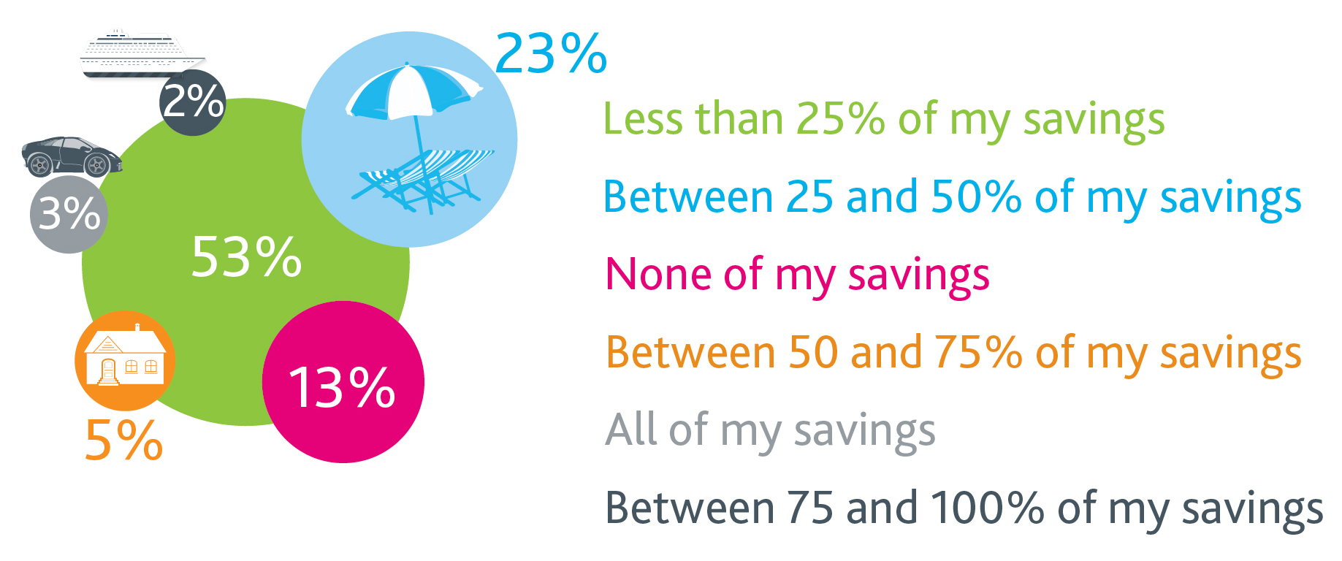
Income needs in retirement
What proportion of savings will you spend in the 1st five years of retirement?

Slide 15
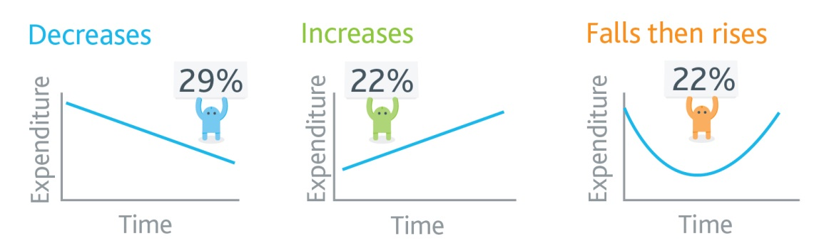


Income needs in retirement
What shape best represents your expected retirement spend?

Slide 16
Factors affecting transfer take-up
Reasons to transfer?
  Lure of a lump sum
  Allows different ‘shape’ of spending and benefits
  Control over investments and returns
  Select against fund e.g. if in poor health
  Supporting younger or older generations
  Higher tax-free cash than in LGPS
  Phased retirement
  Pay off debts/mortgage
  Engagement & education e.g. from employers

Slide 17
Factors affecting transfer take-up (cont.)
Reasons not to transfer?
  Unattractive transfer terms (especially if CETVs reduced)
  Loss of guaranteed income stream
  Loss of inflation protection
  Big income tax bill on cash (at marginal rate)
  Lack of suitable products in DC market
  Reticence to transfer pension pot from public to private sector
  Cost of financial advice
Hard to predict take-up rates in LGPS
Notes:
The Government has rightly said that, for the majority of individuals, retaining membership of their DB scheme will be the best option in terms of the level of security and benefits provided.
However for certain groups such as those with debts, no dependants or impaired life expectancies the option to take DB benefits as cash may be appealing.
Respondents to the consultation have suggested that the numbers transferring will most likely be between 10% and 20% of those approaching retirement although it is acknowledged that this is nothing more than an estimate.
But the reality is that on 1April there will be 13m people over 55 who could immediate access the entirety of their pension pot and all with different factors impacting on their at retirement choices.
Govt estimate v Hymans estimate

Slide 18
Impact on LGPS funds

Slide 19
Implications for LGPS funds
Funding
Liquidity
Cash flows and investment strategy
Employer and member communications
Managing increased transfer requests
Administration of transfer safeguards
  Check independent advice has been received
  Monitor “increased risk to taxpayer”
  Minimise mis-selling risk

Slide 20
Positive impact on deficit…
…but it depends on your actuary!
Source: Sample LGPS fund advised by Hymans Robertson , males only, standard 2013 valuation assumptiions
Notes:
Typical 2013v basis, RPI + 1% for salary growth, FS not CARE, age 65 (impact less at age 60)

Slide 21
Does the fund hold enough assets?
Asset share before transfer
Liabilities (L) | Assets (A) | Deficit (A – L) | Funding level (A/L) | Corresponding transfer value
£200 | £140 | (£60) | 70% | £160
Asset share after transfer
Liabilities (L) | Assets (A) | Deficit (A – L) | Funding level (A/L) | Corresponding transfer value
£100 | £60 | (£40) | 60% | £80
Lower deficit and funding level
Notes:
Typical 2013v basis, RPI + 1% for salary growth, FS not CARE, age 65 (impact less at age 60)

Slide 22
Liquidity risk?
Source: Sample LGPS fund, cash equivalent transfer values (CETVs) based on January 2012 GAD factors

Slide 23
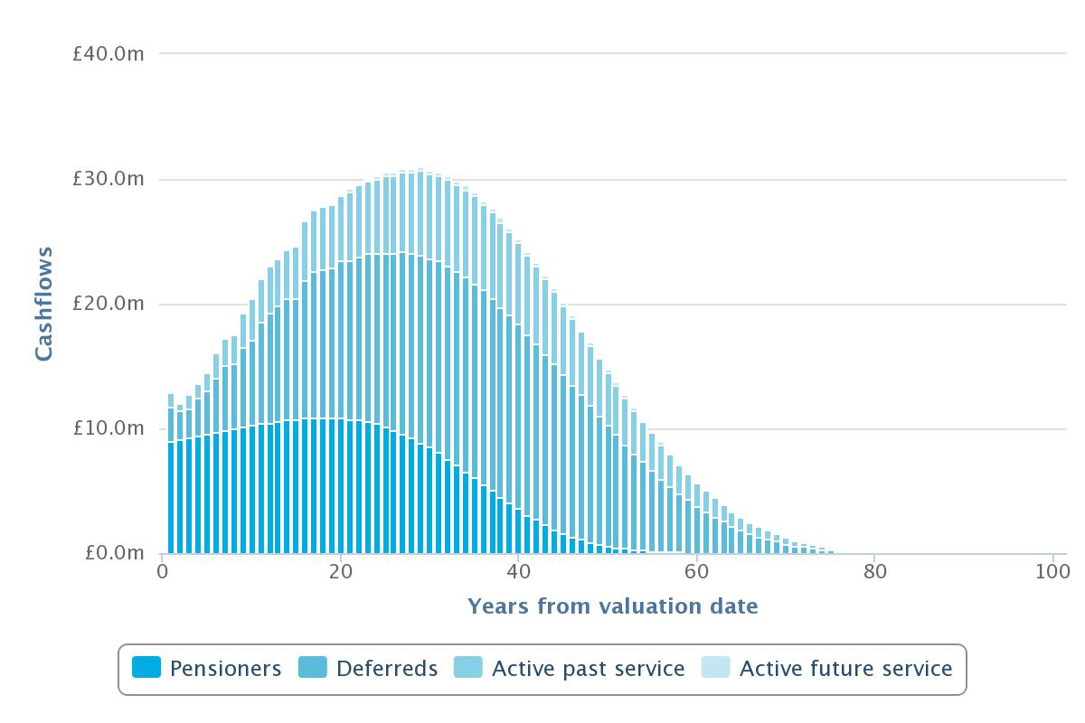
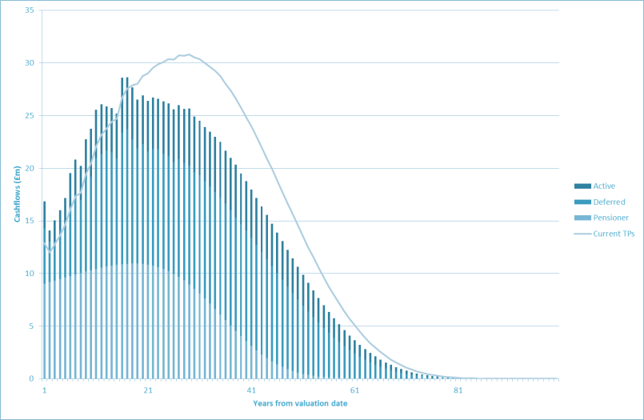
Impact on investment strategy
30% CETV take-up
Transfers bring forward cashflows
Notes:
We’ve also looked at the change in cashflow shape to understand the investment impact. The cashflows here show the impact of allowing for transfers at retirement:
Transferring brings forward the cashflows
Liquidity is the big issue – doubles cashflows from non-pensioner liabilities in first 10 years
=> need to revisit liquidity programmes and ensure hold enough cash to pay transfers
2nd order impact on hedging and LDI programmes because changes cashflow shape…
…although transfers are still linked to interest rates and inflation, and so duration impact is lower than you might initially think
Beneficial impact on required returns:
Generally required returns are lower because gives a lower deficit
But could increase required returns in the future in a poorly funded scheme if it accelerates a funding level deterioration

Slide 24
Thank you

