Slide 1


Angela Morgan
Chief Executive
PREVENTING FAMILY BREAKDOWN
OR COMMUNITY PLACEMENT BREAKDOWN
TRANSITIONAL SUPPORT
SIGN UP FOR OUR NEWSLETTER AT WWW.INCLUDEM.ORG
^{There for young people 24/7}

Slide 2

is a specialist charity, founded
in 2000 to address a gap in
services for Scotland’s most vulnerable and chaotic young people and their families.
SIGN UP FOR OUR NEWSLETTER AT WWW.INCLUDEM.ORG
^{There for young people 24/7}

Slide 3
PREVENTING FAMILY BREAKDOWN
OR COMMUNITY PLACEMENT BREAKDOWN
TRANSITIONAL SUPPORT
SIGN UP FOR OUR NEWSLETTER AT WWW.INCLUDEM.ORG
^{There for young people 24/7}

Slide 4
Well-defined target group
Clear logic model
Rigorous evaluation protocols
Intensive, enduring and community based
Cognitive and behavioural interventions
PREVENTING FAMILY BREAKDOWN
OR COMMUNITY PLACEMENT BREAKDOWN
TRANSITIONAL SUPPORT
SIGN UP FOR OUR NEWSLETTER AT WWW.INCLUDEM.ORG
^{There for young people 24/7}

Slide 5
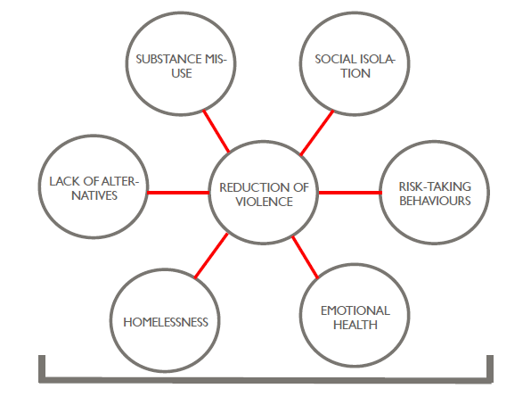
PREVENTING FAMILY BREAKDOWN
OR COMMUNITY PLACEMENT BREAKDOWN
TRANSITIONAL SUPPORT
SIGN UP FOR OUR NEWSLETTER AT WWW.INCLUDEM.ORG
^{There for young people 24/7}

Slide 6
Interim analysis of offending data suggests a significant reduction in frequency of offending for those involved with the IMPACT project for the six month period after the intervention
Interim analysis of offending data suggest a significant reduction in severity of offending for those involved with the IMPACT project for the six month period after the intervention
Severity of offending at baseline appears to have increased, suggesting a refinement of referral pathways
PREVENTING FAMILY BREAKDOWN
OR COMMUNITY PLACEMENT BREAKDOWN
TRANSITIONAL SUPPORT
SIGN UP FOR OUR NEWSLETTER AT WWW.INCLUDEM.ORG
^{There for young people 24/7}

Slide 7
But it’s not just offending……..
Getting It Right For Every Child includes their education, health and general wellbeing.
How do we focus services to deliver and measure this at the individual level?
PREVENTING FAMILY BREAKDOWN
OR COMMUNITY PLACEMENT BREAKDOWN
TRANSITIONAL SUPPORT
SIGN UP FOR OUR NEWSLETTER AT WWW.INCLUDEM.ORG
^{There for young people 24/7}

Slide 8
Michael O’Neill
Scottish Government Justice Analytical Services

Slide 9
Estimating Economic Impact of Policy Interventions

Slide 10
Background
Developed between the Justice Analytical Service and the evaluation team at Dartington SRU for the Governance Board to establish the effectiveness of the Includem Service as part of the RRCF initiatives
Estimating costs of crime can assist in evaluating the cost effectiveness of providing services focused on reducing reoffending
Establishing objective mechanisms that can be tracked over time was necessary
Using those data to perform an economic valuation of the changes witnessed

Slide 11
Specific Focus on Crime?
What are the costs of crime?
  Actions associated with the anticipation of crime
  Actions arising from consequences of crime
  Actions in response to crime
How do we value these costs?
  UK Home Office estimates of economic and social costs of crime
  Volume of crime

Slide 12
What are the required data?
In this case the following Police Data was used
  Crime/offence type
  Frequency

Slide 13
Methodological Issues
Actual levels of incidence
  Actual crime
  Reported crime
Need for crime type multipliers

Slide 14
Scope of Data
Current Project Scope
  Anonymous, individual, cleared-up offending data provided by Police Scotland on 46 individuals from the Includem programme
  Information on type of offences committed in period 6 months prior to joining the Includem programme and 6 months after leaving
  Allowed a comparison of crimes committed per person before and after being on the programme
How do we expand or replicate this type of objective data in both volume of individuals and scope across public services e.g.:
  Education Data
  Social Services Data
  Health Data

Slide 15
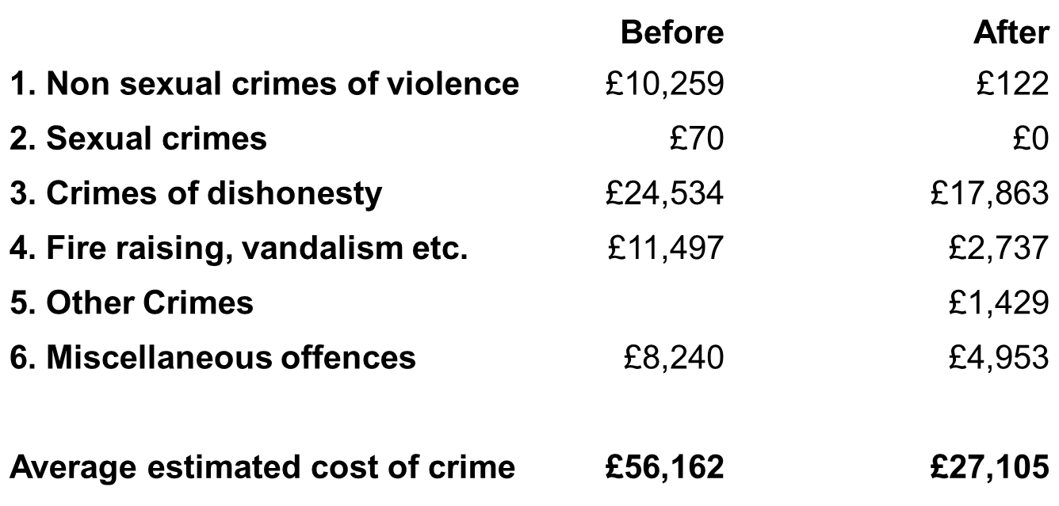
Estimates of the social and economic costs of crime before and after

Slide 16
What the data showed – recorded crime
Average recorded crime per individual
Before 4.3 after 2.3

Slide 17
What the data showed – incidence of crime
Total estimated average incidence of crime per individual
Before 26.7 After 14.4

Slide 18
Summary of Findings
Data showed within limitations mentioned
  Reduction in crime in before and after comparison is statistically significant, in the 6 months after
    33% reduction in recorded offences per offender
    50% reduction in estimated total incidence of offences
    10% reduction in severity of crime per offender
    50% reduction in estimated cost of crime per offender
This is the impact on crime, but what of other areas relating to the Young Person and can similar objective data be supplied? i.e.
  Education
  Social Welfare
  Health

Slide 19
Caveats
Whilst the results are statistically significant, attribution cannot be made with certainty to any one approach
Other services happening simultaneously
Selection bias
Changes in Police behaviour
Changes in Individual’s behaviour
Custodial sentences or other external impacts
Methodological factors
Behaviour whilst on the programme
Scope of numbers analysed

Slide 20
Issues to overcome over expanding scope of data to obtain bigger picture of Young Person over time
In order to develop this type of analysis further
  Objective data from other public services
  Sharing data anonymously
  Greater volumes for analysis
  Extended time frames to measure long term impact
  Comparator Groups
  Manage external factors

Slide 21
Thank you
Contact:
Michael O’Neill, Scottish Government Justice Analytical Services.
Telephone: 0131 244 5913
E-mail: michael.o’neill@scotland.gsi.gov.uk

