Slide 1
CIPFA North West Society
Regional Conference and Annual Dinner
14th November 2014
Place and Sustainability Resilience:
Growth of the North
Graham Burgess
Wirral Council

Slide 2
Liverpool City Region Combined Authority
Established by statute on 1 April 2014
Brings together 6 Councils, LEP, Merseytravel,
West Lancs Associate Member
Constitution and operating agreements in place
Includes transport duties of former Merseyside Integrated Transport Authority and from Halton Council
Statutory functions relating to Economic Development, Strategic Housing and Employment and Skills
Lead Officers for Economic Development, Employment and Skills, Housing and Planning and Scrutiny

Slide 3
The Combined Authority
Mayor and Leaders of the constituent Councils
Chair of the LEP co-opted to capture views of business
Lean strategic decision making body
Focused on economic growth and jobs
A signal to businesses and Government of the area’s collective ambition
Builds upon a shared sense of place and in no way seeks to replace individual Councils
“This is an opportunity which must be seized if the area is to secure jobs for residents and growth for businesses”
Notes:
Shaun Woodward

Slide 4
Benefits of a Combined Authority
Transparent and open democratic accountability
Acts in the best interests of the City Region as a whole
Integration of strategic activities across economic development, transport, housing and skills
Prioritisation, communication and delivery of the strategic projects for investment aligned to growth
Strategic City Region body to support Parliamentarians
A united front to Government from both the private and public sector; Wider lobbying role
Notes:
Social Enterprise NW

Slide 5
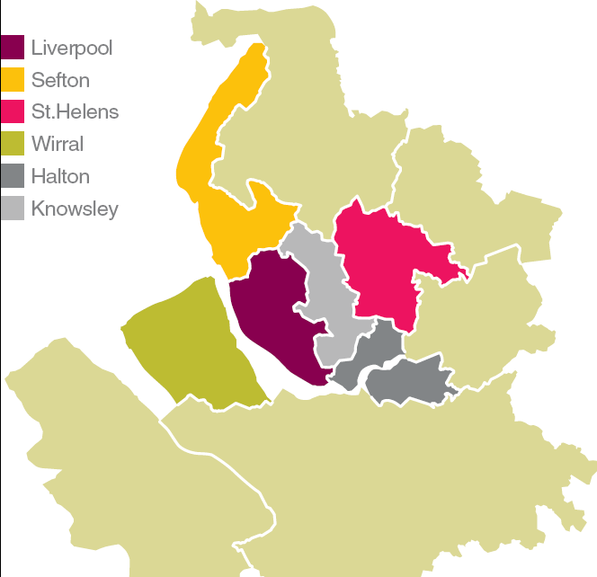
A ‘functional economic area’
1.5m residents
£25.3bn economy
38,000 businesses
6 constituent councils

Slide 6
Significant items of business ...
Liverpool City Region Growth Plan
Long Term Rail Strategy
High Speed Rail
Freight and Logistics Action Plan
Inward Investment
Youth Unemployment
Housing Investment Plan
Management of European Programme

Slide 7
Key messages
The City Region collectively ‘punching its weight’ with Government
Enables a single conversation on Liverpool City Region economic matters
Better lobbying opportunities
Provides the democratic accountability necessary for delivering long-term growth priorities
It’s about maximising growth potential
It’s about connecting the City Region’s economic assets to our residents and communities
Local identity will be retained for local issues

Slide 8
Place based devolution
Consensus that more funding and powers will be devolved by Government
Need to identify our priorities for decentralisation
Need also to demonstrate credibility by delivering on our current devolved funding and powers

Slide 9
Northern Devolution Agenda
An increasing level of national debate and discussion around the need for greater devolution of budgets, resources and political powers from Whitehall
Within the context of the Scottish referendum, and emerging political policy from all mainstream Parties indicating an appetite for some extent of devolution

Slide 10
Emerging Policy
The Adonis Review; IPPR’s Devolution Decade; the Cities Manifesto; New Deal for England
Chancellor’s announcement; Northern Futures
Publication of City Growth Commission
http://www.citygrowthcommission.com/wp-content/uploads/2014/10/City-Growth-Commission-Final-Report.pdf
Autumn Statement to include devolution policy

Slide 11
Devolution Agenda
In this increasingly crowded arena, what is the distinctive role of the Combined Authorities?
The Combined Authorities are starting to deliver better strategic planning around economic development, regeneration and transport
Recent Lord Adonis’ review suggests that Combined Authorities and LEPs are better placed to tackle entrenched problems of poor skills, infrastructure and economic development

Slide 12
Northern devolution
We now have five Combined Authorities based around the largest cities of the North – in the Liverpool City Region, Sheffield, Greater Manchester, the North East and West Yorkshire
The Northern regions account for 28% of England population (just over 15million people)

Slide 13
Northern Economy
Contributing around a fifth of economic output, the Northern economy is twice the size of Scotland (OECD, IPPR 2014)
If the North was country, it would rank as the eighth-largest in the EU, ahead of Sweden, Denmark and Belgium
Halving the output gap between the North and the national average would increase national economic output by £41 billion (OECD, IPPR 2014)

Slide 14
Northern Devolution
Combined Authorities therefore have a crucial role in working together to harness significant economic assets to create a powerhouse for growth that can be truly globally competitive
BUT this potential needs to be much more fully energised, & arguably the Northern economy holds significant unrealised potential

Slide 15
Devolution Agenda
A key question then, is how the new and emerging collaborations of the Combined Authorities & LEPs can best drive economic growth across our functional economic areas, and what increased devolved powers we need to do so

Slide 16
Our Proposals
We have a number of key proposals
Fiscal devolution; taxes; business rates
Transport and infrastructure; HS2 and HS3
Welfare and Skills
Research and Development
Transfer ownership of public land
Northern Investment institution
Creation of an Office for the North

Slide 17
Deliverability
Some of our proposals could be achieved quickly
Others within a 3-5 year transition period
Focus now is to gain partnership and political support to make devolution to the CA and across the North, a reality

Slide 18
Questions

