Slide 1
Building Resilience in Partnerships: The West Cheshire Experience Matt Dodd: Commissioning Manager Adrian Jones: Finance Manager

Slide 2
Contents:
To illustrate the learning from the integration of public services in West Cheshire, and discuss our approach to traditional barriers to partnership working:
Introduction: The Borough of Cheshire West &Chester
Driving Change: The theory and context behind integration
Local Partnership: The breadth and challenges
Overview of Progress: Our achievements to date
Traditional Barriers: Six challenges requiring resilience
Lessons Learnt: If we were starting again

Slide 3
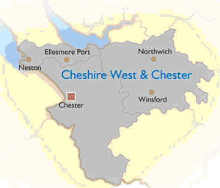
An Introduction to West Cheshire:
Total Population: 331,000
A microcosm of the nation: Rural Areas and Urban Areas (one city, four market towns)
Pockets of deprivation: Approx. 9% of working age population on out of work benefits
Health inequalities : 13 year gap in life expectancy between wards.
Ageing population: 22% pensioners, with forecast increase of over 50% in the number of residents over 85 by 2020.

Slide 4
The Drivers for Partnership Working:
Fragmentation and un-coordination: Too much resource and attention addressing symptoms not causes, particularly for the most challenging people and places.
Cost of Failure: Results in poor outcomes, high costs, and constraints on growth.
Historic and Ad Hoc Arrangements: For supporting initiatives, this has not been core to ‘mainstream’ public services.
Prioritising Prevention: We need a reduction in demand, away from unplanned, expensive, reactive spend, moving the most challenging people and places from dependency towards self-reliance.
New Delivery Models: That prioritise and measure preventative practice across partners.
New investment models that enable us to work at scale, so money can flow freely across silos – with incentives for partners to invest jointly to achieve returns for the whole public sector.

Slide 5
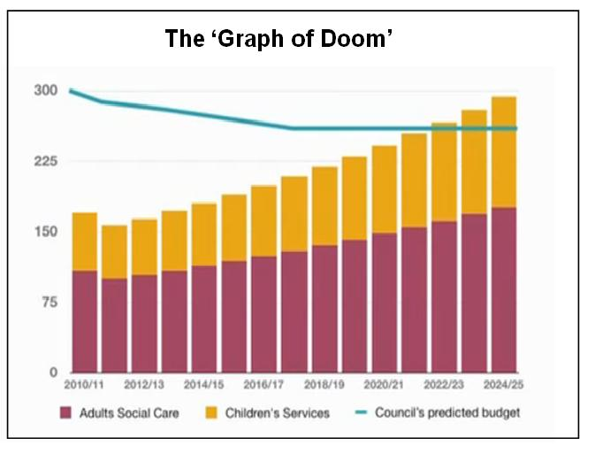
The Financial and Political Drivers:
Financial
Policy
‘Nudge Unit’
Big Society
Community Budgets
Public Health Transition
Integration Pioneer Programme
Better Care Fund
Transformation Challenge Award

Slide 6
The Local Context:
Organisation | Total Budget | Required Savings
Police | £242 million | £25 million (5 years)
Fire Service | £45 million | £5 million (4 years)
Local Authority | £780 million | £48million (5 years)
West Cheshire Health Services | £1,164 million | £19 million (5 years)

Slide 7
The Breadth of Local Partners:

Slide 8
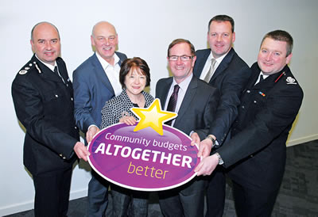
2012: Altogether Better:
Known nationally as a ‘whole place community budget’
One of four areas working with Whitehall and partners to develop: “A plan setting out how joined-up services and joined-up funding could improve outcomes for residents, reduce duplication, and reduce demand on costly interventions”
March to October 2012 (planning)
Joint local-central team
Not another Total Place – implementation as well as theory

Slide 9
Altogether Better: Business Cases:
22 ideas
Follow the money
Low Volume, High Cost Cohorts
March-October 2012: Development of six business plans and an operational plan (five years).
Critique of current services; a new delivery model; cost benefit-analysis and an implementation plan
Co-design with partners and Whitehall

Slide 10
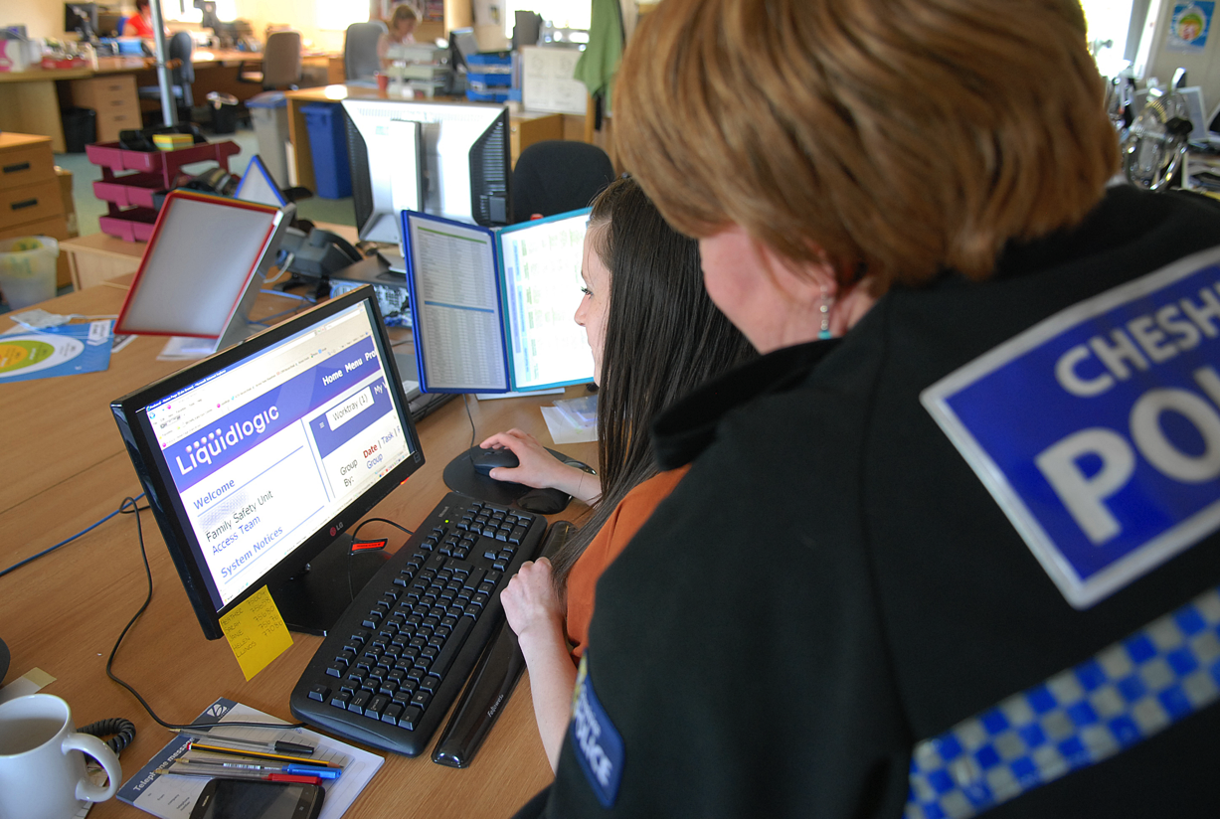
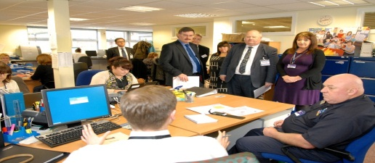
Starting and Living Well Integrated Early Support
Impact So Far
Over 477 (63 %) of troubled families cohort ‘turned around’ as per national definition.
Overall numbers of Children in Need (CIN) cases at Level 4 (statutory) are reducing. At latest count in July this had reduced by approx.20% since January 2014.
Signs of reducing demand on crisis services , particularly domestic violence (tested quarterly)
From a council perspective, on track to deliver associated savings - £570k by 2016/17
Reduced processing time (360 profile turnaround)
Exceptional levels of staff engagement
Access Team
Single Front Door to Early Support
360degree profiles
9 FTE drawn from Police, CW&C, Probation, NHS
Case Management Teams
3 core teams / Single line management / 140 staff
Co-located in and around children centres
Grip the case and sequence support against one plan
Police, Probation, CWAC family support, advocates
Evidence based interventions
Parenting – Triple P
Edge of care – Multi-systemic Therapy
Domestic Abuse Perpetrators:
Notes:
So what have we achieved? Well the new delivery model that has made the greatest progress on the ground is integrated early support
This new approach that went fully live in October last year goes well beyond troubled families and support families at an earlier stage of need as well as domestic violence victims, domestic violence perpetrators and complex worklessness cases.
Supported by £8m of multi-agency investment and 150 staff it has three key components
A single front door to deal with complex demand – essentially this is a dedicated multiagency team that screens and triages referrals, interrogates data about individuals across a range of partner systems, and builds up a 360 profile of of case
The second key component are the case management teams. These are again mutiagency teams under single line management that act as a real team around the family rather than a virtual team. Co-located in and around childrens centres they assign a lead professional to deal with the case who then builds up a single plan with the right mix of sequenced and coordinated interventions. All key agencies been colo-cated but also have links with other organisations in the public and voluntary sector not co-located
The thrid key component is a menu of evidence based interventions that we believe will help turn around demand for complex cases – MST care and cudstody, parenting, domestic violence accommodation recovery programmes, tagging etc. These have been recently commissioned and funded from a multi-agency pooled budget
In terms of impact – still early days but certainly supported strong performance on our troubled families, also data showing signs of impact particulalry around reducing demand on level 4 child safeguarig services, ened to process times have reduced, and staffing very positive - service felt facing death by a thousand cuts.

Slide 11
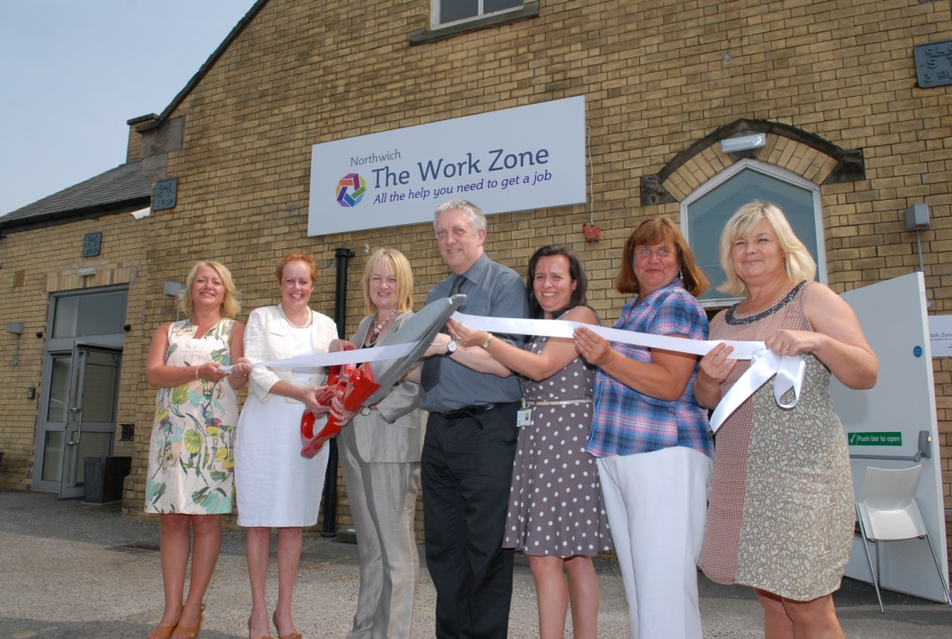
Work zones: All the help you need to get a job.
Three Co-located teams (Winsford, Ellesmere Port, Northwich): Bringing together CWAC, Citizens Advice, Job Centre Plus, National Careers Service, Work Programme Providers
Impact So Far
1002 registrations
450 work zone customers into sustainable work
Against backdrop of 1400 reduction in JSA claimants over last 10 months
New assessment process to drive joint working between employment and skills services
Tailored offers for high priority cohorts particularly early support for ESA
New Governance Model to ensure Employment and Skills provision meets local needs
Notes:
On worklessness – our proposition was to integrate all of the services that enable an individual or a family to be work ready.
Four key components
We have physically co-located a range of agencies that enable people to be work ready under one roof – known as work zones – launched 3 plan for a further 3 across the borough. Bring together JCP, CAB, council, NCS, work programme providers
We’ve also put in place new processes to smooth the process of assessment and referral between the range of worklessness and skills organisation across the borough
We are piloting a new approach to enable work readiness for the ESA cohort with health
Put in place a new governance model to enable joint planning and decision making across work and skills organisations
Impact – again early days 1000 people on the books, 250 into work, against improving results with worklessness. Real progress will be in the harder groups particulaly ESA

Slide 12
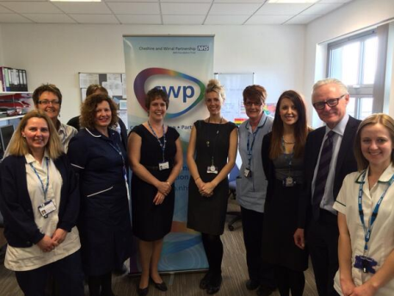
Ageing Well: Seamless care closer to home
Impact So Far
200 referrals per month for each team
480 units of Extra Care Housing
8 fold increase in telecare
Savings of £2m on track to be delivered
Collaborative contracting underway
Pooled budget of £24.3 million under the Better Care Fund
Stronger Communities and Self Care : Working together to develop new approaches to foster community based provision. This includes the establishment of time-bank models, 8 fold increase in telecare, 480 units of extra care housing.
Integrated Care Teams: Early adopter sites gone live (Frodsham, Ellesmere Port) The staff included in this team are from across Health and Social Care, improving case management, reducing repetition, referrals and double running. Supported by a Single Point of Access.
Review of transitional care: Joined-up model of step up / step down care as viable alternative to acute admissions and long term care
Notes:
Turing to health and social care – our goal has been to establish seamless care closer to home, particulalry for frail elderly.
Due to scale of the challenge - Not going to be delivered in 12 months but made real progress
Four key components
A new offer of support to enable older people to live in supportiuve communities- investment in timebanks, a joint approach to investment in the VCS, 8 fold expansion of telecare, 480 units of extra care
Scondly established integrated care teams that bring together health and social care professionals to intensively manage cases where individuals are at the greatest risk of admission to hospital or residential care. Three have gone live. Supported by a single point of access.
Thirdly we are joining up all our step up and step down care – all commission this in silos and not the appropriate offer – first step that operational teams and management have ome together
Finally we have identified a range of enabler that will help make this particualy funding and contracting to help us move money around the system, data sharing, workforce development
In terms of impact very strong patient stories but too early to show a huge reduction in demand. Steafy increase in referrals to integrated teams, we’ve pulled together an innovation fund from existing budgets across the health and social care economy to meet transition costs and manage risk of double running costs, started negotiations with health providers around a new funding and contracting model.

Slide 13
Traditional Barriers to Partnership Working:
Evidence for change: “We don’t know what works”
Leadership and Governance: “Too many masters”
Timelines and Context: “Do we have time for this?”
Silo Working: “That won’t work for all partners”
Prioritising Crisis: “We can’t afford to do this”
Benefits Realisation: “How do we know what works?”

Slide 14
1. “Evidence for change”:
Traditional Barriers:
Lack of evidence for new models. Sign-Up and Approval to try new things
West Cheshire Response:
Pilot on a small scale (Neighbourhood Teams) Use effectiveness from elsewhere (Telecare) Joint Commissioning and a Common Evidence Base (Better Care Fund)

Slide 15
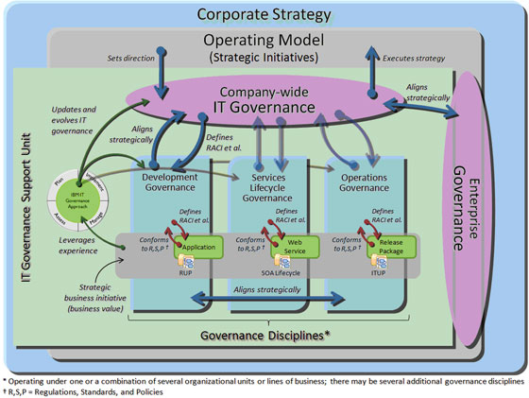
2. Leadership and Governance:

Slide 16
3. Timelines and Context:
Traditional Barriers:
Today’s challenges versus tomorrow’s gains. Political cycles (short-term and unstable) Financial cycles (incongruent and short-term)
West Cheshire Response:
5 - 10 year planning Quick wins along the way (e.g. Troubled Families). Share the good news.

Slide 17
4. Silo Working:
Traditional Barriers:
Differing Organisational Cultures Split Incentives: If we shake the tree the apple can fall elsewhere Traditional models of working / What went before
West Cheshire Response:
Joint Team: Multi-Agency (Development & Delivery) Business Cases: Shared vision across partners CBA: Evidence to organisations of their invest/ return Joint Investment Agreements (Small Scale)
Notes:
Different Cultures
I’ve always done it this way
What’s in it for me?
Partnership working is as much about developing delivery models about tackling root causes of demand rather than just managing the symptoms – Partners need to think differently.
You may be interested to know that of the NHS budget of 98bn – 4% is spent on prevention.
Split Incentives
Use quote – why should I invest in an intervention when the bulk of the savings fall elsewhere?
We need to start thinking of the Whole System – Removing fragmented Public Services through better planning, better commissioning, evidencing joint outcomes and collaborative case management. Or to put it another way – Working in Partnership.
So What have we done to breakdown these barriers?
We brought together the West Cheshire partnership (co-located) to develop the Altogether better business case, reinforcing the collective shared vision.
We used a nationally prescribed financial modelling tools – namely the CBA model (Developed by New Economy in Manchester) that builds on HM Treasury Green Book principles (reference TCA Bids) – Deadweight, Optimism bias, drop off and lag.
We brought together senior finance leaders from across the partnership regularly to help in the development, review and sign-off of our financial cases. Partners needed to have sight and understand where the ‘apples fall’.
So that’s how we developed the business cases. In setting up our integrated teams we:-
We secured new partnership investment towards the non-recurrent costs of establishing the joint teams…but we also
Secured a shared investment to a suite of new evidence based interventions, with contributions informed by the anticipated size of the ‘apple pile’

Slide 18
5. We Can’t Afford It:
Traditional Barriers:
We can’t get the headroom to get upstream. We might reduce demand, but not cashable savings.
West Cheshire Response:
We can’t afford not to: Despite the complexity and need for investment. Quick wins: Reduction in duplication and overlap. Medium – Long-Term: Five year financial modelling (minimum).
Notes:
We can’t get the headroom to redesign our services
Or can we afford not to redesign / join up / collaborate?
Cashable Savings
There’s almost certainly some immediate cashable savings from partnership working through identifying process efficiencies (through less duplication) but when does reduced demand for services result in cashable savings available for reinvestment.
Whilst one of the outcomes linking to taking a partnership approach to tackling DA could be to have fewer A&E attendances, but will this save NHS money? Answer – yes marginally only when reached at scale.
Partners need to transparent as to when and why a benefit a financial benefit articulated as part of the CBA may or may not translate into cashable savings.
We also need to acknowledged that the benefits of partnership working is longer term – Taking a collaborative approach to managing Troubled Families, will have short term and cashable benefits, but the bigger prize is longer term….can we break down the cycle of intergenerational behaviours?
I’m not saying we approached partners to contribute and invest in partnership working based upon a modelled benefit that fall in five/ten years time but….

Slide 19
6. How do we measure what works?:
Traditional Barriers:
Different views on outcomes (organisation by organisation). Data Protection and sharing information. Understanding cash-ability of outcomes.
West Cheshire Response:
Invest in analysis (Build in from the front end) Joint view of outcomes (Across outcomes frameworks and organisations). Quantitative and Qualitative: Mandate them to return information.
Notes:
So we’ve established the business case (part of which is through robust CBA development);
We’ve secured some non-recurrent partnership investment to establish integrated teams;
We’ve trained the team, changed business process, established integrated IT systems and established new Governance arrangements
How do we know its working?
At West Cheshire we’ve established a Benefits Realisation framework made up of finance, performance and operational staff from across the partnership
We’ve established data sharing protocols and established data sharing agreements
Each partners has established a suite of outcome measures and where possible monetised to establish savings
We’ve established a quarterly cycle of formal Benefits Realisation reporting to our Public Services Board that captures
Input measures (numbers of referrals, source of referral, reason for referal…..,
Key qualitative analysis through questionnaires to front line workers and more recently to users of the integrated teams
Part of a quantitative analysis, tracking the cohort across the partnership to understand a before and after analysis of demand on services
Importantly – again our benefits realisation solution is a partnership developed.
So from our experience – what are the lessons learnt?

Slide 20
Lessons (1):
Pick a firm deadline and stick to it: Focus and ambition.
Integrate where it makes sense: Impact is most likely around complex cohorts that can’t be served by one agency.
Avoid new silos: If you integrate project by project you miss the bigger picture.
Collaborative Leadership: All leaders have a role to play.
Flexible on Geography: Issues should define the most appropriate footprints.
Notes:
Pick a date and stick to it
We were forced to complete the Altogether better business case proposals by 31 Oct 2012 – Whitehall was our ‘stick’
However to maintain momentum the Leadership team agreed to a rapid programme of implementation – soft launch of IES June 2013 and full launch October 2013 – So a rapid programme of work post submission to get us to this point.
Integrate where it makes sense
Obvious – but think about what cohorts and what services lend themselves to a partnership solution.
Avoid new silos
We’ve removed partnership silos, we were in danger of created further silos by establishing a partnership solution to takling DA, TFs, in isolation. In reality they will be made up of the same cohort and we therefore establsihed our ‘single front door’ to creating a single approach to working with our Integrated Early Support cohort.
Collaborative Leadership
This will only work if all partners engage – and play a leadership role in making it happen.
Each of our Altogether better business cases was led by a different partner.
Flexible on Geography
Co-locate where is makes most sense

Slide 21
Lessons (2):
Invest in analysis: This can’t be nice to do. To make a difference it needs to be financially sustainable. Invest in CBA to ensure all partners are clear on their investment, and put the resources in place so you can evidence impact.
Keep up Momentum: Policy Commissions (elected members and partners to identify new solutions across partners).
National Policy is catching up: Pooling at source through the Better Care Fund.
Share good news stories: With staff, residents, and partners (builds momentum).
Notes:
Invest in Analysis
We need to keep partners round the table by providing an evidence base that the new delivery is working. Evaluation of our delivery models is gaining greater prominence at Whitehall through the PSTN.
Give careful consideration as to how you will evaluate actual delivery at the planning stage
Be clear on what the outcomes to be achieved are – AND HOW YOU WILL Monitor / Report.
Keep up momentum
Continue the ‘sell’. Continue to expand, maintain contact with Whitehall,
National Policy is catching up – Partnership working being the BCF
Share Good news stories
You will have quick wins – be they financial, operationally and importantly improving the outcomes of the population that we support
Shout about them.
SO TO CONCLUDE –
Our intention today was to give you a flavour of what we’ve done at West Cheshire in building partnerships, how we overcame barriers and where we have successfully implemented true partnership working.
However CAN I confidently STAND IN FRONT OF YOU TODAY AND SAY WE’VE TRULY ‘BUILT RESILIENCE IN PARTNERSHIPS WITHIN WEST CHESHIRE?
Next slide

Slide 22
Resilience in Partnerships 500km
Are we there yet?
Notes:
Going to take you on a journey,
We’re on route to our destination, but we’ve still got some way to go.
Its not been an easy journey, and I can’t promise there won’t be more bumps in the road or wrong turns
You are in the driving seat – you making it a reality will get us to our destination
So…..
Where did we start from?
Where do we want to get to?
How are we going to get there?

Slide 23
Resilience in Partnerships 250km
Not Far Now
Are we there yet?

Slide 24
Nearly There ????
Are we there yet?

Slide 25
Thanks for listening
Any Questions?

