Slide 1


CIPFA - growing the regions, building a better institute
Mike Owen
President

Slide 2
Analysis last year…
Falling student numbers
Rising average age
Falling revenues
CIPFA needs to become successful !
We need a new operating model
We have three growth aims – voice, members, income
We need to invest through a development programme

Slide 3
Development programme…
  5 Build an Institute to Institute offer
  Raising CIPFA’s profile, including in health
  Public Audit Bill & New Syllabus to meet changing market
  Improving our institute
Increasing UK membership
Expanding our product and services portfolio
Defining and improving our member offer
Increased direct international membership

Slide 4
Successful progress to date - examples
Increasing UK membership - winning NHS Graduate Scheme
Expanding our product and services portfolio – Counter Fraud Centre launched, FM sales, FAS, BIQ
Defining and improving our member offer – CMI resources free to members
Increased direct international membership – more UN bodies signed up, CIPFAJ
5 Build an Institute to Institute offer – MOUs with ICAP, ICAG
Raising CIPFA’s profile, including in health – LG Finance Commission and involvement with FFF
Public Audit Bill & New Syllabus to meet changing market – FRC - AQ approved, Charities SORP won
Improving our institute - Robert St sold and move to a single London Office will yield c£3m-£4m

Slide 5
CIPFA global footprint is growing…

Slide 6
Next steps, 2015…
Policy
From trade press to national media
2015 Manifesto
PFM focus at WCOA
Membership
Build NHS, Academies and launch Charities Strategy
Build overseas membership
Drive BL5 strategy
Drive PQ, Cert IPSAS, AQs, DipPFM
CPAA, AAT MOUs
Launch CPD offer and FCPFA
Commercial
Launch a Financial Leadership Faculty
New markets: Mutuals, Information Management, Corporate Partner
MOUs with HFMA, SOLACE
Organisational
Governance Review
Refresh the Development Programme

Slide 7
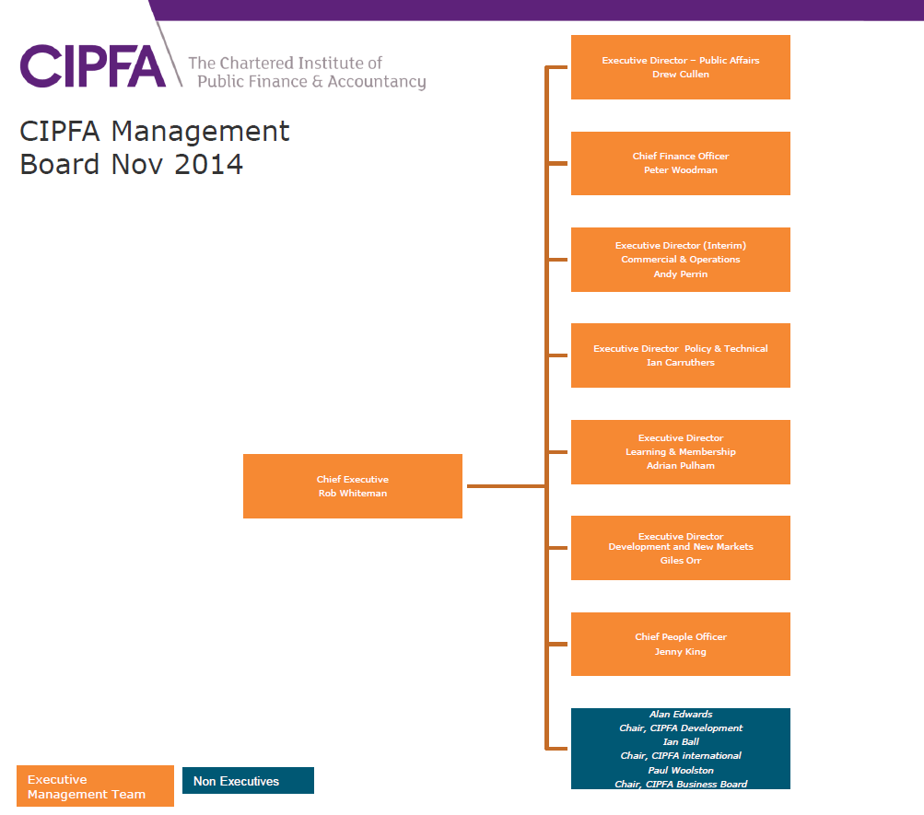
The 2015 team…

Slide 8

A new Professional Qualification…
Our new PQ will be fully operational in 2016, though students at certificate level in 2015 will benefit
We are innovating to ensure the PQ meets the needs of fast changing and increasingly diverse public services
The PQ will better reflect the needs of public finance practitioners, based around four competency levels: Steward, Enabler & Innovator, Business Partner and Leader

Slide 9
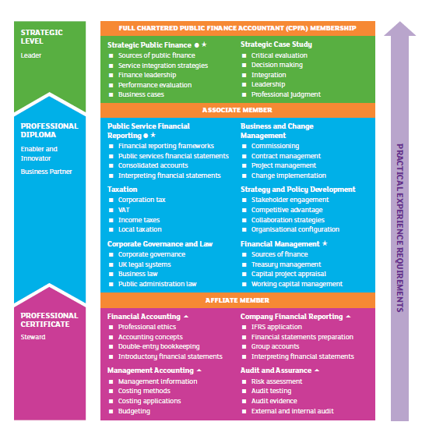
Delivering a fit for purpose PQ…
Increase the focus on commercial skills such as commissioning, contract negotiation, financial modelling, financial instruments, and partnership working.
Provide greater portability
Have more entry routes
Enhance the Practical Experience Portfolio (PEP) by placing greater emphasis on the role of the employer.
Enable greater flexibility around blended and online learning options.
This includes a partnership with Calibrand to deliver e-learning and assessment.

Slide 10
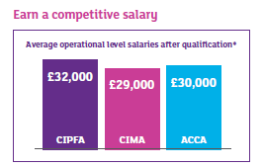
Diversifying entry routes…
1 Level 3 NVQ or GNVQ, or Scottish equivalent
2 GCSEs & A'levels – Minimum required is three GCSE passes A-C and two A’level passes from A-C (including Maths and English)
3 Graduates from a range of disciplines
4 AAT qualified
5 Part qualified accountant
6. Fully qualified accountants – e.g. ACCA, CIMA, ICAEW, ICAS or ICAI – just need to sit two papers
7 Chartered Internal Auditor (IIA) – just three papers to sit
8 Senior finance professionals who don’t hold a professional accountancy qualification – will gain exemptions
9 Bye-law 5 membership for nominated accountants qualified with other bodies and of good standing within the sector
10 Bye-law 6 – honorary membership for nominated professionals of good standing within the sector

Slide 11

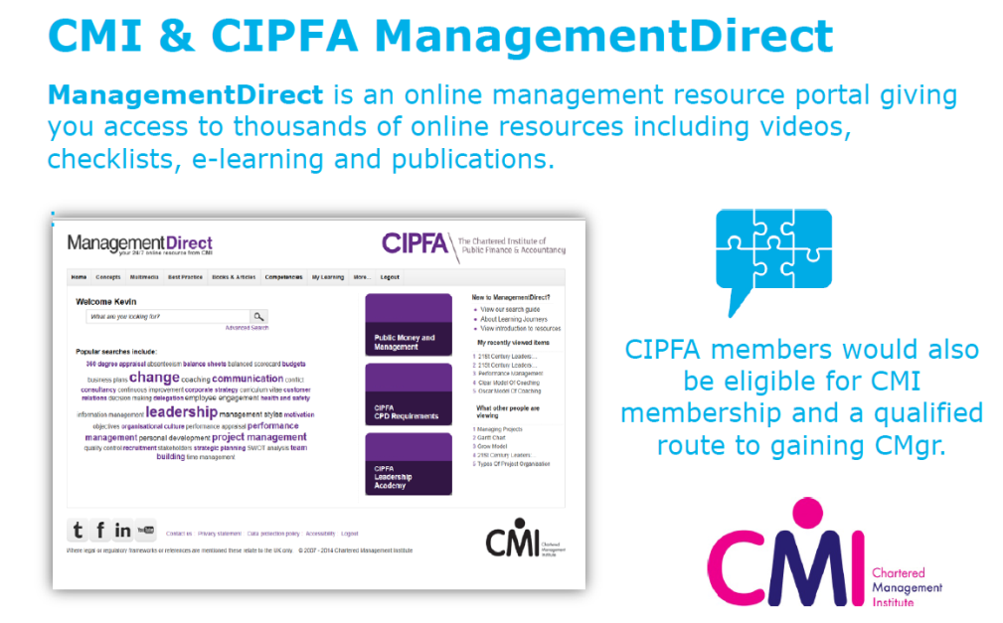
Developing the membership offer…
New resources and support
  Access to ‘Management Direct’ - an online support tool –
  e-learning modules, checklists, e-journal articles, books
  Free full text online access to CIPFA’s internationally renowned journal Public Money and Management
  Free selected publications for members
  Master classes online – insight across a range of topics
  Improved Technical Enquiry Service – our team of experts are on hand to help answer your questions
  An online members directory

Slide 12
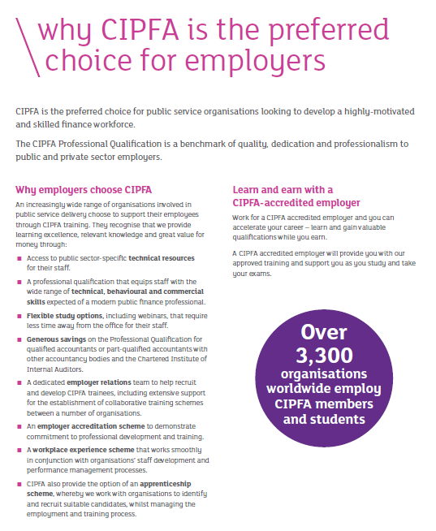
CIPFA needs you!
We need your to help to grow member and student numbers
We need the regions to promote the PQ, holding regional PQ events to highlight the launch
We need to recruit volunteers to visit employers and inform them about the exciting evolution of the PQ
We need new dual members to increase our base

Slide 13

Specifically we suggest…
A Regional employer lead
  Recruits volunteers
  Increases employer visits
  Focus on NHS
A Regional dual member lead
  Identifies target members
  Approaches and recruits members
Both to work closely with our employer and member relations teams

