Slide 1
CIPFA Southern Section
Mayoral Investment Strategy
Tim Povall – Head of Finance – Regeneration Communities & Capital Investment Programme

Slide 2
Mayoral Investment Strategy
Background
Capital Strategy
Case Studies
Paddington Village
Cunard Building
Briggs Automotive
How commercial are you prepared to be?
Questions

Slide 3
Capital Strategy
Deliver projects that focus on delivering a number [i.e. more than one] of the long term benefits to the City listed below:
Deliver corporate budget objectives
Protecting the most vulnerable
Grow the Economy
Spend to save, including capital flexibilities
Create sustainable income - business rates or council tax
Spend to earn income - rents, interest, dividend, capital appreciation.
Deliver budget decisions
Attract significant third party or private match funding to the City
Addresses major infrastructure investment
Deliver economic outcomes of jobs and growth

Slide 4
Paddington Village

Slide 5
Paddington Village - Central
Over 1 million square feet of development
Life sciences focus
Borders major partners – Knowledge Quarter – The Royal & Universities
Land owned by the Council
Self development using Public Works Loan Board
Returns on investment – Capital Receipts – Rents – Business Rates
Third Party partners on board
Royal College of Physicians – Northern Hub
Proton Cancer Treatment
Kaplan International Students
Hotel, conference and car parking facility
Other commercial uses
Limited residential

Slide 6
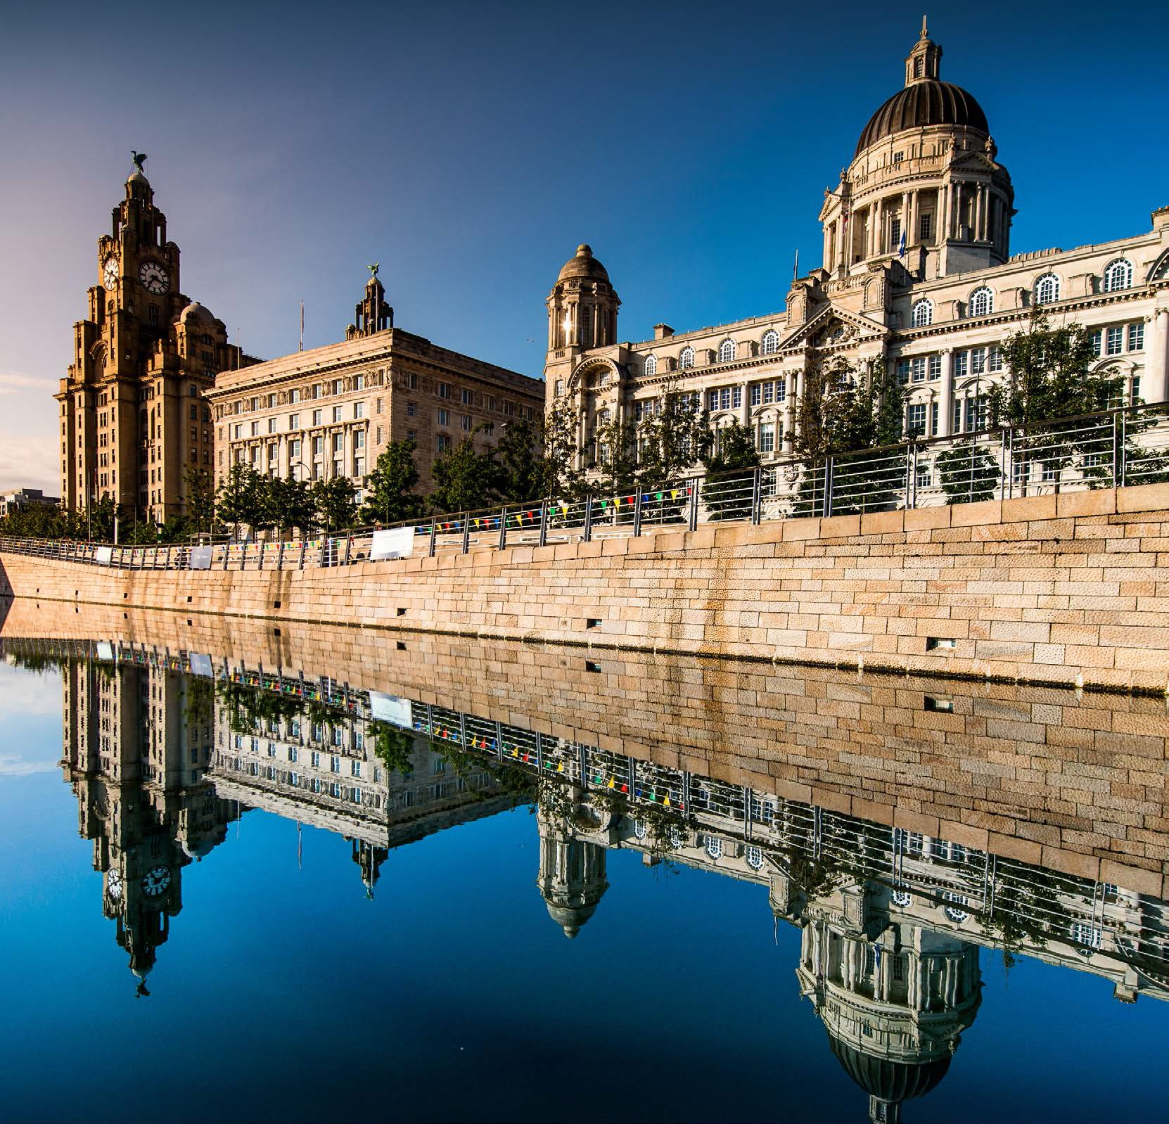
Cunard Building

Slide 7
Cunard Building
Accommodation Strategy
Back to back arrangements – Hotels
Cost
Purchase
Stamp Duty Liability Tax / VAT / Fees
Removal costs
Savings
Fiscal
Non Fiscal
New income
Rents – Rates – Service Charge - Concessions
Animation of the Waterfront

Slide 8
Briggs Automotive Company

Slide 9
Briggs Automotive Company
Relocation from Cheshire to Liverpool
Supply chain
Export access
Grant funding
Employment
Equipment
De – minimus
Growth success – UK parts – majority exported
Expansion plans

Slide 10
How commercial are you prepared to be?
Redx Pharma
Growth in the City
Partnered
New dedicated facilities
Due diligence – independent advisors
Terms
Restructuring and Enforcement
Revision to terms
Administration route
Engagement with advisor partners
Learning curve

Slide 11
Questions

