Slide 1
Future of Public Audit Paul Dossett 7 June 2019
Society of District Treasurers

Slide 2
Notes:
Has someone struck a curse on the accounting profession?

Slide 3
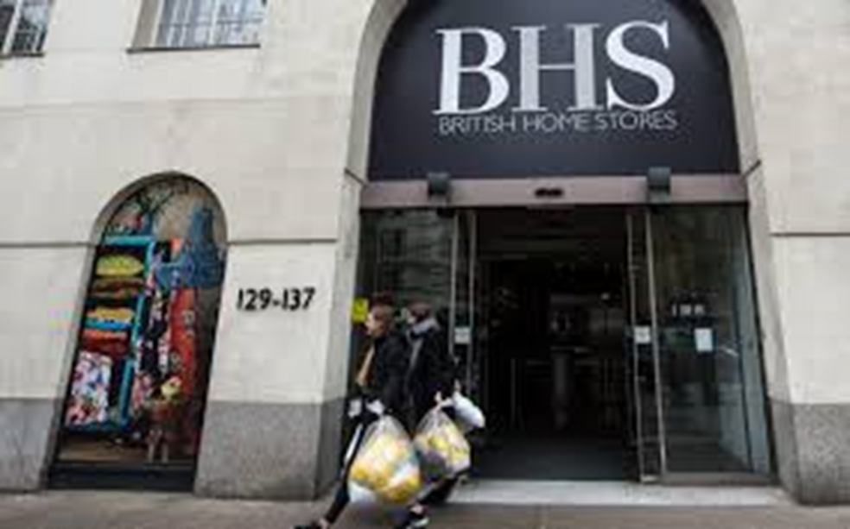
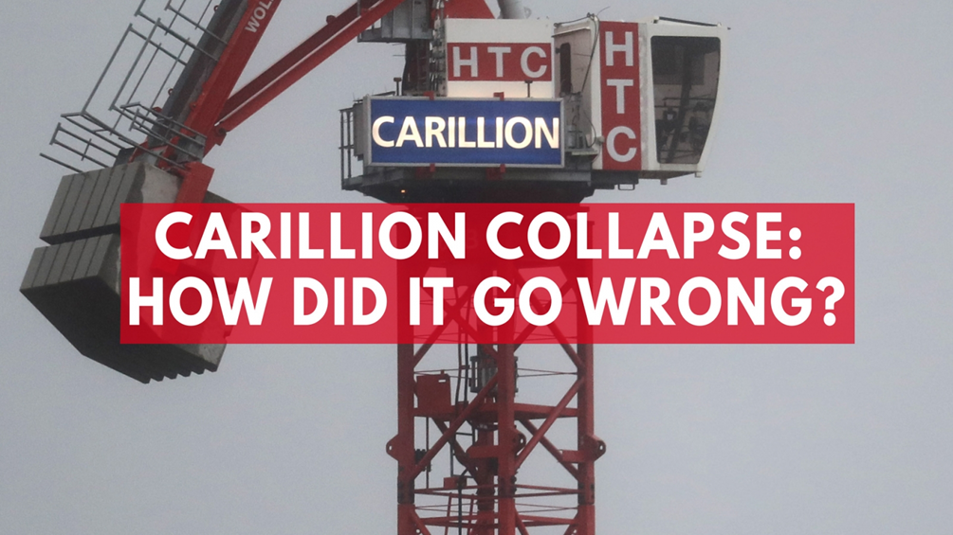
Auditors in the headlines…
Notes:
Recent years have seen a number of high profile audit failures. These are just some:
BHS
PwC fined by the FRC: £6.5m
Partner Steve Denison fined: £325k and banned for fifteen years
Carillon – KPMG
Accounting firm: KPMG
FRC review in progress
Ted Baker
Accounting firm KPMG
Issue: Non audit work which breached independence
Fine £3m
Nichols GT

Slide 4
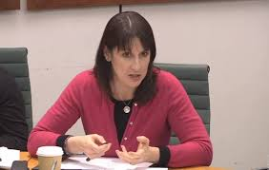
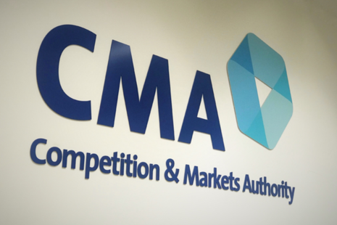
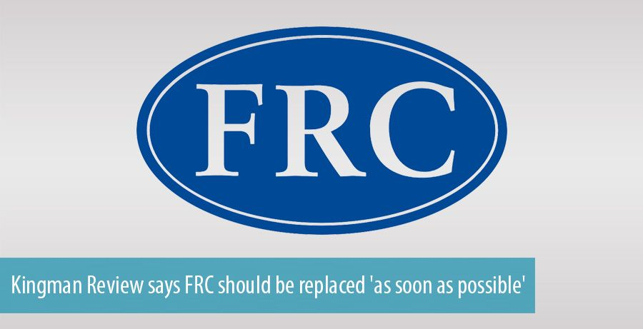
Auditors in the headlines…
Notes:
Rachel Reeves – Chair of BEIS
Sir John Kingman recommends replacement of the FRC with the ARGA (Audit Reporting and Governance Authority)

Slide 5
And we are in the news in the public sector too…
Notes:
Northamptonshire is the most high profile case (KPMG issuing a statutory report). Other challenges authorities include Somerset, Surrey, East Sussex, Birmingham. And others…

Slide 6
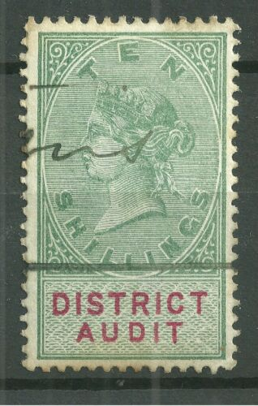
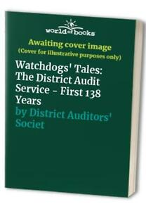
A proud history…

Slide 7
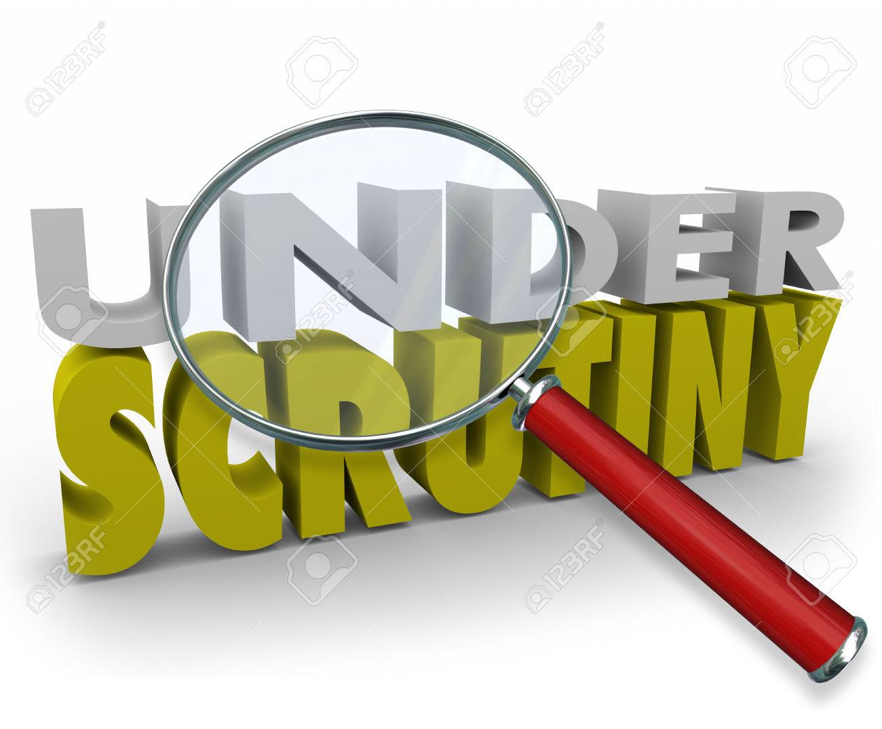
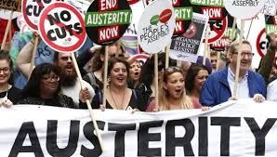
A proud history which is under threat
Notes:
Increased scrutiny of auditors, both from regulators and the public (enhanced role of the ARGA and QAD)
Not a lot of sympathy for the profession at the moment
Many of our clients (across Local Government and NHS) are facing the most challenging set of financial circumstances they have ever known
Significant recruitment and retention problems

Slide 8
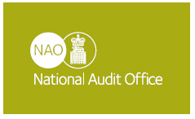
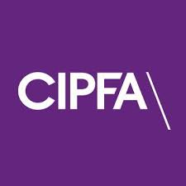
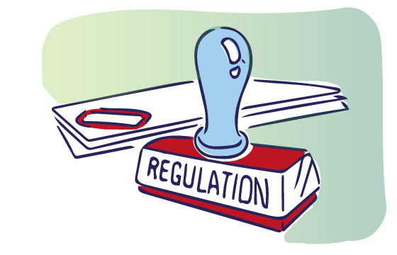
Seizing the moment – a prescription for public audit

Slide 9
NAO Code Consultation
The NAO are consulting on a new Audit Code, for publication April 2020
Our response:
Reaffirm unique principles of public audit
Reframe Value for Money
Notes:
Across the sector, there is now a recognition of a need for change. Our response to the NAO consultation will be published shortly and you will see that we are arguing for fundamental changes

Slide 10
NAO Code Consultation
Principle of public audit
Safeguarding the interests of the citizen as taxpayer and user of public services
Audit work which is proportionate and focuses on what matters to stakeholders
Wider scope not just the accounts
Notes:
Here are our recommendations in terms of core principles

Slide 11
NAO Code Consultation
Value for Money
Forward as well as backward looking
Narrative report to replace the VFM conclusion
Reported in public
Different time of year to the accounts
Notes:
And our recommendations on value for money

Slide 12
A Prescription for Public Audit
CIPFA
Refresh the Accounting Code
Focus on those things which matter to the tax payer
Approach to asset valuation?
Other ways to make more accessible?
Notes:
CIPFA also has a key role

Slide 13
A Prescription for Public Audit
Regulation
Recommendations of Sir John Kingman
Current regulatory system is too disparate
A single regulatory body for local audit
Not a new Audit Commission
Notes:
We endorse the recommendations of Sir John Kingman on local audit

Slide 14
A Prescription for Public Audit
What might the future look like?
Retaining specialists
Joined up regulation
Expertise, knowledge and insight
Increase in fees on Value for Money – with value added
No significant change to opinion fees but with major shift in focus

Slide 15
Questions

Slide 16
Contact details.
Paul Dossett, Partner.
T: 07919 025198
E: paul.dossett@uk.gt.com
W: grantthornton.co.uk

