Slide 1
Financial Sustainability and Resilience
Tracy Bingham
7 March 2024

Slide 2
Where are we now

Slide 3
Where are we now
1% uplift to minimum Funding Guarantee - Additional £600 million
5.92% average increase in CSP for Districts
Exceptional funding for councils facing increases in IDB levies
15% real terms spending squeeze since 2015
District increases in CSP remain below sector average
10% cuts and savings across Districts – but many residual budget gaps left

Slide 4
Where are we now
19 Councils supported via Exceptional Financial Support framework - Woking BC and Eastbourne BC
High level of media coverage
Data and intelligence much more penetrable – wider understanding
6 March Budget:
Extension of Household Support Fund for another 6m
New Town Deals announced
Levelling Up Culture projects
Village Halls
Additional flexibility RTB receipts
Empty property BR relief extended from 6w to 3m
£75m to Internal Drainage Boards

Slide 5
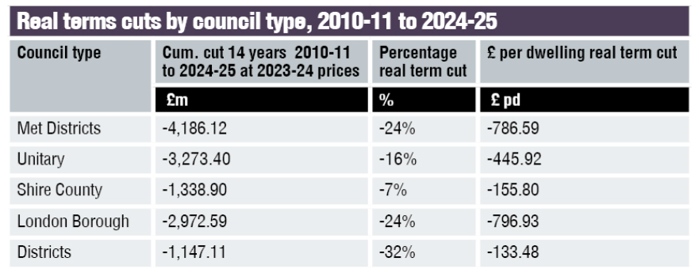
Sigoma – find out how much your council’s funding has been cut
SIGOMA - SIGOMA analysis: Find out how much your council's funding has been cut

Slide 6
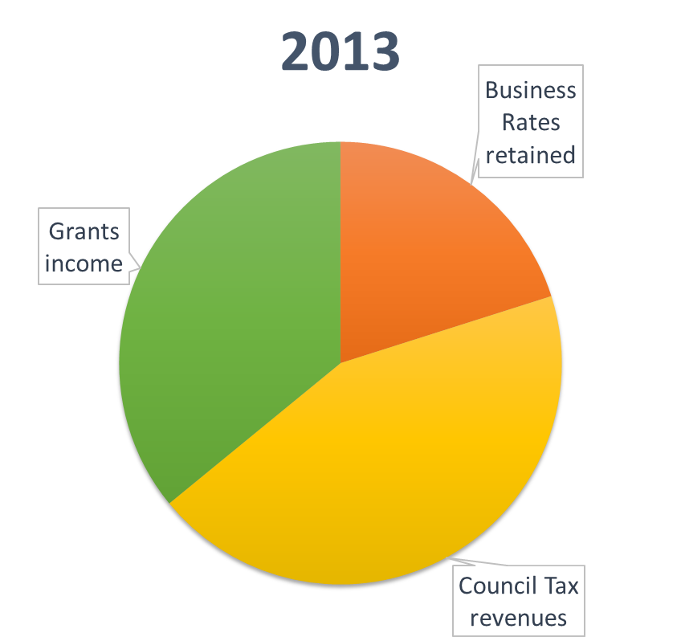
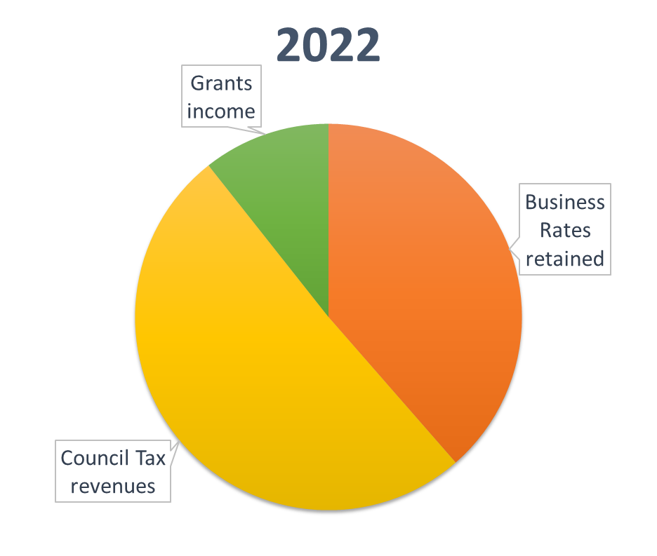
Where are we now?

Slide 7
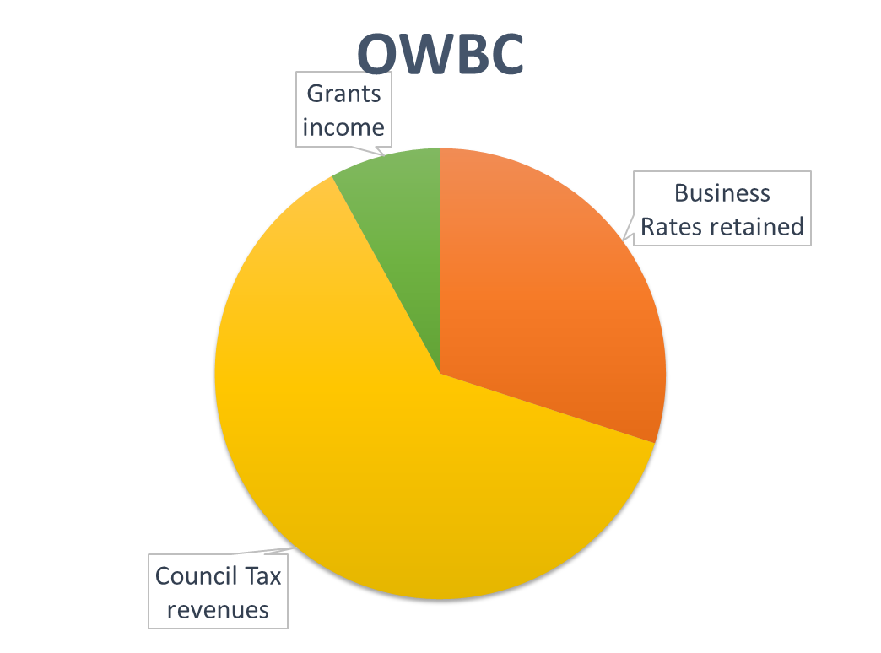

Slide 8
Key Challenges for Districts and DCN asks

Slide 9
Key Challenge - Homelessness
Housing benefit subsidy in the form of Local Housing Allowance (LHA) tied to 2011 rates
Effects is Council can claim only up to £109pw
Significant resultant shortfall, excavated by increase in demand
Can be between 20 – 50% of a districts total budget
Uplift in LHA rates announced in Autumn 23 helpful but not enough

Slide 10
Key Challenge - Homelessness
DCN ask:
Increase the level of housing benefit subsidy that can be claimed on temporary accommodation – 90% of current market rent, then uprate annually
Create a new capital fund to incentivise councils to rapidly build or acquire new temporary accommodation and housing for homelessness

Slide 11
Key Challenge – Waste Reforms
Insufficient funding and unrealistic deadlines to ‘simplify’ recycling
Costs to revamp recycling services could be into the multi-million pounds – new waste vehicles, new depots potentially
Government’s calculation of capital funding required devised in 2018 – before inflationary storm
DCN ask - Address the cost of implementing Defra’s Simpler Recycling reforms

Slide 12
Key Challenge – Preventative Services
As council closest to communities, often help vulnerable people
These services lead to significant savings elsewhere in public sector
Very little recognition
Other financial pressures mean many of these services now at risk
DCN ask - Extra support for vital preventative services

Slide 13
What’s next?

Slide 14
LUHC – Financial distress in LAs
On funding reform:
Urgently reform council tax by undertaking a revaluation of properties and introducing additional council tax bands
Raise the referendum threshold for council tax in line with inflation – scrap in the long-term
Ensure that the implications of any additional flexibilities it grants on capital funding are carefully considered
Implement the business rates reset and Fair Funding Review
On Homelessness:
Reconsider its position on re-freezing local housing allowance rates from 2025–26 onwards
Re the next government:
Embark on fundamental review

Slide 15
LGIU – State of LG Finance in England
S114 no longer exceptions because of abnormal governance matters (equal pay disputes, excessive borrowing), but now heading toward them being a normal occurrence
Long-standing Democratic freedoms arguably undermined
Levers?
Increasing council tax, raising limited fees and charges, and increasing commercial activity = only major reliable levers in terms of income and being pulled
struggling to reduce expenditure.
Finite reserves being depleted
Assets sales Vs commercial and housing development
Consequences - S114 or concern that won’t deliver statutory services to the level they should

Slide 16
LGIU – State of LG Finance in England
Pressures for districts – housing and homelessness
Short term pressures – aligned – housing and homelessness
Long term – split, housing and homelessness, environment and waste

Slide 17
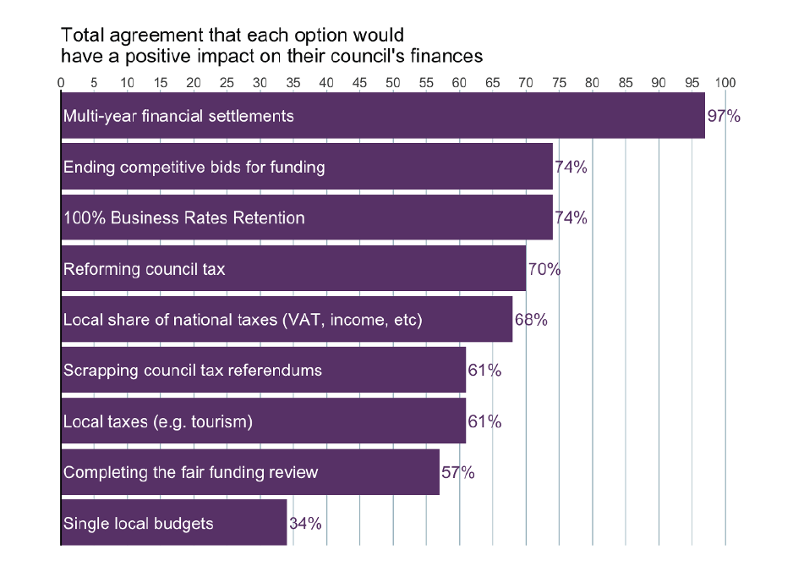
LGIU

Slide 18
LGIU - Learning from local government finance across the world: Proposals for improving the financial resilience of local government in England, January 2024
1. Rework the local government needs assessment [the Fair Funding Review].
2. Establish a systematic form of territorial equalisation between local authorities.
3. Establish a standing commission, akin to the ‘English Devolution Council’ proposed by the Institute for Government.
4. Develop a long-term programme exploring assigning national tax revenues to local authorities.

Slide 19
New Local - Place Based Public Service Budgets, Making Public Money Work Better for Communities
Austerity has created a ‘doom-loop’ – short term urgency to respond to crises prevents the development of long-term solutions to underlying problems
Government of next Parliament should consider: Place based budgeting
New powers – for LAs and agencies to collaborate and pool budgets to meet local need
Longer-term funding settlements to enable planning and joint investment
A new accountability framework

Slide 20
Links
Financial distress in local authorities - Levelling Up, Housing and Communities Committee (parliament.uk)
District Bulletin: With funding and freedom we can end homelessness | District Councils' Network
‘Well-run councils will have to make counterproductive cuts’ | District Councils' Network
‘A missed opportunity’: DCN responds to the Budget | District Councils' Network
The State of Local Government Finance in England 2024 – LGiU
Learning from local government finance across the world: Proposals for improving the financial resilience of local government in England – LGiU
Place-Based Public Service Budgets: Making Public Money Work Better for Communities - New Local

